Slide 1
Lesson 14.4 Living Green
Chapter 14

Slide 2
Write About It
What does it mean to live green?
Do you think about the environmental impact of your daily life?
Why or why not?

Slide 3
Our Changing Environment
Climate change refers to any significant change in the measures of climate that last for an extended period.
Temperature changes
Changes in precipitation (rain and snow)
As the human population grows and we produce more pollution in the air, we are contributing to climate change.

Slide 4
Protecting the Environment
According to the EPA, there are five ways to protect the environment.
Reduce
Reuse
Recycle
Treat
Dispose

Slide 5
Reduce
The most impactful way to protect the environment is to reduce the amount of trash and pollution we create in the first place.
Focus on energy sources that create less pollution.
Utilize renewable energy sources, which are a type of energy that will never run out (energy generated from the sun and wind).

Slide 6
Reuse
On average, each person in the United States produces five pounds of waste materials every day.
For example, try to buy less stuff and find ways to reuse what you have, reuse plastic shopping bags, and give clothing items you no longer want to someone who will use them longer.

Slide 7
Recycle (1 of 2)
Recycling is the process of collecting and processing materials that would otherwise be thrown away as trash and turning them into new products.
This reduces the amount of trash that goes to landfills.
In most places, plastics, paper products, and glass are commonly recycled.
(continued)

Slide 8
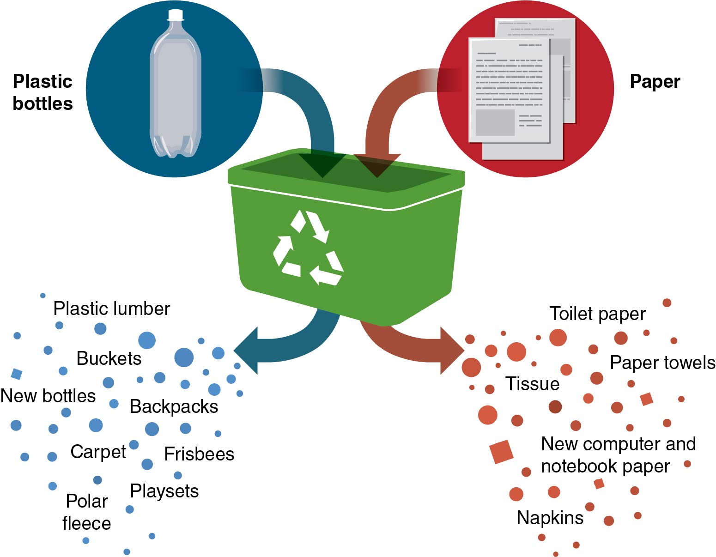
Recycle (2 of 2)
Notes:
Figure 14.13 What happens to commonly recycled items.

Slide 9
Treatment
Treating substances that may be dangerous to the environment can protect people and the environment from the damage the substances cause.
Examples include
treating contaminated water for safe use and
treating land that is contaminated so that it can be used for future projects.

Slide 10
Dispose
Dispose properly of materials that can’t be recycled or otherwise treated.
This includes
not littering;
properly disposing of any item containing toxic or dangerous substances so that they don’t contaminate the water, soil, or air; and
disposing of batteries at designated areas.

Slide 11
What Does Living Green Mean?
Living green means being aware of the affect your lifestyle and choices have on the environment.
Living green means being earth friendly or environmentally friendly in your personal choices.

Slide 12
Tips for Being a Green Student
Take notes electronically.
Carry and reuse water bottles.
Use reusable lunch bags.
Recycle your papers.
Read more tips for being a green student in lesson 14.4 of your textbook!

