Slide 1
Lesson 14.3 Chemicals, the Environment, and Your Health
Chapter 14

Slide 2
Write About It
Have you ever considered whether the personal care products you use are safe?
How would you feel if you found out that your shampoo, soap, or sunscreen contained dangerous ingredients?
Would you try to change the products you use?

Slide 3
What Are Chemicals?
A chemical is a substance that cannot be broken down without changing into something else.
Chemicals can occur naturally (gold found in rocks or vitamin C found in fruits) or be man made (synthetic chemicals).
A toxic chemical is any chemical that can cause death, make you pass out for a period, or cause permanent harm to humans or animals.

Slide 4
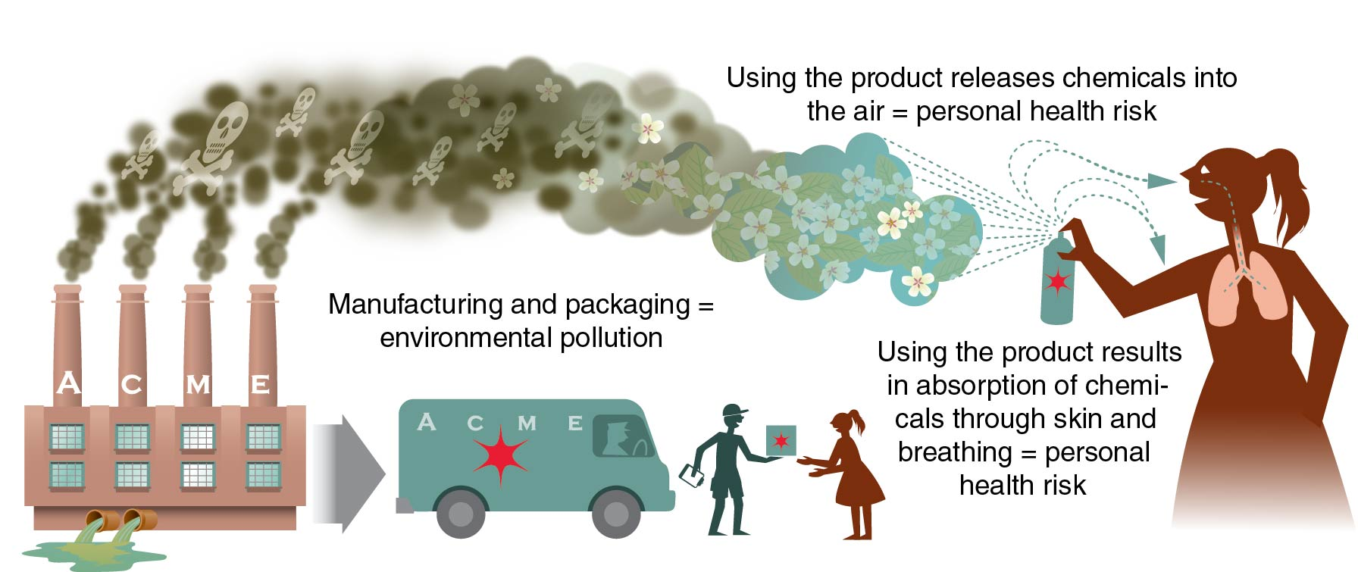
Why Chemicals Matter
Chemicals are linked to both environmental and personal health risks.
Notes:
Figure 14.9

Slide 5
Chemicals in Personal Care Products
Your body absorbs chemicals through your lungs and skin when you breathe, bathe, eat, drink, and use personal products.
Personal products include shampoo, toothpaste, deodorant, sunscreen, and makeup.
A single product may have a chemical level that is considered safe, but the use of multiple products over many years may be dangerous.

Slide 6
Chemicals in Household Items
Household products and materials that we use to build our homes and communities can also contain toxic chemicals.
Examples include
solvents, paints, batteries, pool cleaners, antifreeze, and bug and weed killers.

Slide 7
Getting Help When Needed
All products containing dangerous chemicals are labeled according to the danger they pose.
If you inhale or ingest a dangerous chemical, tell a doctor, school nurse, or trusted adult right away.
You can also call the national Poison Control Center for advice (800-222-1222).

Slide 8
Proper Disposal of Chemical Waste
Hazardous materials include items that can cause damage to human or animal life or the environment.
All products containing chemicals are labeled with instructions on proper disposal.

