Slide 1
Lesson 14.2 Air, Water, and Noise Pollution
Chapter 14

Slide 2
Write About It
Do you think you are exposed to much pollution in your daily life?
Explain your answer using specific examples.

Slide 3
Air Pollution and Your Health
Air pollution happens when the air contains dangerous particles.
Air pollution can trigger asthma and allergy attacks; sleepiness; headaches; and irritation of the eyes, nose, throat, and skin.

Slide 4
Outdoor Air Quality
Outdoor air is influenced by natural forces in the environment and human activity.
Smog is the combination of moisture in the air that has mixed with smoke and chemical fumes.
Acid rain is caused when chemicals that are released in the air mix with water and oxygen to form acids.

Slide 5
Indoor Air Quality (1 of 2)
Indoor air quality refers to how polluted the air is inside buildings and structures, including your school.
The best ways to improve indoor air quality are to
keep things clean, including bedding, clothing, curtains, and furniture;
keep air filters clean in heating and cooling units;
use chemical-free cleaning products when possible;
use an air purifier; and
let fresh air in when outdoor air quality is good.
(continued)

Slide 6
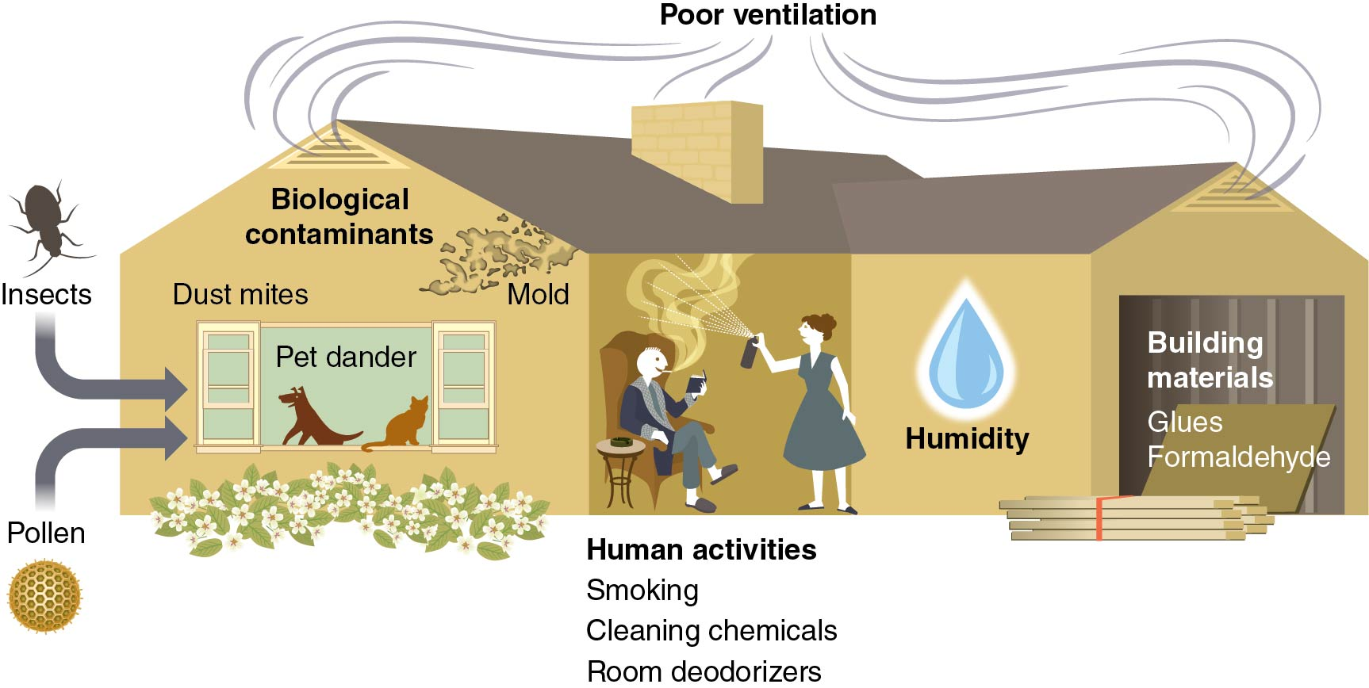
Indoor Air Quality (2 of 2)
Notes:
Figure 14.6

Slide 7
Water Pollution and Your Health
Potential causes of water pollution include
humans using chemicals on lawns, washing the car in the driveway, and using weed killers;
chemicals used in the manufacturing of products;
not properly disposing of products containing chemicals (paint, batteries, and medicines);
microorganisms from animal and human waste and garbage/food waste; and
natural disasters.

Slide 8
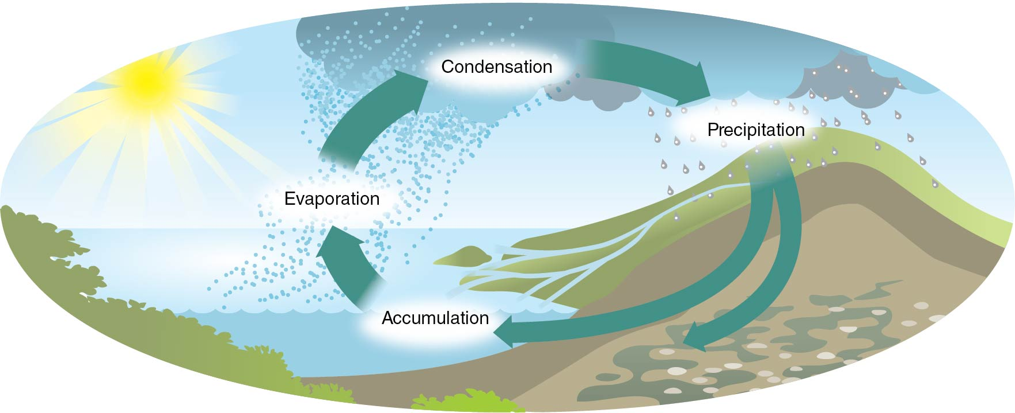
The Water Cycle
Notes:
Figure 14.8

Slide 9
Noise Pollution and Your Health
When sound is unwanted, excessive, or bothersome, it is called noise pollution.
Noise pollution can damage hearing among other things.
A major cause of noise pollution is earbuds and headphones worn with personal devices.
It is estimated that one in five teenagers has developed mild hearing loss.
It is important to reduce the volume on your personal device to protect your hearing now and in the future.

