Slide 1
Lesson 14.1 Exploring Public Health
Chapter 14

Slide 2
Write About It
Have you ever heard of public health?
What do you think it means?
Provide examples in your response.

Slide 3
What Are Public and Community Health?
Public health is the art and science of protecting and improving the health of individuals and large populations.
Community health is a form of public health that is focused on a group of people or geographic area.

Slide 4
Public Health and You
Your individual health is affected by the people around you, the community you live in, and the society you live in and the policy and rules that govern it.

Slide 5
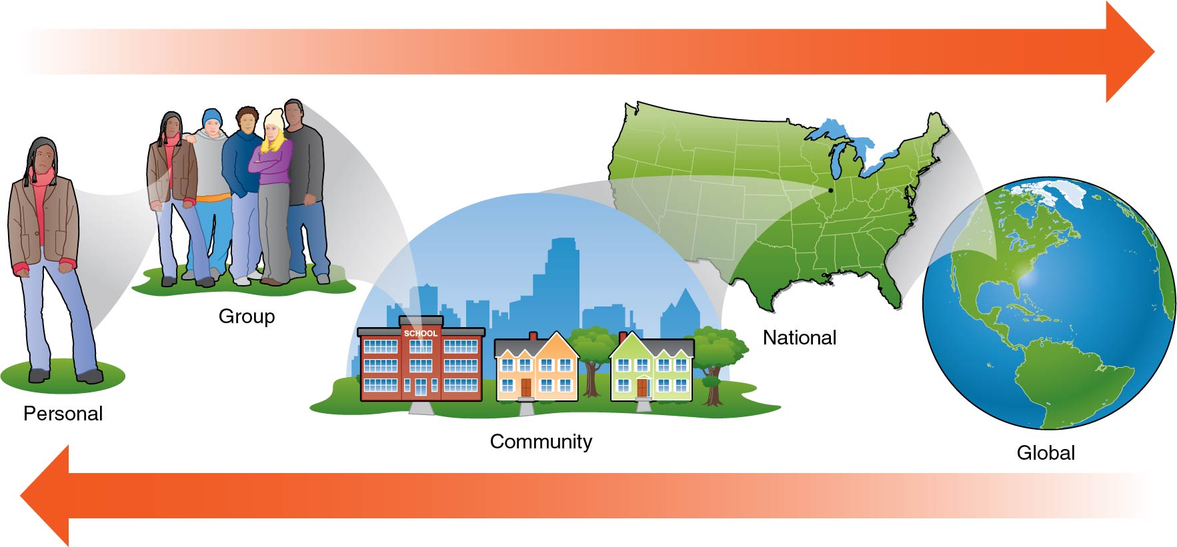
You Are Surrounded by Public Health Influences
Notes:
Figure 14.1

Slide 6
Careers in Community and Public Health
Public and community health workers are part of the health care industry.
There are a wide range of jobs in public and community health.
Most of these jobs require at least an undergraduate college degree, and many require graduate education.

Slide 7
Examples of Public and Community Health Careers
Career | Description
Epidemiologist | Researches and investigates patterns of disease
Social worker | Provides counseling and assistance to people in need (like children, veterans, seniors, homeless)
Public health nurse | Focuses on working to improve the health of a specific group or community
Microbiologist | Researches microorganisms with the goal of developing drugs to fight infectious diseases
Public health educator | Provides education to a community in order to promote their health or prevent the spread of disease
Public health analyst | Gathers and tracks data about public health activities and programs to determine their effectiveness
Health inspector | Ensures that state laws and sanitary codes are followed in a community
Notes:
Table 14.1

Slide 8
Examples of Government and Nongovernment Public Health Organizations
Government agencies | Nongovernment agencies
Centers for Disease Control and Prevention Health and Human Services National Institutes of Health Indian Health Services Food and Drug Administration Division of Adolescent and School Health State Health Departments Local Health Departments City Health Departments | World Health Organization American Public Health Organization Doctors Without Borders World Bank The Carter Center Bill and Melinda Gates Foundation American Red Cross National Kidney Foundation
Notes:
Table 14.2

Slide 9
State and Local Health Departments (1 of 2)
Each state has its own state and local health departments with the goal of reducing health disparities.
A health disparity is a preventable difference in disease, injury, violence, or opportunities to achieve optimal health.
(continued)

Slide 10
State and Local Health Departments (2 of 2)
Health disparities exist for a variety of reasons, including
poverty,
environmental conditions,
inadequate access to health care,
individual and behavioral factors, and
educational inequities.

Slide 11
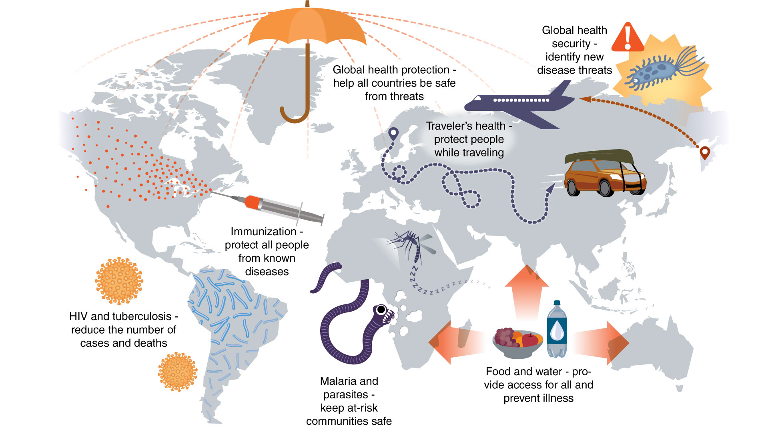
Major Global Health Issues
Notes:
Figure 14.2

