Slide 1
Lesson 13.3 Safety Online
Chapter 13

Slide 2
Write About It
How could you be safer on the Internet or on your phone?
List at least three ways you could be safer.

Slide 3
Internet Safety
There are so many things we can do on the Internet, such as search for information, get help with homework, listen to music, stream shows and movies, and interact on social media.
With so many options also come risks you need to be aware of. Some of the risks include social media sharing, identity theft, and phishing attacks.

Slide 4
Social Media Sharing
Social media is electronic communication in which users create online communities to share information, ideas, personal messages, and other content.
Social media sharing is when you share your current location through pictures or checking in to a specific building or event.
Social media criminals can easily find where you are when you are sharing so much information. They will also know where you aren’t, such as your home, which can lead to break-ins.

Slide 5
Identity Theft
It happens when someone uses your identity or personal information without your permission to commit a crime.
Your identity can be stolen, and you may not know about it until you are older and applying for student loans or a credit card and are denied because your identity was stolen.
Make sure your computer and cell phone are protected by a strong password, a fingerprint scan, or facial recognition.

Slide 6
Phishing Attacks
Phishing attacks involve dishonest websites, apps, or emails that look legitimate but are not.
Phishing attacks often appear as a link in an email that you are asked to click on to fix a problem with your password or a credit card you may have used.
The link takes you to a website that looks real, and, when you log in, all your personal information has just been given to the attacker.

Slide 7
Passwords
Many of the hacks to your social media, email, and online sites are due to weak or stolen passwords.
Passwords should be complex and have multiple types of characters, including numbers, letters, and symbols.

Slide 8
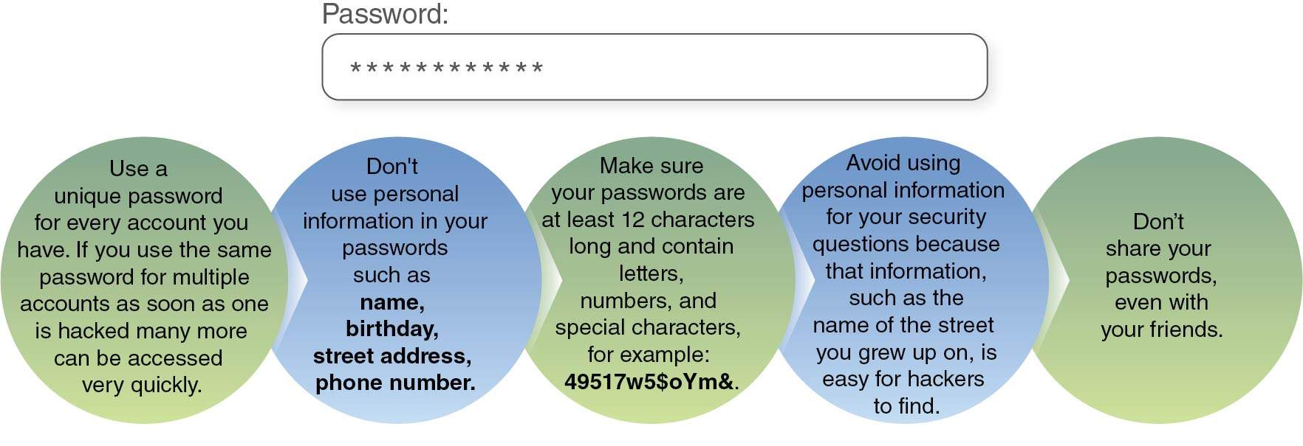
Password Tips
Notes:
Figure 13.6

Slide 9
Technology Safety Tips
Don’t click on links or apps you aren’t familiar with, as they often spread malware, which is a virus that invades your computer system.
Think before you share your location.
Know your “friends” and don’t accept friend requests from people you don’t know in real life. Hackers try to create a rapport with you and then hack your passwords and computer systems.
Use antivirus software to detect, prevent, and remove malware.
Don’t meet people in person you know only from being online.

