Slide 1
Lesson 13.1
Injury Prevention and Safety at Home
Chapter 13

Slide 2
Write About It
If you have been in a natural disaster, describe what happened.
If you haven’t been in a natural disaster, explain what natural disaster could strike where you live and what you are most worried about.

Slide 3
Injuries
Two types of injuries
  Unintentional: caused by accidental or unplanned events
    Caused by motor vehicle crashes, drowning, poisoning, fires, and falls
  Intentional: caused by another person or is self-inflicted to cause injury
    Caused by another person or is self-inflicted to cause injury, such as violence, suicide, self-injury, and homicide

Slide 4
Falls
They are the leading cause of nonfatal injuries for children and teens.
Tips for preventing falls
  Clear things off floor.
  Have good lighting outside.
  Use night lights.
  Don’t stand on chairs or tables to reach something high.
  If using a ladder, make sure someone else is there to steady it for you.

Slide 5
Poisoning
Poison is a substance that causes harm to a person if too much is eaten, inhaled, injected, or absorbed through the skin.
Children under six are unintentionally poisoned by personal care products or household cleaning supplies, especially detergent pods for laundry and dishwashers.
Preteens and teens are unintentionally poisoned when they mix different prescription medicines.

Slide 6
Firearm Safety
Keep firearms unloaded and locked up.
Add gun locks, and lock ammunition separately from the firearm.
If you see or hear about someone having a gun at school, tell an adult right away, even if you aren’t sure it’s true. It’s better to be cautious and find out the truth than not say anything and people get hurt.

Slide 7
Fire Safety
Fire safety involves the planning that takes place to try to prevent fires from ever starting and what to do if a fire does happen.
Notes:
Fire Triangle picture is from the chapter.

Slide 8
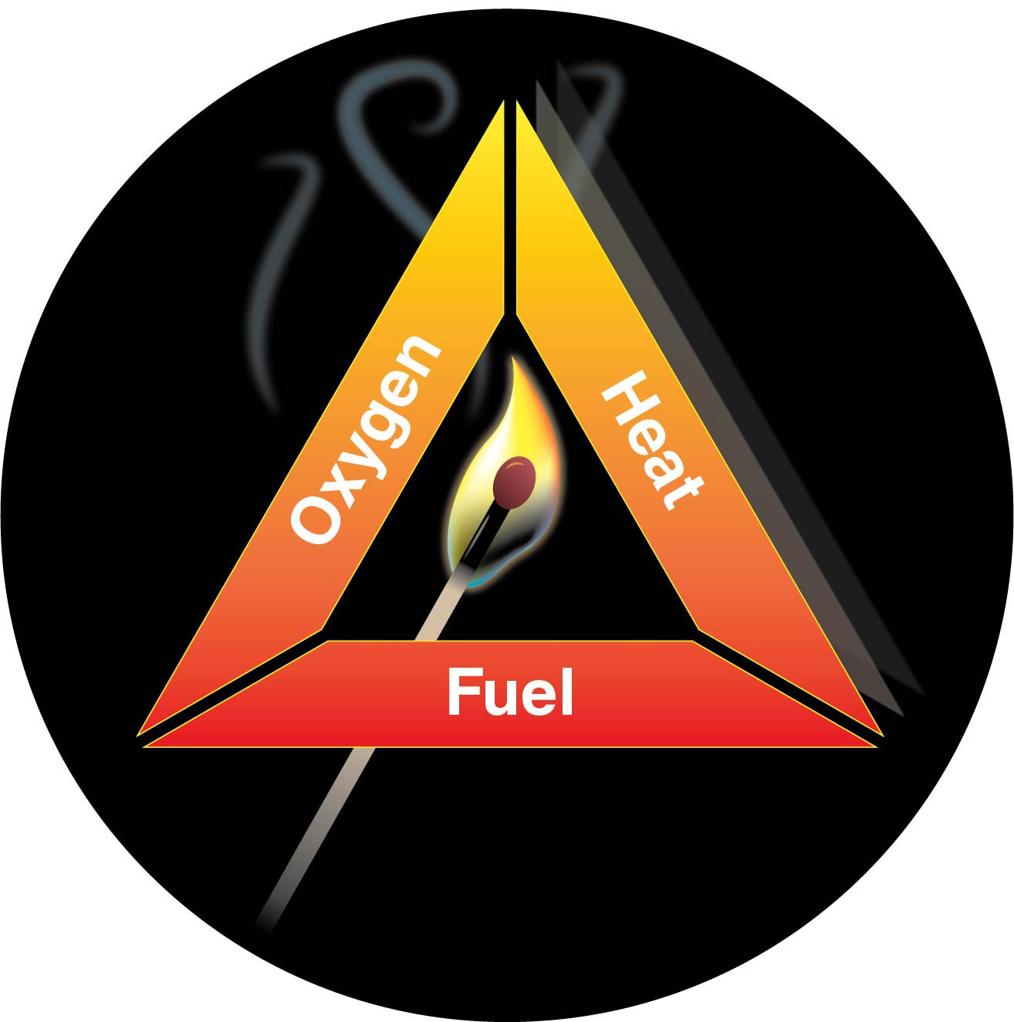
Fire Triangle
Notes:
Figure 13.1

Slide 9
Natural Disasters
Any type of severe weather that has the potential to be a significant threat to human health, safety, and property
Types of natural disasters include winter storms, floods, thunderstorms, tornadoes, hurricanes, earthquakes, volcano eruptions, wildfires, and tsunamis.

Slide 10
Preparing for Disasters
Create a disaster preparedness plan.
Sign up for your community or state warning system.
Make sure you have food that will keep if power goes out, extra water, first aid supplies, flashlights. and batteries.
Make sure you have food and water for your animals also.
Plan how you will communicate with family members after a disaster.

