Slide 1
Lesson 12.4
Prevention, Treatment, and Being Drug-Free
Chapter 12

Slide 2
Write About It
What would be the consequences if you were found using or possessing marijuana at school?
Are you aware of your school’s policies related to the use, possession, and sale of drugs?
If so, list them. If you don’t know what they are, where do you think you could find this information?

Slide 3
Substance Use Disorder
Substance use disorders are patterns of symptoms resulting from the use of a substance that you continue to take, even though you experience problems as a result.
A substance use disorder means the use of a drug is changing how you live your life.
Even if you know the drug is causing you problems at school or with your family or friends, you continue to use it.

Slide 4
Addictive Potential of Drugs (1 of 2)
A drug’s addictive potential is determined by the drug’s ability to provide the following characteristics:
  The effects of the drug happen quickly.
  The feeling of great happiness and excitement go beyond normal expectations.
  Both tolerance and withdrawal are effects of the drug.
The more of these aspects a drug has, the higher its addictive potential.
(continued)

Slide 5
Addictive Potential of Drugs (2 of 2)
Tolerance means the person will require higher doses of the drug to have the same effect and they will want to continue use of the drug to prevent withdrawal symptoms.
Withdrawal is a group of symptoms that a person experiences when the quantity of the substance is reduced.

Slide 6
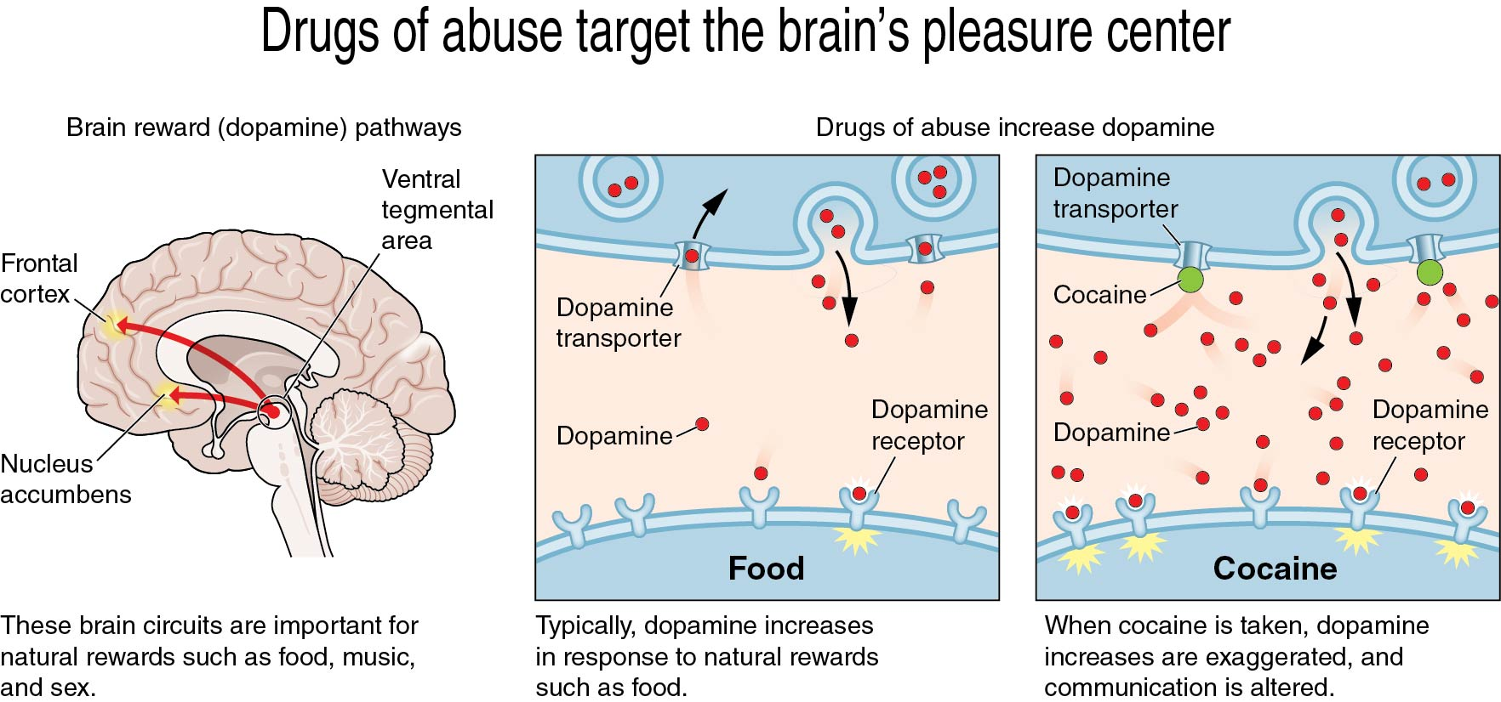
Effects of Drugs on the Brain
Notes:
Figure 12.9

Slide 7
Being Drug-Free (1 of 2)
Being drug-free is a behavior that teens choose to make.
The choice to be drug-free is difficult because peers and friends may encourage you to use with them and it can be hard to say no.
Being aware of why you are choosing not to use drugs is an important step in practicing healthy behaviors.
(continued)

Slide 8
Being Drug-Free (2 of 2)
Schools can help educate teens about the risks of using substances: alcohol, nicotine, illicit drugs, OTC drugs, and prescription drugs.
Families and adult role models can also play a large part in teen substance use prevention.

Slide 9
Benefits of Being Drug-Free
  Healthier life
  Clean conscience
  Making friends
  Better school and job opportunities
  Mental health

Slide 10
Barriers to Being Drug-Free
Drug users don’t feel they need treatment.
They are not ready to stop using.
Their family can’t afford the cost of treatment.
They worry about the negative effect treatment would have on school.
They are concerned with what others will think.
They don’t know where to go for help.

Slide 11
Treating Substance Use Disorders (1 of 2)
Most effective types of treatment are a combination of medication and behavioral therapy.
Medications are used to treat withdrawal symptoms while the teen stops using prescription drugs.
Behavioral therapy helps teens learn how to modify their attitudes and behaviors around using drugs.
(continued)

Slide 12
Treating Substance Use Disorders (2 of 2)
Treatment must be long enough and strong enough to be effective.
The most common treatment settings for teens
  Outpatient treatment programs
  Intensive outpatient treatment programs
  Day treatment and partial hospitalization treatment programs
  Residential treatment programs

Slide 13
School Policies
All schools have specific policies related to the use, possession, and sale of drugs on school grounds and at school functions on or off school grounds.
They also have policies for the use, possession, and sale of illicit drugs off school grounds if you are an athlete or involved in other clubs or organizations as a representative of the school.
How schools handle the use, possession, and sale of illicit drugs is described in their student handbook.

Slide 14
Community Laws
Juveniles (individuals under the age of 18) can get charged with a variety of drug crimes.
  Possession of an illicit substance
  Sale of an illicit substance
  Intent to distribute an illicit substance
  Transportation of an illicit substance
  Cultivation of an illicit substance
Even a small amount of illicit drugs can result in serious legal charges being filed.

