Slide 1
Lesson 12.2 Illicit Drugs
Chapter 12

Slide 2
Write About It
Brainstorm three potential short-term and three long-term consequences of using drugs to cope with problems.

Slide 3
Illicit Drugs Overview
Illicit drugs are substances that are illegal to possess, have no medical applications, and can be dangerous to consume.
They stimulate or slow the central nervous system or cause hallucinogenic effects.

Slide 4
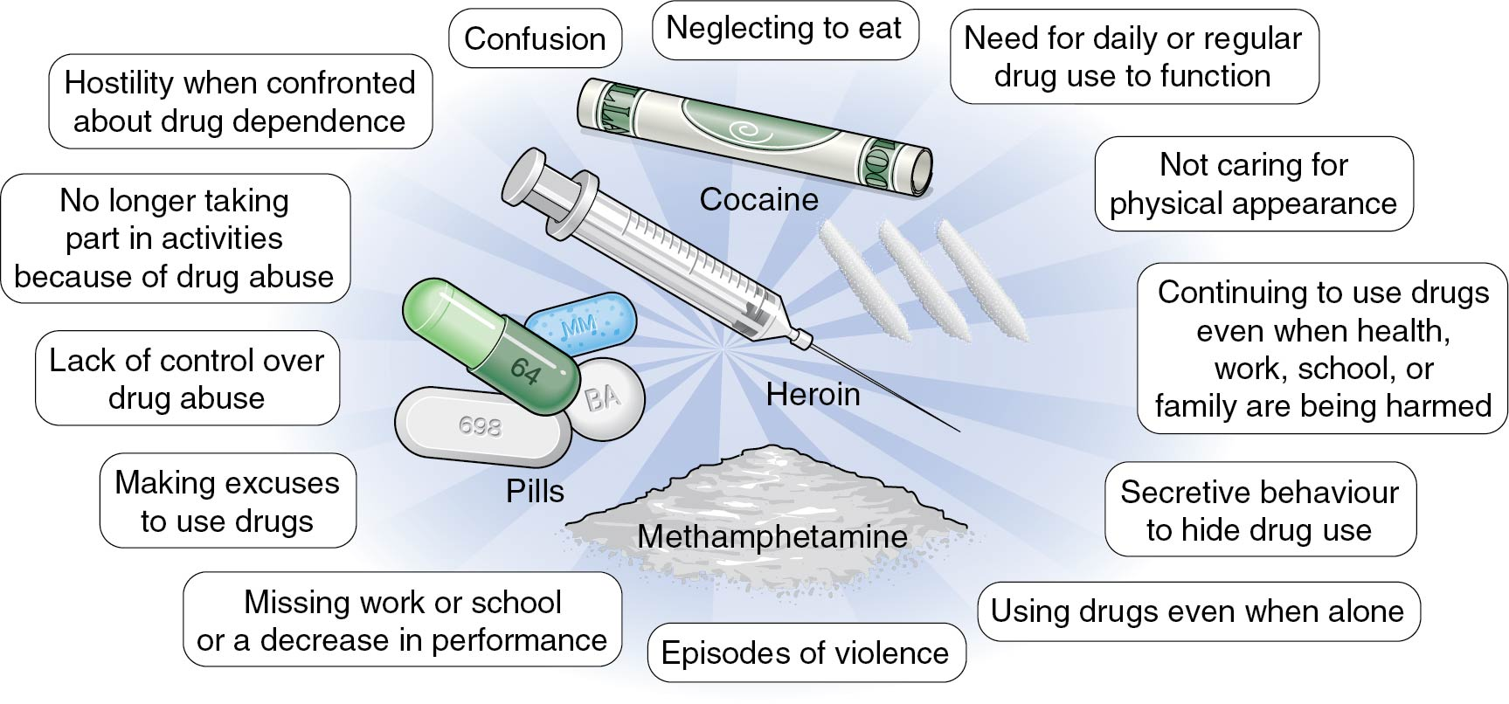
Dangers of Illicit Drugs
Notes:
Figure 12.3

Slide 5
Marijuana (Cannabis) (1 of 2)
Marijuana is one of the most popular drugs and is most used by smoking or vaping.
It is a mind-altering psychoactive drug made from the Cannabis sativa plant.
The main ingredient in marijuana is tetrahydrocannabinol (THC), which produces the psychoactive effect known as the high.
Short-term side effects may include being overly relaxed and having an increased appetite, an altered sense of time, and impaired judgment.
Long-term side effects may include mental health problems, respiratory infections, and addiction.
(continued)

Slide 6
Marijuana (Cannabis) (2 of 2)
Marijuana is currently legal in many U.S. states and in the District of Columbia for people over the age of 21.
Some states have approved medical marijuana only, and other states have also approved adult-use recreational marijuana.
It is still illegal to use marijuana according to the federal government.

Slide 7
Stimulants
Stimulants speed up the body’s systems.
This class of drugs includes
prescription drugs, such as amphetamines, used to treat ADHD;
OTC drugs;
diet pills; and
illicit drugs, such as cocaine and methamphetamine.

Slide 8
Cocaine (Stimulant)
Cocaine is a white crystalline powder derived from coca leaves.
Its street names include coke, crack, rock, and snow.
Crack cocaine, which is another common form of cocaine, looks like small, unevenly shaped white rocks.
Cocaine has an almost immediate effect, making the user feel energetic, alert, and overly sensitive to sights, sounds, and touch.

Slide 9
Methamphetamine (Stimulant)
Methamphetamine is one of the most common Illicit drugs in the United States because it is so easy to create.
Its street names include meth, speed, ice, and crystal.
Meth creates a type of excitement that makes people feel good partly because of the high level of dopamine that is released.
Common side effects of meth use are a severe dental problem called meth mouth and intense itching and scratching leading to skin sores.

Slide 10
Opioids (1 of 2)
Opioids, a form of narcotic, are naturally found in the opium poppy plant.
This class of drugs includes the illicit drug heroin as well as pain relievers available by prescription, such as oxycodone, hydrocodone, and morphine.
Opioids are often used as medicine because they contain chemicals that relax the body and relieve pain.
(continued)

Slide 11
Opioids (2 of 2)
Heroin is an opioid drug made from morphine.
Heroin can be a white or brown powder or a sticky black substance known as black tar.
Heroin can be injected, snorted, or smoked.
Short-term effects may include dry mouth, heavy feeling in the arms and legs, and difficulty in thinking.
Long-term effects may include an inability to make decisions, antisocial behavior, and heart and lung complications.

Slide 12
Inhalants
Inhalants are found in common household products (felt-tip markers, air freshener) that produce chemical vapors, which are inhaled through the nose or mouth to produce mind-altering effects.
Most inhalants affect the central nervous system and slow down brain activity.
Short-term effects may include slurred speech, lack of coordination, headaches, and dizziness.
Long-term effects can include loss of coordination and brain damage.

Slide 13
Steroids
Anabolic steroids are a lab-created version of the male hormone testosterone.
They are used illegally to promote muscle growth, enhance athletic performance, and improve physical appearance.
They can cause acne, mood swings, kidney problems, and aggression.
Men may experience shrinking testicles, decreased sperm production, and male-pattern baldness.
Women may experience a deepening of the voice, a decrease in breast size, and an increase in facial and body hair.

Slide 14
Club Drugs: Hallucinogens
Club drugs are primarily used by teens and young adults at parties, concerts, and clubs.
Hallucinogens are used to alter perception and mood.
Two examples of hallucinogens
Ecstasy comes in pill or powder form.
GHB comes in pill form but more often is a colorless, odorless liquid put into drinks.

Slide 15
Club Drugs: Depressants
When prescribed by a doctor and used properly, depressants can calm nerves and help you sleep.
Two examples of depressants
Benzodiazepines (Valium and Xanax)
Rohypnol (not approved for medical use in the United States)

Slide 16
Why Some Teens Use Illicit Drugs
Teens experiment with drugs for a variety of reasons.
To fit in
Curiosity
To feel good
Low self-esteem
To feel better or to forget
To improve performance
Boredom
To cope with problems

Slide 17
How Drugs Affect Athletic Performance
Drugs take a toll on your mind, body, physical activity, and athletic performance in many negative ways.
Depressants affect your alertness and concentration, slow down your breathing, and reduce your coordination.
Stimulants increase your heart rate, can make you irritable and restless, and can make it difficult to concentrate on the game.

Slide 18
Illicit Drugs and Risky Behaviors
There is a direct connection between using illicit drugs and engaging in risky behaviors, such as unprotected sex, number of sex partners, underage drinking, and dating violence.
Teens who don’t use any substances are the least likely to engage in sexual risk taking.

Slide 19
Warning Signs of Teen Drug Use
Sudden change in friends, eating habits, sleeping patterns, physical appearance, or academic performance
Missing school or extracurricular activities
Making poor decisions, being irresponsible, and having a general lack of interest in anything
Breaking rules or withdrawing from friends and family
Acting secretive
Sudden mood swings

