Slide 1
Lesson 12.1
Over-the-Counter and Prescription Drugs
Chapter 12

Slide 2
Write About It
List three ways you think over-the-counter (OTC) medications are different from prescription medications.

Slide 3
Over-the-Counter and Prescription Drugs
Medicine is defined as the science of diagnosing and preventing disease and maintaining health.
Medicine can also be defined as a drug used to maintain health or treat a health issue.
Drugs can ease symptoms, help prevent or manage diseases, relieve pain, and treat multiple conditions.
Drugs are divided into two categories: nonprescription or over-the-counter (OTC) drugs and prescription drugs.

Slide 4
Differences Between OTC and Prescription Drugs
OTC drug | Prescription drug
Does not require a doctor’s prescription | Prescribed by a doctor
Bought off the shelf in stores | Bought at a pharmacy
Can be used by more than one person | Prescribed for and to be used by only one person
Regulated by the Federal Drug Administration (FDA) | Regulated by the Federal Drug Administration (FDA)
Notes:
Table 12.1

Slide 5
Using OTC and Prescription Drugs Safely (1 of 2)
The U.S. Food and Drug Administration (FDA) is the government agency that decides which drugs require a prescription and which drugs may be sold over the counter.
To use an OTC drug safely means using the drug properly.
To use prescription drugs safely, it is important you use them as they are prescribed by your doctor.
(continued)

Slide 6
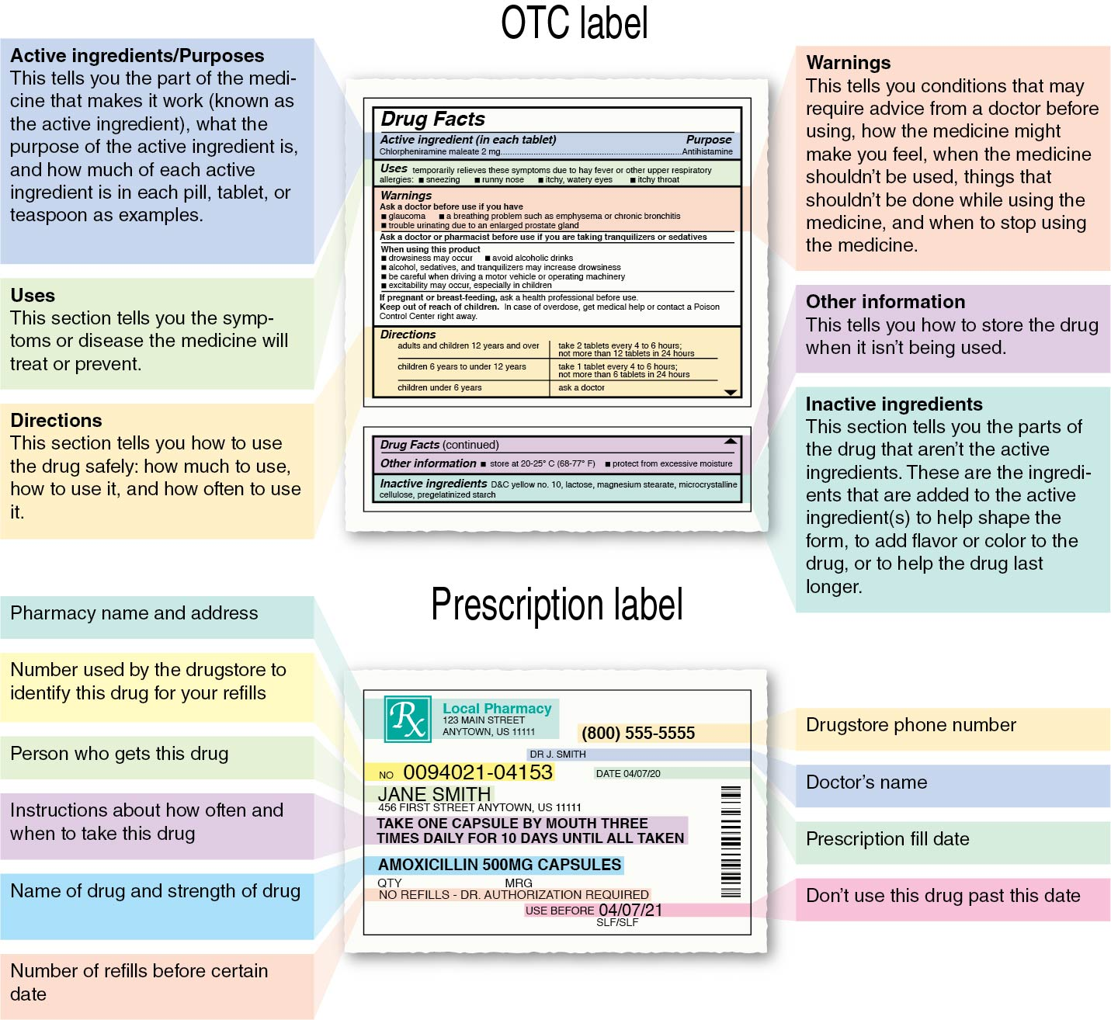
Using OTC and Prescription Drugs Safely (2 of 2)
Notes:
Figure 12.1

Slide 7
Potential Risks of Taking OTC and Prescription Drugs
Side effects
Drug–drug interactions
Drug–food interactions
Allergic reactions

Slide 8
Abuse of OTC and Prescription Drugs
Middle school students are more likely to abuse OTC and prescription drugs because the drugs are easy to obtain and the desire to fit in with peers is strong.
  Prescription drugs are the fourth most abused substance by teens.
  The use of prescription drugs, other than as prescribed, by teens is the fastest-growing drug problem in the United States, affecting teens’ mental and physical health.

Slide 9
Commonly Misused OTC and Prescription Drugs
Cough syrup
Cold medicine
Adderall and Ritalin
Vicodin and OxyContin

Slide 10
Performance-Enhancing Drugs
Performance-enhancing drugs are substances used to improve athletic performance.
Creatine is produced by your body and helps muscles release energy.
Caffeine is a stimulant most often found in coffee and energy drinks and may be used by athletes to speed up the central nervous system and increase heart rate and blood pressure.

Slide 11
Diet Pills
Diet pills often come with a large promise of significant weight loss. While diet pills may help with weight loss, they can also have health risks.
The primary ingredient of most diet pills is caffeine, but they may have other ingredients you don’t always know about.
Over-the-counter diet pills are marketed to help you lose weight by increasing your metabolism. Metabolism is how your body converts what you eat and drink into energy your body needs to function.

