Slide 1
Lesson 11.1 Tobacco Products and the Rise of E-Cigarettes
Chapter 11

Slide 2
Write About It
Can you name four types of tobacco products?
Can you list the common ingredient found in all forms of tobacco?

Slide 3
Tobacco Facts
According to the Centers for Disease Control and Prevention (CDC), there has been a significant increase in middle school and high school students’ use of tobacco products, primarily in e-cigarettes.
Tobacco use is the number one cause of preventable deaths in the United States.

Slide 4
Tobacco and Its Ingredients (1 of 2)
Tobacco is a plant grown for its leaves, which are dried and put into tobacco products.
Tobacco contains nicotine, which is the addictive chemical and the main ingredient in tobacco.
Nicotine stimulates the release of dopamine, which is the chemical responsible for feelings of excitement, relaxation, and stress relief.
(continued)

Slide 5
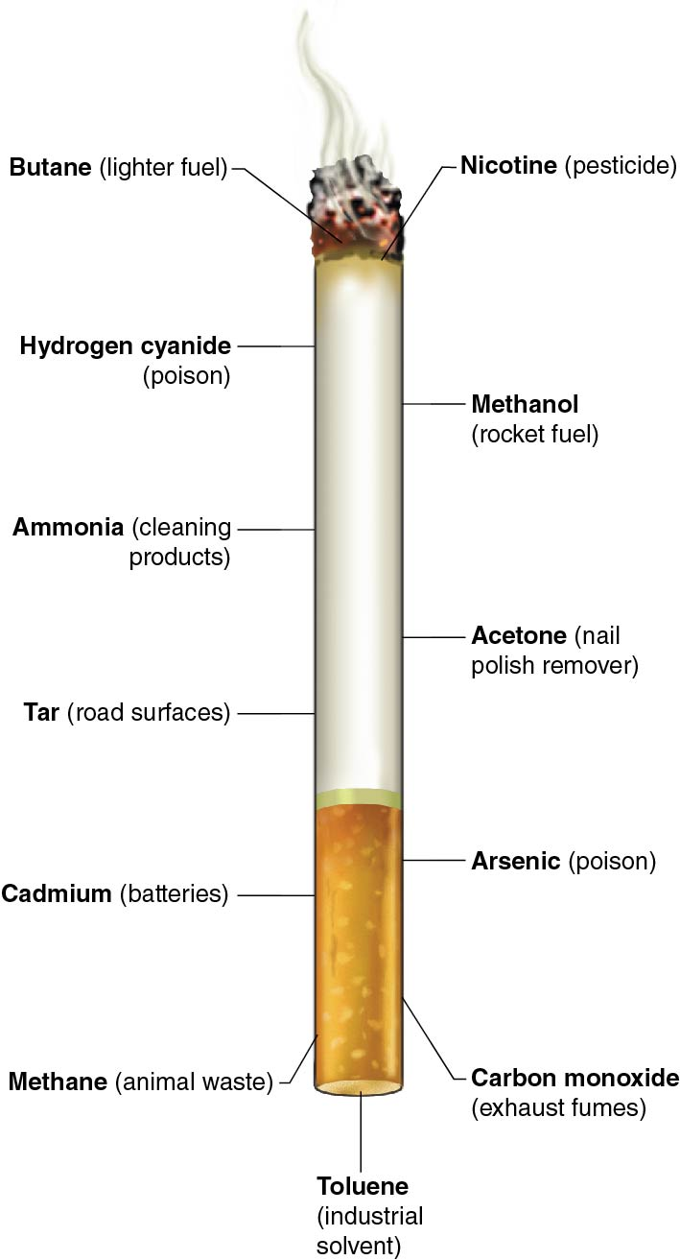
Tobacco and Its Ingredients (continued)
Notes:
Figure 11.2 Common cigarette components and what else they can be found in.

Slide 6
Types of Tobacco Products
Cigarettes
Cigars
Electronic cigarettes (e-cigarettes)
Pipe
Chewing tobacco
Snuff and snus
Dissolvables

Slide 7
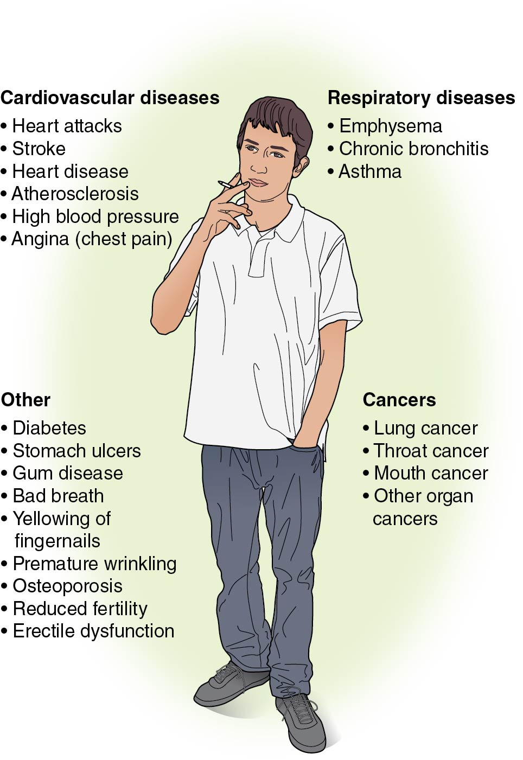
Tobacco’s Effects on the Body
Notes:
Figure 11.3

Slide 8
Health Effects of Smokeless Tobacco
Smokeless tobacco is also a serious risk to your mouth and overall health.
It contains twice as much nicotine as a regular cigarette.
It can cause cancer of the mouth, esophagus, or pancreas.
It destroys gum tissue and causes cavities, tooth discoloration, tooth decay, bad breath, and bone loss around teeth.

Slide 9
E-Cigarettes (1 of 2)
They are also known as e-cigs, vape pens, vapes, mods, tank systems, and ENDS.
An e-cigarette is a battery-operated device that heats a liquid and produces an aerosol.
The aerosol that is inhaled and exhaled can contain nicotine; flavorings; chemical particles; cancer-causing chemicals; and heavy metals, such as nickel, tin, and lead.
(continued)

Slide 10
E-Cigarettes (2 of 2)
The use of an e-cigarette is often known as vaping.
Vaping is the act of inhaling and exhaling aerosol produced by an e-cigarette.
The liquid is often referred to as e-juice and usually contains nicotine, flavoring, and other chemicals.
The amount of aerosol produced by the e-cigarette affects how much nicotine is consumed.

Slide 11
Who Uses E-Cigarettes?
E-cigarettes are popular with teens who have never smoked cigarettes before and may never have intended to.
Teens using e-cigarettes are at an increased risk of smoking cigarettes later in their lives partly because of the addiction to nicotine.
E-cigarettes may be more socially acceptable than smoking cigarettes because the aerosol does not smell as bad as cigarette smoke does.

Slide 12
E-Cigarettes Are a Dangerous Alternative to Smoking
E-cigarettes have been advertised as a safe alternative to smoking and a method to quit smoking cigarettes.
There is little evidence showing e-cigarette use reducing cigarette smoking or leading to completely quitting smoking.
Vaping an average-sized e-cigarette is equal to 12 cigarettes, and most tobacco cigarettes contain between 8 and 20 mg of nicotine.

Slide 13
Health Risks and E-Cigarettes
Since e-cigarettes are relatively new, there is still much to be learned about their long-term effects.
Many of the health risks people are aware of are like those for cigarettes.
It is unclear what all the ingredients are in the different e-juices, so no one knows what the side effects will be. It could be years before this information is available.
Vaping can cause lung and cardiovascular diseases, lung cancer, and fainting and can reduce how well your immune system works.

Slide 14
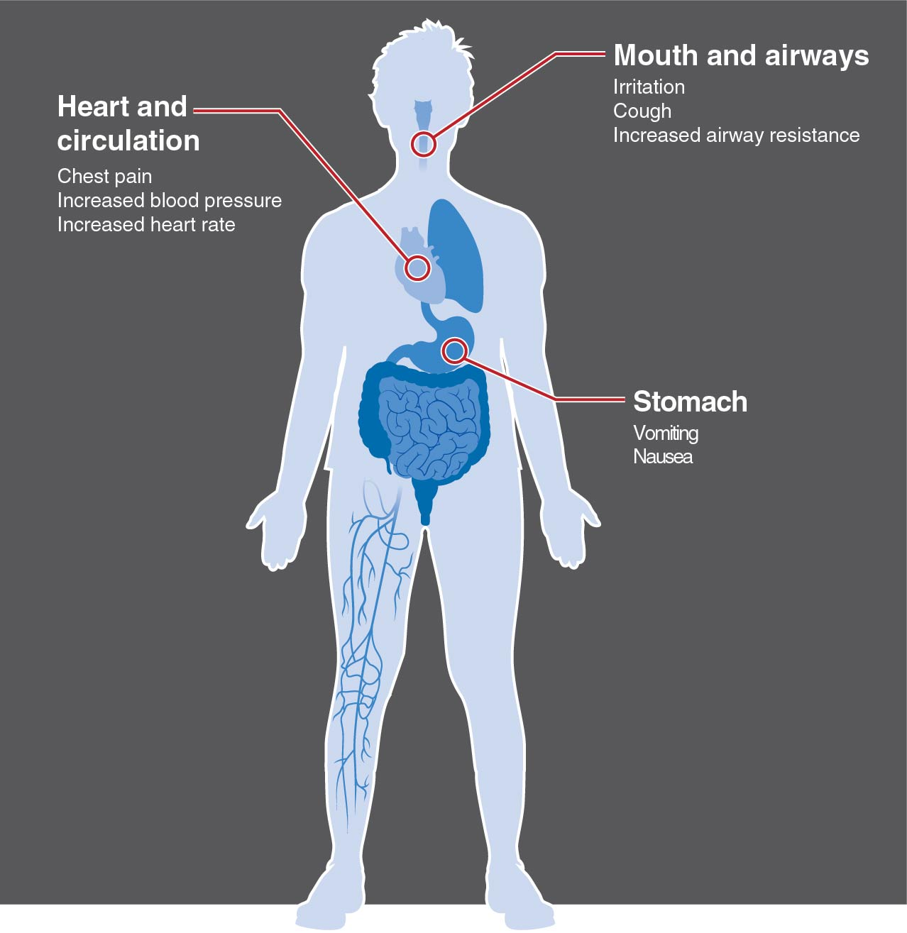
Side Effects of Vaping
Notes:
Figure 11.5

Slide 15
Pregnancy and the Use of Cigarettes and E-Cigarettes (1 of 2)
Women and men who smoke have more difficulty becoming and getting their partners pregnant.
Smoking while pregnant can cause health problems to the mother and the baby.
(continued)

Slide 16
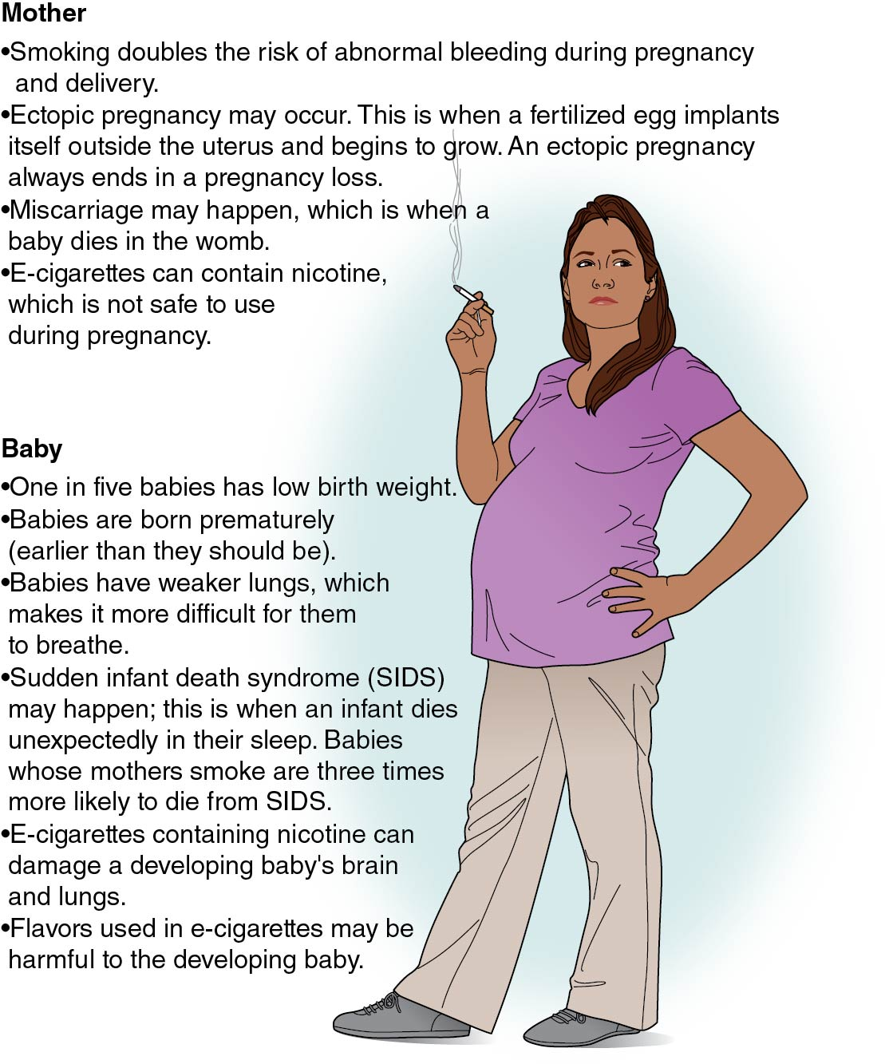
Pregnancy and the Use of Cigarettes and E-Cigarettes (2 of 2)
Notes:
Figure 11.6

Slide 17
Secondhand and Thirdhand Smoke or Vape
The smoke or vape from a cigarette, e-cigarette, cigar, or pipe and the smoke breathed out by a smoker are known as secondhand smoke or secondhand vape.
More than 60 of the 7,000 chemicals in tobacco smoke are known to cause cancer. The chemicals that cause cancer are known as carcinogens.
Secondhand vape contains nicotine, ultrafine metal particles, and low levels of toxins that are also known to cause cancer.

