Slide 1
Lesson 10.2 The Effects of Alcohol
Chapter 10

Slide 2
Write About It
What do you know about the physical, mental, emotional, and social effects of drinking alcohol?

Slide 3
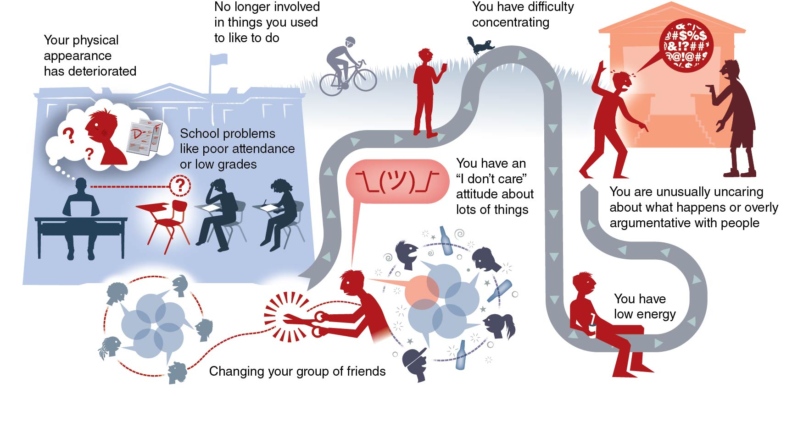
Signs of Alcohol Use
Notes:
Figure 10.4

Slide 4
What to Do for an Alcohol Overdose
An alcohol overdose is when a person has drunk so much alcohol that the areas of the brain controlling basic life-support functions begin to shut down.
If you think someone has overdosed, call 911.
Do not leave them alone.
They may be semiconscious or unconscious.
Lay them on their side with their ear to the floor so that, if they vomit, it will come out of their mouth and they won’t choke on it.

Slide 5
Factors That Influence the Effects of Alcohol
Body size
How fast you drink
Food
Medications
How much you drink

Slide 6
Short-Term Physical Effects on the Body
Vision is blurred or double.
Sweating increases, and skin becomes flushed.
The more you drink, the longer it takes for your liver to metabolize the alcohol; therefore, you become drunk faster.
Dehydration occurs.
Nausea, vomiting, diarrhea, and indigestion may happen.

Slide 7
Long-Term Physical Effects on the Body
Brain damage, memory loss, or stroke
Cardiovascular disease and high blood pressure
Cirrhosis of the liver and cancer
Less ability to fight off infections
Inflamed lining and bleeding and cancer of the esophagus

Slide 8
Effects of Alcohol Use During Pregnancy
There is no safe time or amount of alcohol for a pregnant woman to drink because a baby also absorbs the effects of alcohol.
Drinking alcohol during pregnancy can cause
miscarriage;
stillbirth; or
fetal alcohol spectrum disorder, or FASD (a group of conditions that can cause physical, behavioral, and learning problems).

Slide 9
Mental Effects of Alcohol Use
Alcohol affects your brain and ability to do simple, routine tasks.
Even one or two drinks can affect your ability to walk, see, speak, react, and think clearly.

Slide 10
Short-Term Mental Effects of Alcohol Use
Short-term mental effects of drinking alcohol may last a few hours, depending on how much you have had to drink, and may include
difficulty with decision making,
engaging in inappropriate or risky behavior,
being less likely to recognize potential dangers, and
aggressive or violent behavior.

Slide 11
Long-Term Mental Effects of Alcohol Use
Long-term mental effects of drinking alcohol may be permanent and may include
difficulty understanding information,
difficulty learning new information, or
an increase in the risk of developing an alcohol use disorder later in life.

Slide 12
Emotional Effects of Alcohol (1 of 2)
People may choose to drink alcohol because it can initially change their mood and how they feel.
There are four main reasons people drink.
To increase a positive mood
To gain a social reward, such as approval of others or membership in a group
To reduce the pain or discomfort of negative feelings
To fit in
(continued)

Slide 13
Emotional Effects of Alcohol (2 of 2)
People also hope alcohol will help them be able to
express feelings,
mask feelings, or
avoid feelings.

Slide 14
Social Consequences of Risks of Underage Drinking
You may lose some of your friends.
Family and friends may not trust you because you may lie to them in order to drink.
You may have hangovers and not feel well if you drink too much.
You may act more impulsively, meaning you don’t think before you do something.

Slide 15
Risk Taking
Drinking can result in making risky decisions that lead to
unintentional injuries,
violence,
suicide,
sexual risk behaviors, or
use of other drugs.

