Slide 1
Lesson 9.3 Youth Violence, Bullying, and Gangs
Chapter 9

Slide 2
Write About It
Do you think teasing someone is the same as bullying?
Explain your answer.

Slide 3
Youth Violence
Youth violence is any violent behavior between young people ages 10 to 24.
It includes fights, gang violence, bullying, and threats.
One in 5 students report being bullied at school.
Youth violence also impacts the larger community.
It does so because there is a need for more medical care, there is more crime, and there is more demand on police and other social service workers.

Slide 4
Bullying
Bullying is the most common form of youth violence.
Bullying is any unwanted aggressive behavior by another youth or group of youth who are not siblings or dating partners.
Bullying involves perceived power.
Bullying can be physical, emotional, or social.

Slide 5
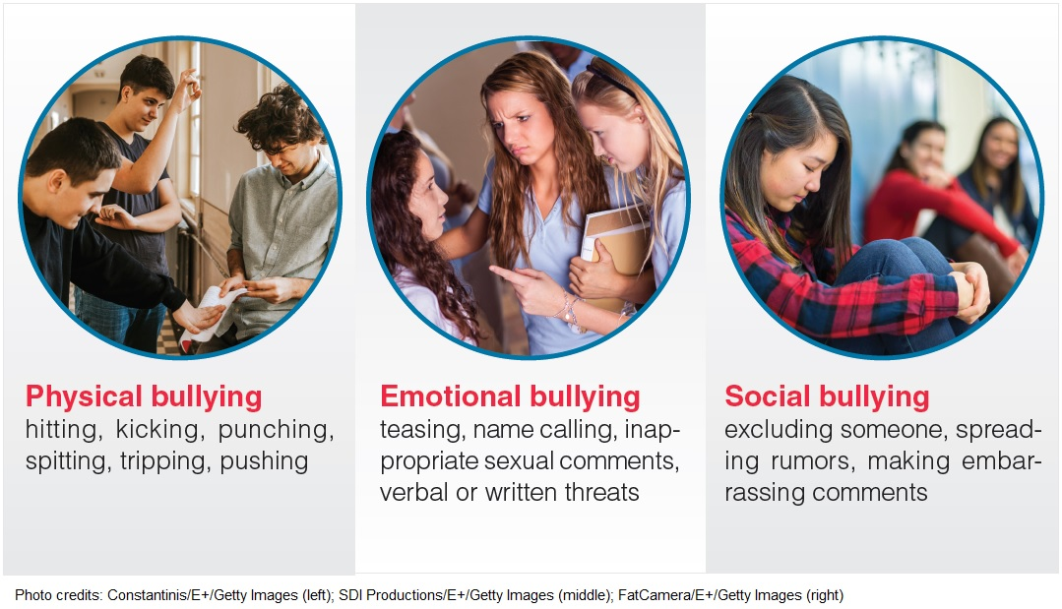
Types of Bullying
Notes:
Figure 9.7

Slide 6
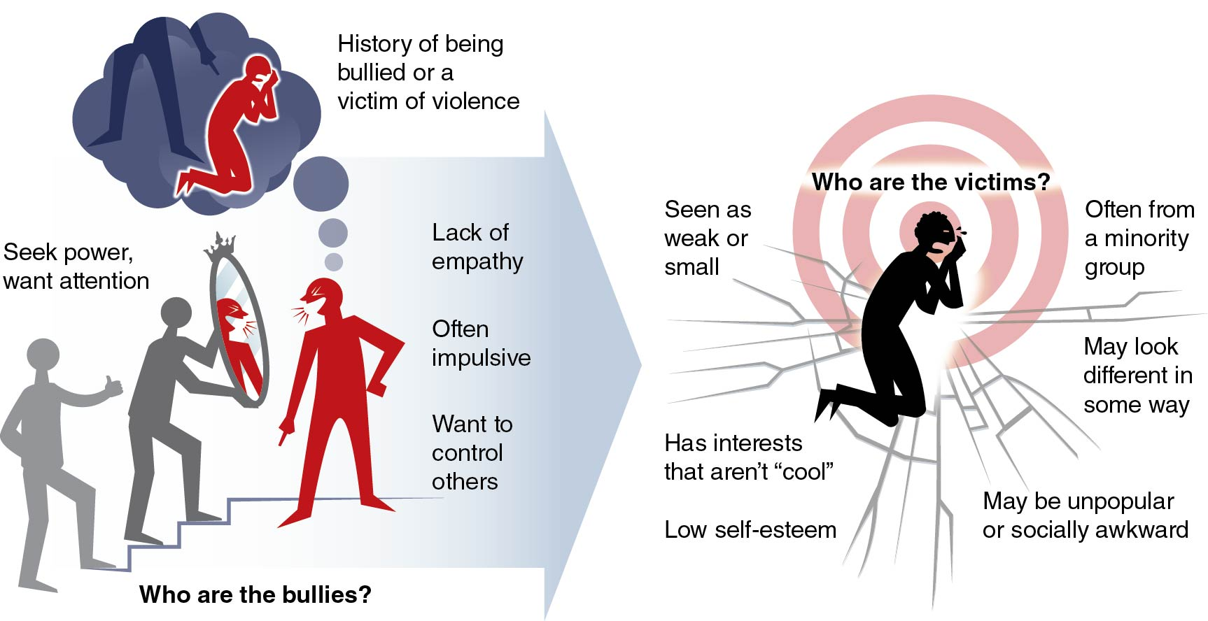
Influences on Bullying Behavior
Notes:
Figure 9.8

Slide 7
Consequences of Bullying
Consequences of bullying can be short and long term.
Fear
Anxiety
Difficulty concentrating
Poor academic performance
Depression
Suicide

Slide 8
Responding to Bullying
Speak up and tell someone.
Ask the bully to stop.
Don’t respond; just walk away.
Avoid physical confrontation.
Stay close to others.

Slide 9
Helping Others Who Are Bullied
Say something to the bully.
Don’t bully back.
Be a friend to the victim.
Say something to other witnesses.
Tell an adult.

Slide 10
Cyberbullying
Electronic media is fast.
Damage is done quickly.
People are more aggressive when they can “hide” online.
It happens repeatedly over time.
It is bullying; treat it like bullying.

Slide 11
Gang Violence
Risks of gang violence include illegal activities, friends in gangs, friends who use drugs, family members who use drugs, lack of role models, family violence, and neglect.
Consequences of gang violence often last a lifetime.
They include death, injury, criminal record, and loss of job or inability to go to school or get work in the future.

Slide 12
Avoid and Report Gang Violence
Use a strong voice, stand up tall, and be clear that your answer is no.
Give a reason for saying no.
Walk away, and go to a safe place, such as your classroom, your home, or a community center.
Reach out for help.

Slide 13
School Violence
It is any violence that happens on school property.
It can have consequences for education even if criminal charges are not filed.
Follow rules and policies at school.
Report suspicious activity and violence.
Suspicious activity is anything that seems out of place or doesn’t belong.

