Slide 1
Lesson 9.2 Anger, Aggression, and Conflict
Chapter 9

Slide 2
Write About It
When you experience a conflict how does it make you feel?
How do you usually handle conflict?

Slide 3
Anger and Aggression
Anger is a normal human emotion.
Aggression is when someone engages in a forceful action with the intent to control another person.
Aggression is a behavior, not an emotion.
Aggression is not always violent, such as in competitive sport.
Often, aggression is linked with violence.

Slide 4
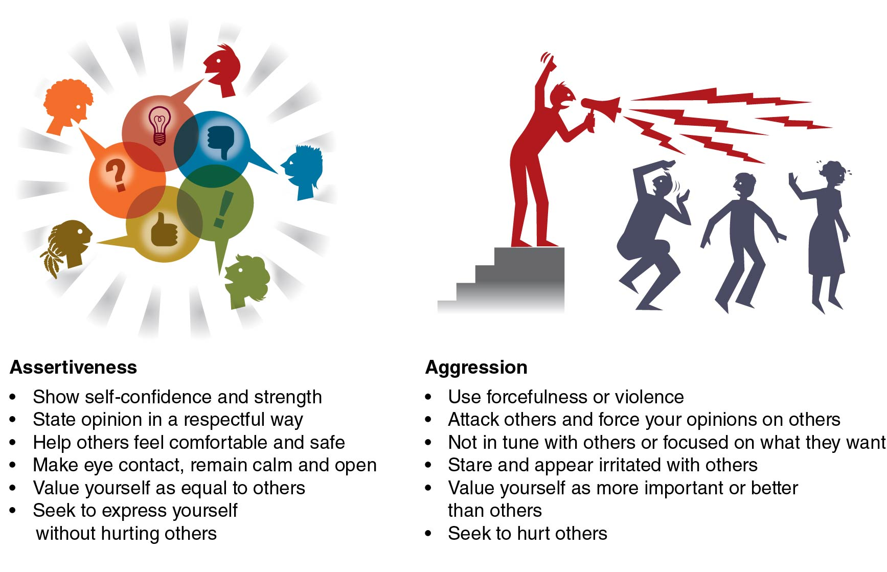
Assertiveness Versus Aggression
Notes:
Figure 9.5

Slide 5
Conflict
Conflict occurs when two or more people disagree on an issue and feel threatened in some way.
Conflict is often caused by different
values,
relationships,
interests, and
resources.

Slide 6
Managing Conflict
When we don’t manage conflict, it can worsen or escalate.
Basic conflict management styles include
accommodating,
avoiding,
collaborating,
competing, and
compromising.

Slide 7
Conflict Resolution (1 of 2)
Conflict resolution is the informal or formal process that two or more individuals or groups use to find a peaceful solution to their disagreement.
Conflict is unavoidable.
Not all conflict is bad. Conflict can motivate us to grow and appreciate others or to find solutions to problems.
(continued)

Slide 8
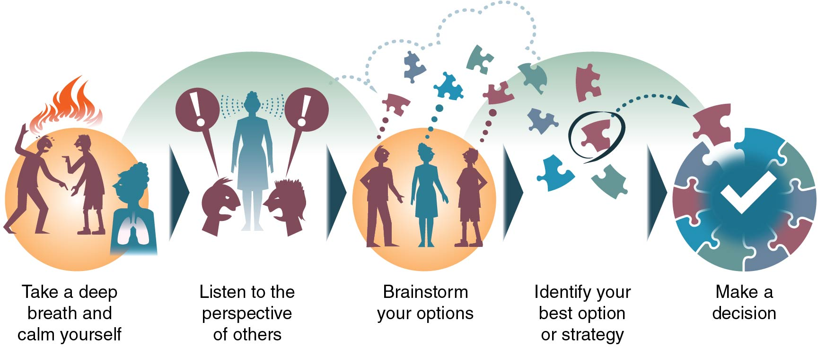
Conflict Resolution (2 of 2)
Notes:
Figure 9.6

