Slide 1
Lesson 9.1 Understanding Violent Behavior
Chapter 9

Slide 2
Write About It
How might your opinion of someone else influence the way you treat that person?
Do you think opinions can lead to violent behavior?
How so?

Slide 3
Violent Behavior
It includes the use of words or actions to cause or threaten to cause injury to someone or something.
It may be
physical violence,
sexual violence, or
emotional violence.

Slide 4
Influences on Violent Behavior
The offender is who commits the violence.
The victim is who is on the receiving end of the violence.
Violent behavior is linked to
personal and social influences, such as peer pressure, gangs, bias, and alcohol abuse and
family and community influences, such as substance abuse and violence in the home, poverty, and high crime rates.

Slide 5
Prejudice, Bias, and Intolerance
Prejudice is having an opinion about something or someone that is not based in reason or actual experience.
Bias is treating a person, thing, or group differently based on how we think about them.
Intolerance is when we don’t examine our prejudices and biases and are unwilling to accept the beliefs or behaviors of others. Intolerance can lead to hate and violence.

Slide 6
Consequences of Violent Behavior
Violent behavior can lead to
emotional and mental disorders, such as anxiety and depression;
injury, illness, and death;
substance abuse;
suicide; and
jail time, job loss, and more violence (offender).

Slide 7
Preventing Violence
Individuals and relationships
Examine your attitudes, beliefs, and behaviors.
Accept and celebrate differences.
Surround yourself with supportive people.
Community and society
Reduce social isolation.
Promote tolerance.
Develop policies and laws that promote equity.

Slide 8
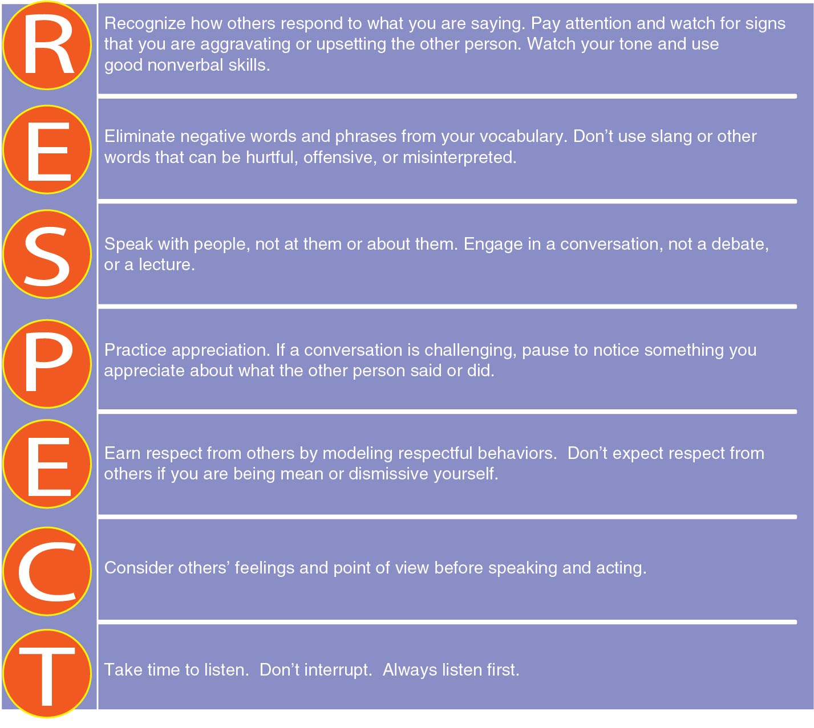
Communicating With Respect
Notes:
Figure 9.4

