Slide 1
Lesson 7.2
Mental Disorders and Anxiety
Chapter 7

Slide 2
Write About It
Do you know anyone with a mental disorder?
What is the disorder and what do you know about it?

Slide 3
What Are Mental Disorders?
A mental disorder is a serious and ongoing problem involving how a person thinks and manages their emotions.
There are a wide range of mental disorders that can be diagnosed by a mental health professional.

Slide 4
Examples of Mental Disorders
Anxiety disorders
Attention deficit hyperactivity disorder
Obsessive compulsive disorder
Post-traumatic stress disorder
Mood disorders
Personality disorders
Schizophrenia

Slide 5
Mental Disorders and Youth by the Numbers
Seventeen percent of young people experience an emotional, mental, or behavioral disorder.
Half of all chronic mental illness begins by age 14 and three-quarters by age 24.
Attention deficit hyperactivity disorder, behavior problems, anxiety, and depression are the most diagnosed mental disorders in youth.

Slide 6
Causes of Mental Disorders
A variety of factors come together to impact an individual’s likelihood of developing a mental disorder.
  Genetics and family history
  Environment and experiences
  Brain injury
  Prenatal history
  How the brain functions

Slide 7
Care and Treatment of Mental Disorders
Each type of mental disorder requires its own plan for care and treatment.
The most common approaches to treatment include counseling and therapy and medications.

Slide 8
Social Stigma and Mental Disorders
A stigma is when someone views another person in a negative way because that person has a distinguishing characteristic or personal trait that is thought to be or is a disadvantage.
Learning about mental disorders and developing empathy for the challenges mental disorders cause will help to reduce any stigma you may have.

Slide 9
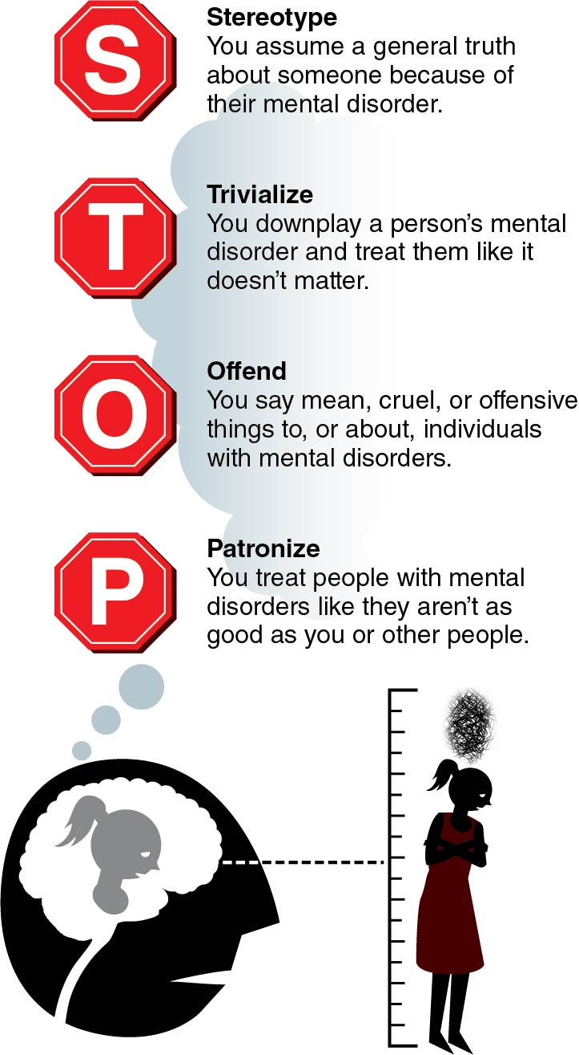
Recognize Stigma and Avoid Applying It
Notes:
Figure 7.7

Slide 10
Anxiety and Anxiety Disorders
Anxiety is an emotion that includes tension; worried thoughts; and physical changes, such as increased blood pressure.
People with anxiety disorders frequently have intense, excessive, and persistent worry and fear about everyday situations.

Slide 11
Common Anxiety Disorders
General anxiety disorder
Panic attacks/panic attack disorder
Social anxiety disorder
Simple phobia
Separation anxiety
Selective mutism

Slide 12
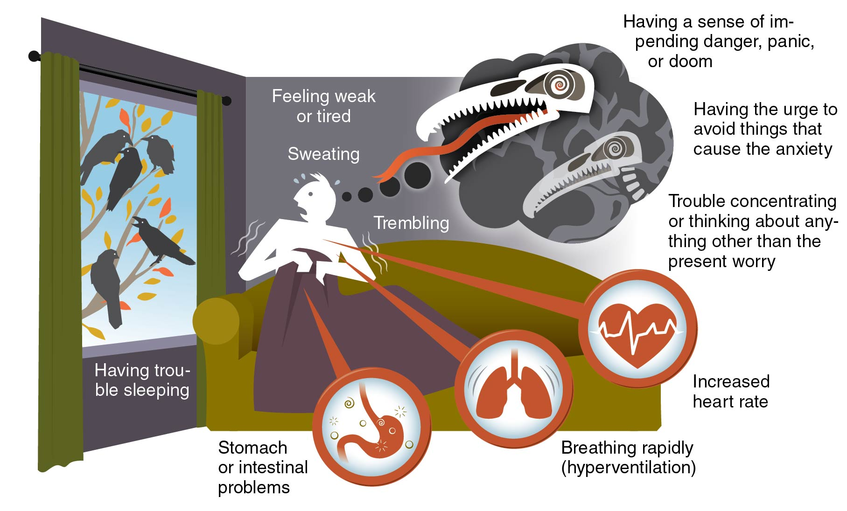
Common Symptoms of Anxiety Disorders
Notes:
Figure 7.8

Slide 13
Getting Help for Anxiety Disorders
Mental disorders, such as anxiety, can be hard to manage.
Common techniques for managing anxiety related disorders include
  therapy,
  medication,
  support groups, and
  self-care.

