Slide 1
Lesson 7.1
Understanding and Managing Stress
Chapter 7

Slide 2
Write About It
What is something that often causes you to feel stress?
Why do you think it is stressful?
What do you do to try to manage or control the stress you feel in that situation?

Slide 3
What Is Stress?
Stress is the body’s reaction to a demanding or difficult situation.
Everyone feels stress, but the things that cause us to feel stress differ from person to person.
The thing that triggers you to feel stressed is called a stressor.
A stressor can be anything from someone jumping out in front of you in a dark alley to having to speak in public.

Slide 4
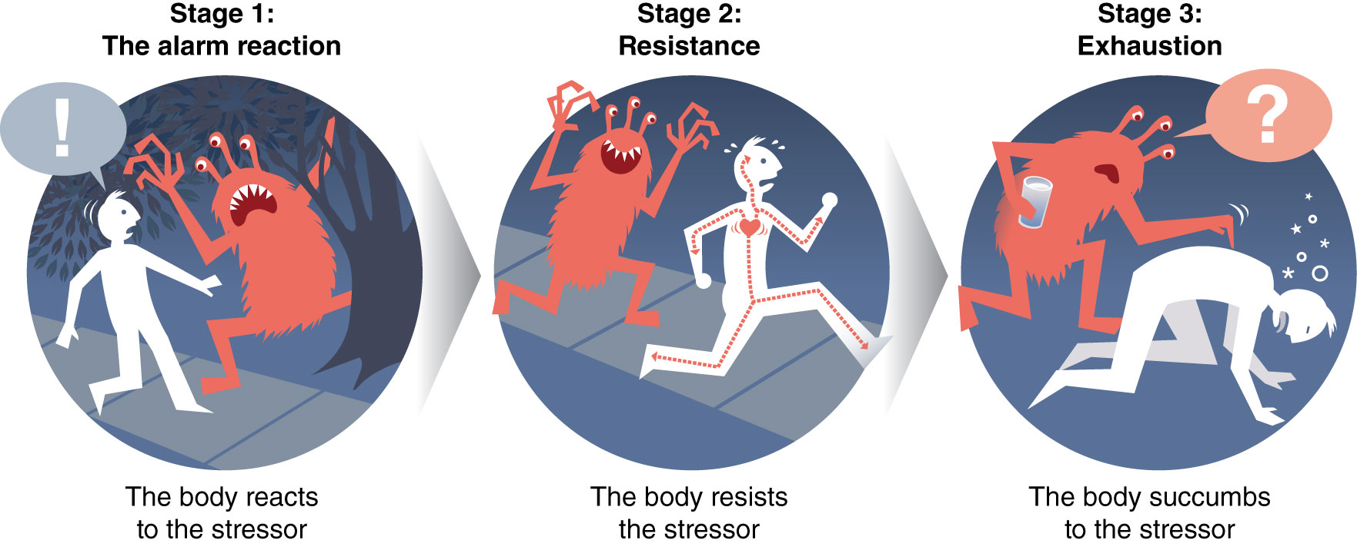
How We Respond to Stress
We go through three stages when we become stressed.
Notes:
Figure 7.1

Slide 5
Types of Stressors
Acute (short-term) stressors, for example, taking a test
Chronic (long-term) stressors, for example, feeling nervous and scared in a new school
Routine stressors, for example, getting homework done on time
Major life events, for example, having to move neighborhoods or to another state
Trauma, for example, a terrorist attack

Slide 6
Common Causes of Stress for Teens (1 of 2)
Tests and homework
Relationships with friends
Relationships with siblings
Having a significant other
Moving to a new home and school
Sports and other extracurricular activities
(continued)

Slide 7
Common Causes of Stress for Teens (2 of 2)
Feeling socially excluded
Too much to do
Family problems, including abuse and alcohol
Not achieving something that you really wanted
Violence in school or in the neighborhood

Slide 8
Stress and the Body
The human body is built to deal with physical stressors, such as a bear on your path or someone chasing you.
The physiological changes in your body are a negative form of stress called distress.

Slide 9
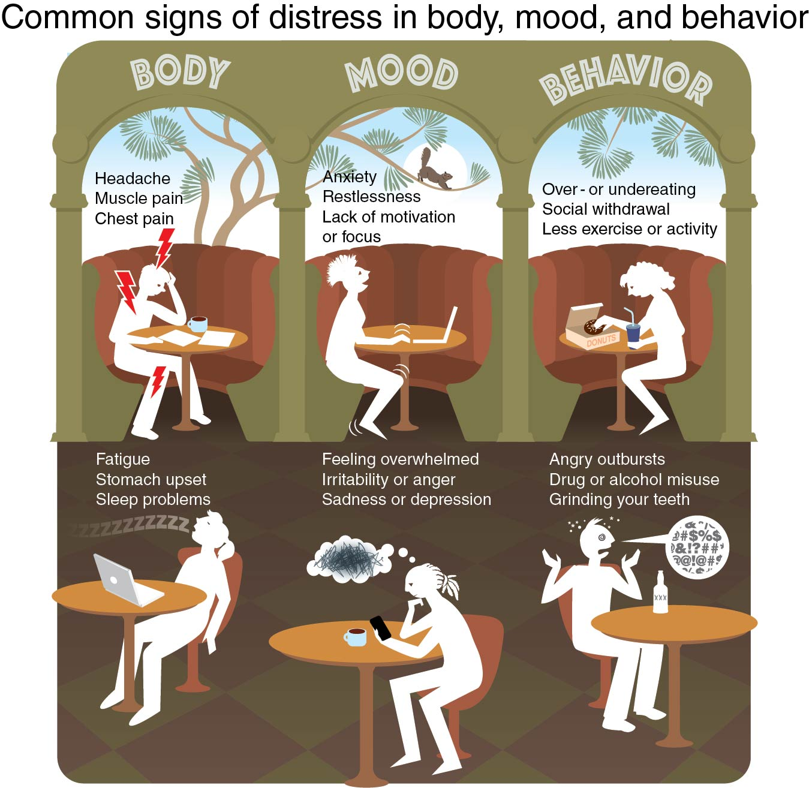
Common Signs of Distress
Notes:
Figure 7.3

Slide 10
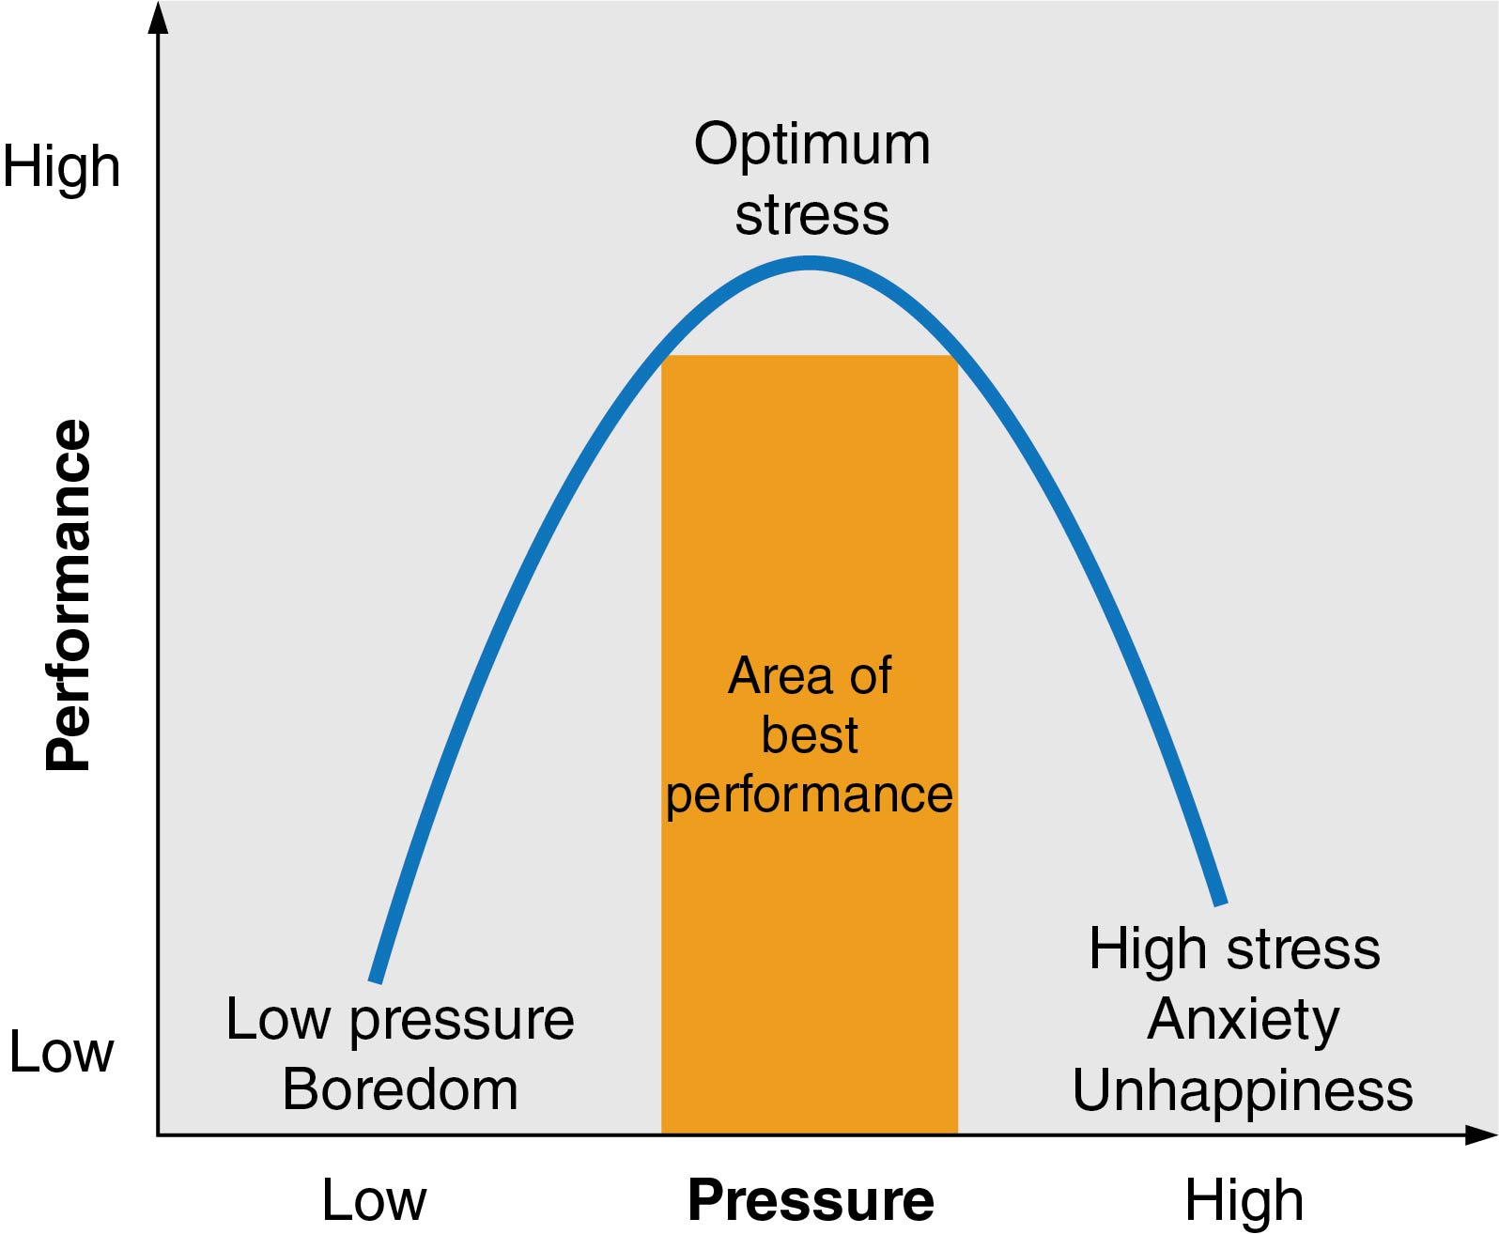
Stress and Performance
Your body is physiologically alert during stress; the right amount of stress can help you perform at your best.
Notes:
Figure 7.4

Slide 11
Stress and Health
Chronic stress can also contribute to a wide range of health problems, including
  type 2 diabetes,
  high blood pressure,
  heart disease,
  obesity,
  ulcers,
  irritable bowel syndrome,
  insomnia,
  skin conditions, and
  infections.

Slide 12
Managing Stress
Managing your stress is like managing your emotions.
Stress management can include things such as time management and positive self-talk.
Relaxation techniques are specific stress management strategies that reduce the intensity of the flight or fight response.

Slide 13
Stress Management Techniques
  Breathe deeply.
  Use positive self-talk.
  Reframe the situation.
  Tend to yourself.
  Remove yourself from the situation.
  Be mindful.
  Find ways to relax.
  Exercise.
  Learn time management.

