Slide 1
Lesson 4.4
Your Body Image
Chapter 4

Slide 2
Write About It
How often do you compare yourself to images you see in the media?
How do you feel when you compare yourself to others?

Slide 3
What Is Body Image? (1 of 2)
Your body image includes your thoughts, feelings, and behaviors related to your body size, shape, and appearance.
  It is not the image you project to others or how you look.
  It is how you feel about yourself and the way you look.
  (continued)

Slide 4
What Is Body Image? (2 of 2)
Negative body image exists when someone has a distorted view of their appearance or they think and feel negatively about how they look.
A person with a positive body image has a realistic sense of how they look, and they are less likely to believe their character, value, or worth is tied to their appearance.

Slide 5
Benefits of a Positive Body Image
Good emotional health
Improved self-confidence
Improved self-esteem
Healthier relationships
Healthier habits (exercise, healthy eating)

Slide 6
Negative Body Image and Health
Negative body image is associated with many other unhealthy behaviors.
People who have a negative body image are more likely to have low self-esteem, engage in unhealthy behaviors, and develop eating disorders.

Slide 7
Weight Prejudice
Weight prejudice is the presence of negative beliefs, attitudes, and behaviors toward individuals who appear to be overweight.
  It can lead to physical, social, and psychological consequences.
People should be seen for their character and not judged on their appearance, including their weight.

Slide 8
Media Influences on Body Image
It is common for people to compare themselves to media images of models and celebrities and to feel bad when they do.
This is called social comparison.
  The truth is that 95 percent of people lack the genetic traits to look like these models and celebrities.

Slide 9
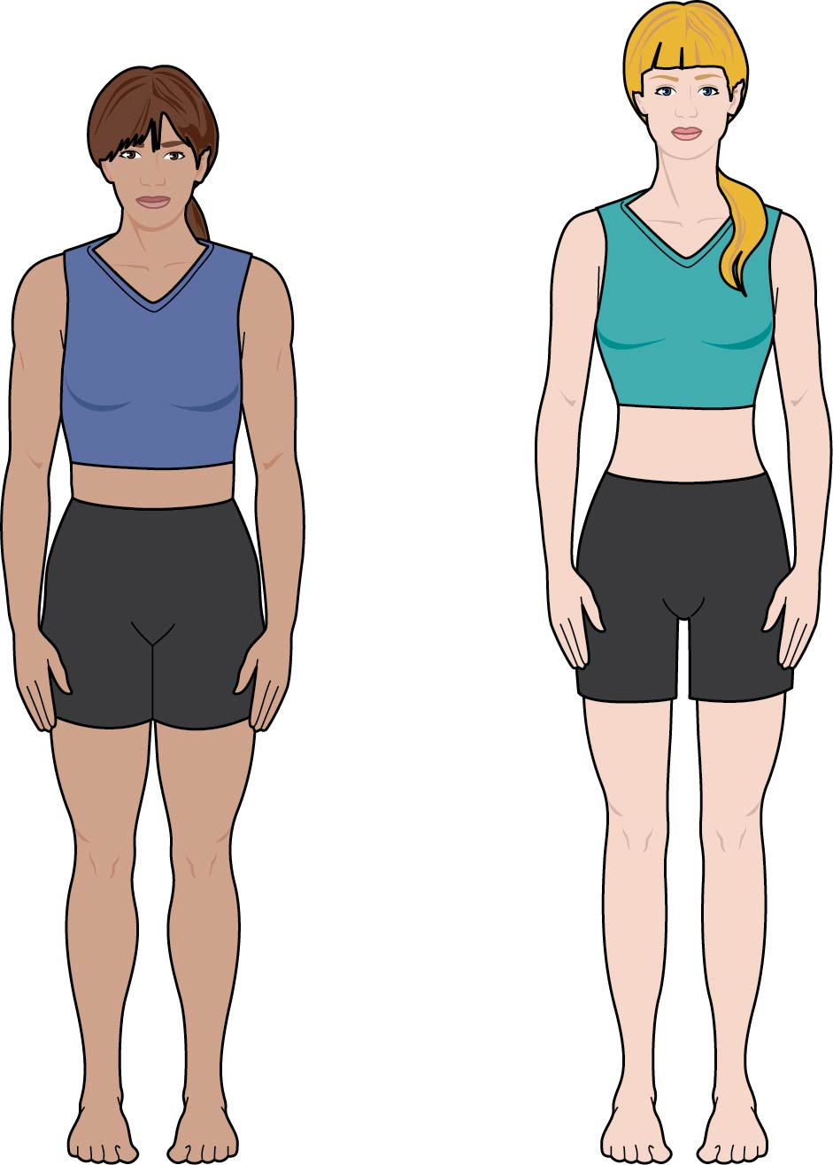
Typical Versus Ideal Body Types
Notes:
Figure 4.8

Slide 10
Altering Images
Not only are the images we see in the media and on social media unrealistic; they are typically altered digitally to remove imperfections (adjusted waist size, changed facial features, etc.).
Even the people in the photos usually don’t look like their image.

Slide 11
Social Media
Any time a picture is posted, others can comment on how you look, which can affect your body image.
Teens admit to posting only photos that represent their best selves or those that are “thinspirational” (inspiring or celebrating thinness) so that they can get more likes.

Slide 12
Disordered Eating and Eating Disorders
In all types of eating disorders, people use food to be in control of themselves and their lives.
Disordered eating includes a range of irregular eating behaviors, such as
  skipping meals, stress eating, periodic fasting, occasional bingeing, eating only certain foods, or avoiding certain categories of foods completely.
Eating disorders are serious, diagnosable mental illnesses.

Slide 13
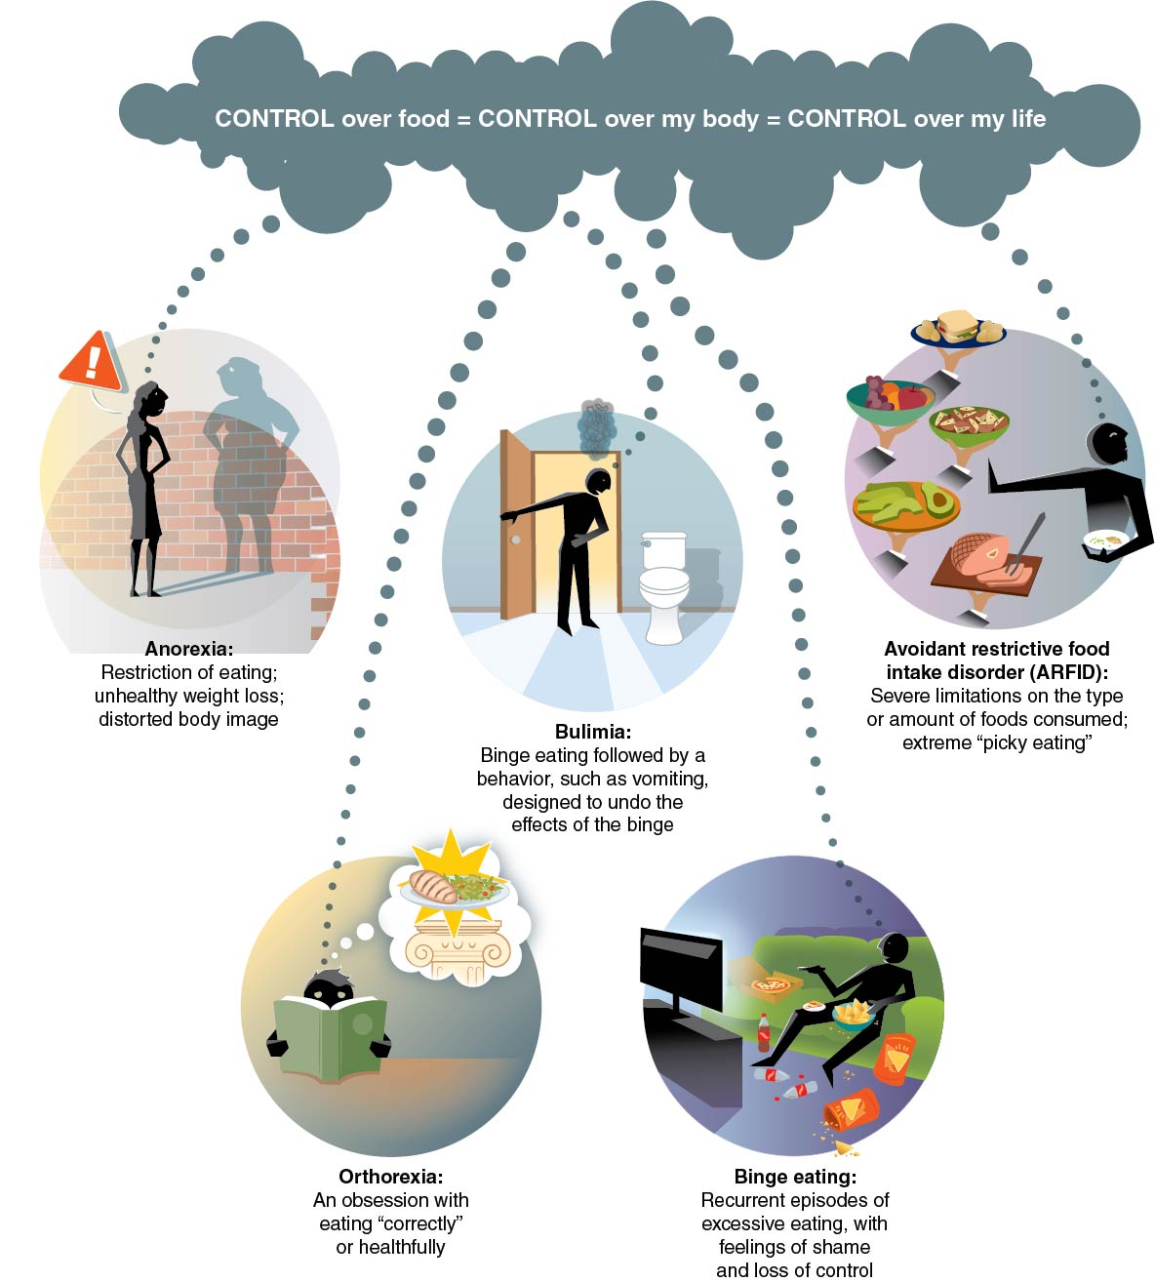
Common Eating Disorders
Notes:
Figure 4.10

Slide 14
Tips for Improving Your Body Image (1 of 2)
Accept your body. Be less of a critic and more of a friend to yourself.
Don’t body shame yourself or others. Saying mean or negative things about how you or other people look is hurtful and can be harmful.
Focus on the things you like about yourself. Give yourself permission to feel good about who you are.
(continued)

Slide 15
Tips for Improving Your Body Image (2 of 2)
Focus on what your body can do, not just on how it looks.
Be mindful in your body; pay attention to how it feels, moves, and plays.
Take care of your body. Eat healthy foods and get plenty of physical activity and sleep.

