Slide 1
Lesson 3.4 The Digestive and Urinary Systems
Chapter 3
Notes:
13 Slides

Slide 2
Write About It
What do you think are common digestive problems that most people experience at some point in their lives?
Describe a time you experienced one of these problems.
What did you do to feel better?

Slide 3
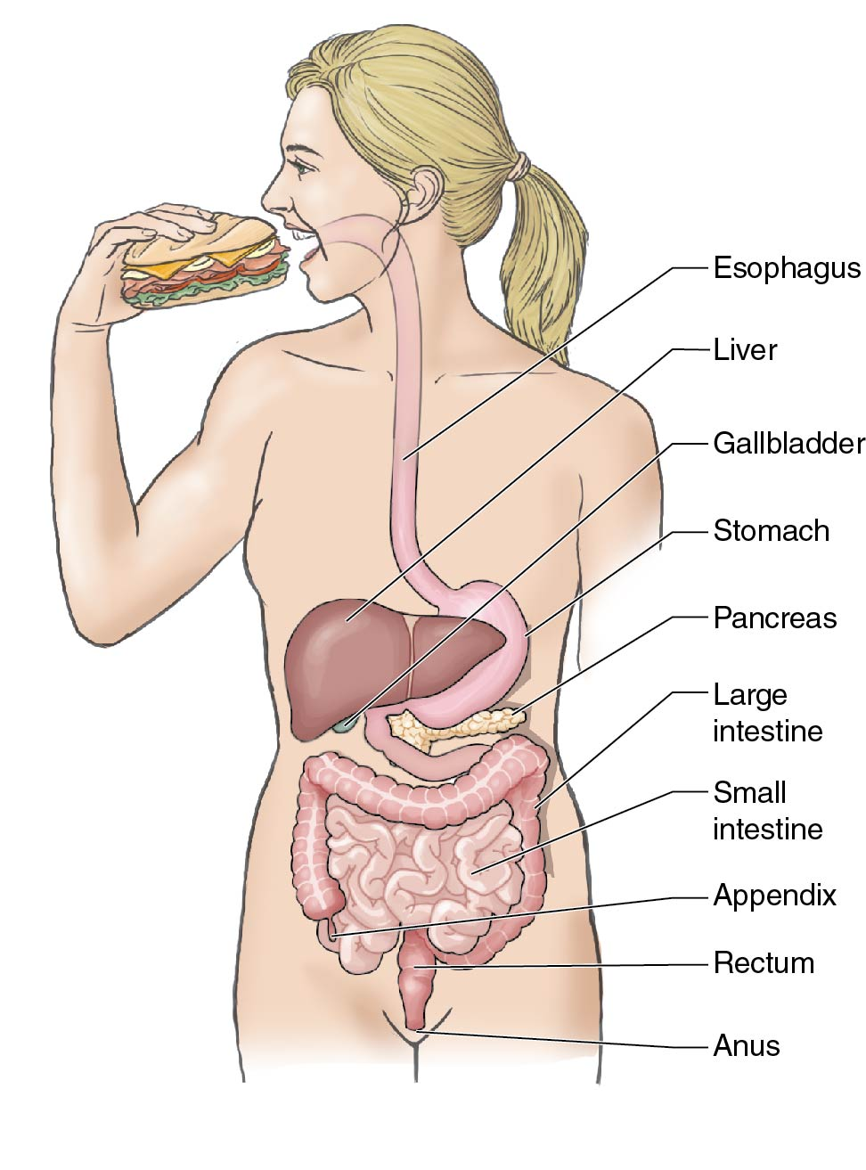
The Digestive System
The digestive system is the group of organs that break down the food you eat and get it to the cells for fuel.
Notes:
Figure 3.22

Slide 4
How Digestion Works (1 of 4)
Digestion is a complex process that involves many organs and actions.
This system is involved in digestion, absorption, and elimination.
(continued)

Slide 5
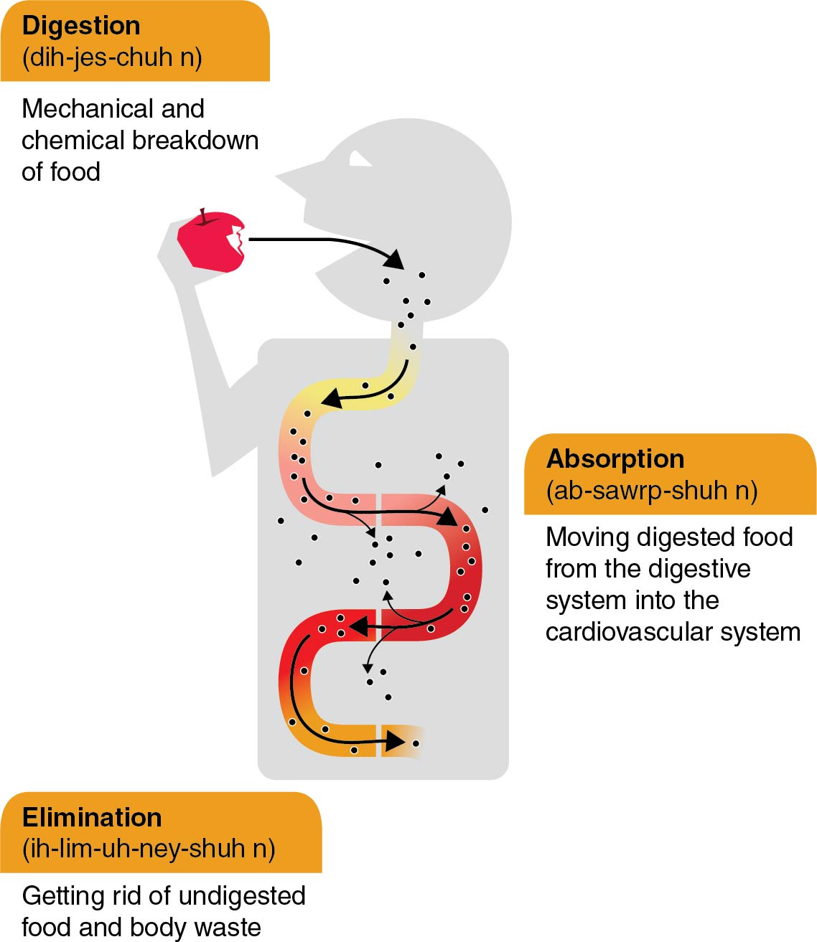
How Digestion Works (2 of 4)
(continued)
Notes:
Figure 3.23

Slide 6
How Digestion Works (3 of 4)
Chewing and swallowing
Chewing is the beginning of digestion.
Salivary glands produce saliva, which begins to break down carbohydrates.
Once swallowed, foods move through the esophagus toward the stomach.
Mixing, storing, and moving foods
The stomach mixes foods with gastric juices, such as hydrochloric acid and pepsin, to chemically break down foods.
The partially digested food produced is called chyme.
(continued)

Slide 7
How Digestion Works (4 of 4)
Absorbing nutrients
Chyme moves from the stomach to the small intestine, where most of the actual work occurs.
About 90 percent of all nutrients are absorbed as food travels through the small intestine toward the large intestine.
Absorbing water and eliminating waste
The large intestine’s primary job is to absorb the remaining water, salts, and vitamins and to eliminate the waste.

Slide 8
Your Gut Bacteria
Your digestive system is home to about 100 trillion (100,000,000,000) bacteria (both good and bad).
Good bacteria help break down the nutrients you eat and protect you from infections.
Your digestive health, the balance of your stomach acid, and your good and bad bacteria are called your gut health.

Slide 9
Prebiotics and Probiotics
The bacteria in your system are living organisms and need fuel to survive.
Prebiotic foods feed the bacteria in your gut.
Examples include bananas, garlic, onions, radishes, carrots, and tomatoes.
Probiotics are the living bacteria found in foods.
Foods high in probiotics include fermented foods and drinks, such as some pickles and sauerkraut, tempeh, kefir, and kombucha, as well as Greek yogurt.

Slide 10
Short-Term Challenges to Digestive Health
Digestive problems can be short term and relate to how your system functions.
Problems can develop in one of the organs in the digestive system.
Some conditions include
indigestion, constipation, gas, vomiting, heartburn, diarrhea, ulcers, and hemorrhoids.

Slide 11
Long-Term Challenges to Your Digestive Health
There are more serious things that can harm the health of your digestive system.
Some of these conditions are genetic. Others relate to eating habits, other diseases, or medications.

Slide 12
Digestive System Conditions
Condition or disease | Description | Cause
Colitis and Crohn’s disease | Both diseases cause swelling in the colon or small intestine | Unknown; could be partly genetic and made worse by stress or diet
Cirrhosis | Damage and scarring of the liver | Alcoholism or diseases that damage the liver
Colon cancer | Cancer in the large intestine; often begins as polyps, or noncancerous growths, in the colon | Genetics or unknown cause; diet and lifestyle play a role
Lactose intolerance | Inability to fully digest lactose (a form of sugar in milk) | Occurs when small intestine does not make the enzyme needed to digest lactose
Irritable bowel syndrome | Occurs when the colon does not function normally; results in severe cramping, gas, diarrhea, and constipation | Could be caused by disruptions to muscle or nervous system in the colon or by infection
Notes:
Table 3.2

Slide 13
The Urinary System
The urinary system removes liquid from the body.
The system is made up of two kidneys and two ureters, the bladder, and the urethra.
The primary purpose of the urinary system is filtering and cleaning.

Slide 14
When Things Go Wrong With Urinary Health (1 of 2)
Urinary tract infections (UTIs)
Most people with UTIs experience a burning pain when going to the bathroom.
Kidney stones
They are small, stone-like deposits in the urinary system made of minerals and salts that have been removed from the blood.
Passing a kidney stone is often very painful.
(continued)

Slide 15
When Things Go Wrong With Urinary Health (2 of 2)
Kidney disease
It is when a person’s kidneys gradually lose function.
It cannot be cured. Treatments try to prevent the disease from getting worse.
People with advanced cases of kidney disease must have artificial machines filter their blood for them. This process is called kidney dialysis.

Slide 16
Maintaining Good Digestive and Urinary Health
There are several ways you can avoid digestive and urinary problems.
Eat foods high in fiber.
Stay hydrated by drinking plenty of water.
Exercise regularly.
Eat on a regular schedule.
Eat prebiotic and probiotic foods regularly.
Manage your stress.

