Slide 1
Lesson 3.3 Tips and Tools for Eating Well
Chapter 3

Slide 2
Write About It
How often do you read a food label when you are choosing what to eat?
Have you ever asked to see the nutrition information when eating at a restaurant?
Why do you think you do or do not use these tools to help you make decisions?

Slide 3
Building a Healthy Diet
The combinations of nutrients you eat and the way you eat is called your diet.
You can think of balance, variety, moderation, and adequacy as the four pillars or legs of a table.
All four are needed for the table to be strong and to do what it is supposed to do.

Slide 4
The Four Keys to a Healthy Diet
Balanced: A diet has balance if it has enough carbohydrate, fat, and protein to meet your body’s needs.
Varied: A diet has variety if it includes lots of different foods.
Moderate: Not eating too much of any one thing means your diet is moderate.
Adequate: Your diet is adequate if you get enough calories and nutrients to stay healthy.

Slide 5
Accessing and Using Nutrition Information
Not all nutrition information from the Internet is accurate.
Inaccurate information that is based on feelings and opinions more than on facts is called biased information.
Some websites might also try to sell you vitamin and mineral supplements with inaccurate information.
The goal of these sites is to get your money, not to make you healthier.

Slide 6
Dietary Guidelines for Americans
The Dietary Guidelines for Americans help us understand what we need to do to eat healthy.
These guidelines are based on research and are updated every five years.

Slide 7
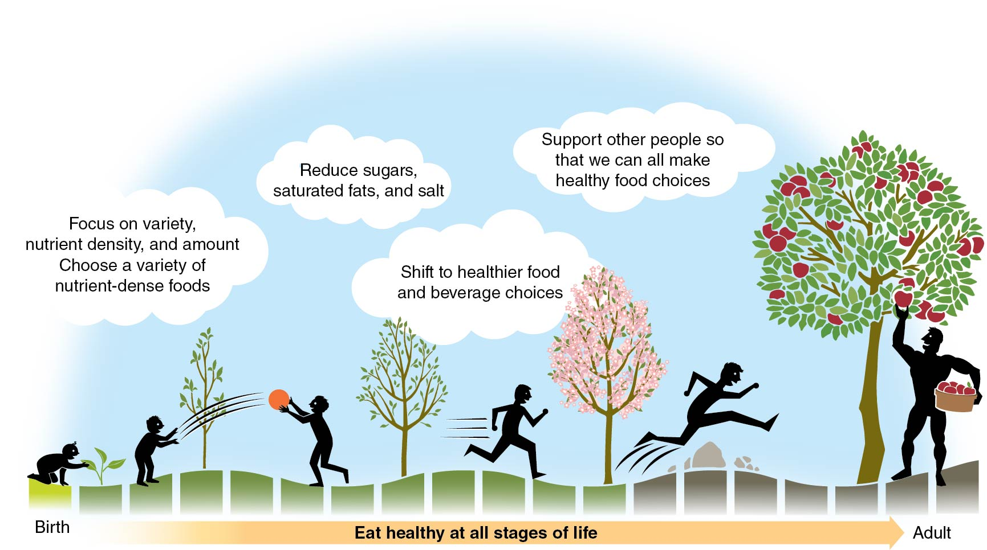
Key Ideas in the Dietary Guidelines for Americans
Notes:
Figure 3.17

Slide 8
Reading Food Labels (1 of 3)
Nutrition facts labels are a great tool you can use to choose healthy foods.
This is a label found on all food products that provides you with important nutrition information.
(continued)

Slide 9
Reading Food Labels (2 of 3)
Use these components of a nutrition label to make healthier food choices.
Serving size: Shows how much of this food is normally eaten
Servings per container: Shows the total number of servings in the entire food package or container
Calories: Tells you how many total calories are in one serving of the food
% Daily Value: Shows how much each nutrient listed contributes to the daily diet
(continued)

Slide 10
Reading Food Labels (3 of 3)
All labels are required to tell you the amount of added sugars in the product.
Added sugars are sugars added to foods during processing or packaging.
The ingredients list is not part of the nutrition facts label, but it is also a helpful tool.
Ingredients are listed by weight, so the ingredient that is most common in the food by weight is listed first.

Slide 11
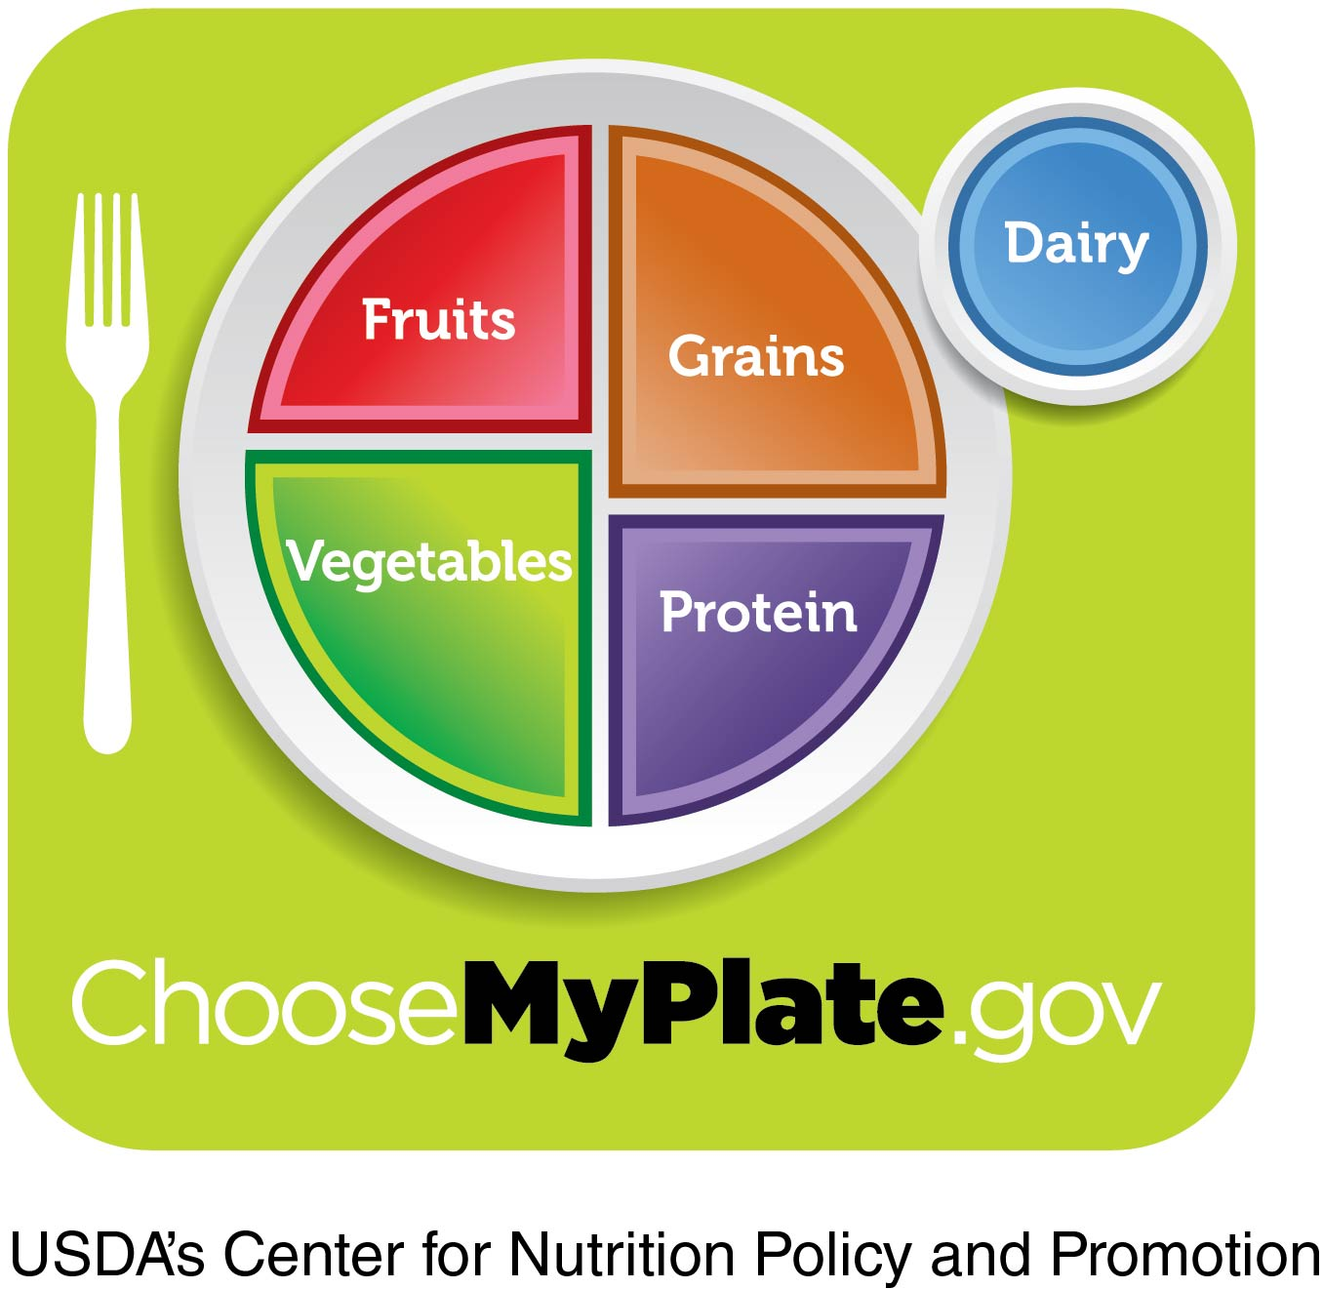
MyPlate (1 of 2)
MyPlate is a graphic tool and website designed to help you make healthy food choices.
(continued)
Notes:
Figure 3.19

Slide 12
MyPlate (2 of 2)
MyPlate can help you make healthier choices.
Helps you plan a balanced, nutritious meal
Includes information about how much of each food group to eat
Can help you balance your calories and get the right types of foods

Slide 13
Other Sources of Nutrition Information (1 of 2)
Dietitians
They are professionals with the most training in nutrition who have a university education in nutrition.
Dietitians have a professional license.
Medical doctors, school nurses, and health and physical education teachers may also be reliable resources.
(continued)

Slide 14
Other Sources of Nutrition Information (2 of 2)
Organizations focused on helping people with a disease or disorder often provide nutrition advice.
The American Heart Association
The American Diabetes Association
The American Cancer Society
Be careful when taking information from nutritionists.
People who claim to be nutritionists may not have been trained at a university and could be more interested in making money.

