Slide 1
Lesson 3.1 Understanding Foods and Nutrients
Chapter 3

Slide 2
Write About It
What do you drink when you are thirsty, and how do you decide what to drink?
Explain your answer using three circumstances and situations.

Slide 3
Nutrients
Nutrients are the substances found in food that your body needs to survive.
Each nutrient plays a different role.
Nutrients help keep you healthy, help you grow, and give you the energy you need to move.
Nutrients are grouped into six categories.

Slide 4
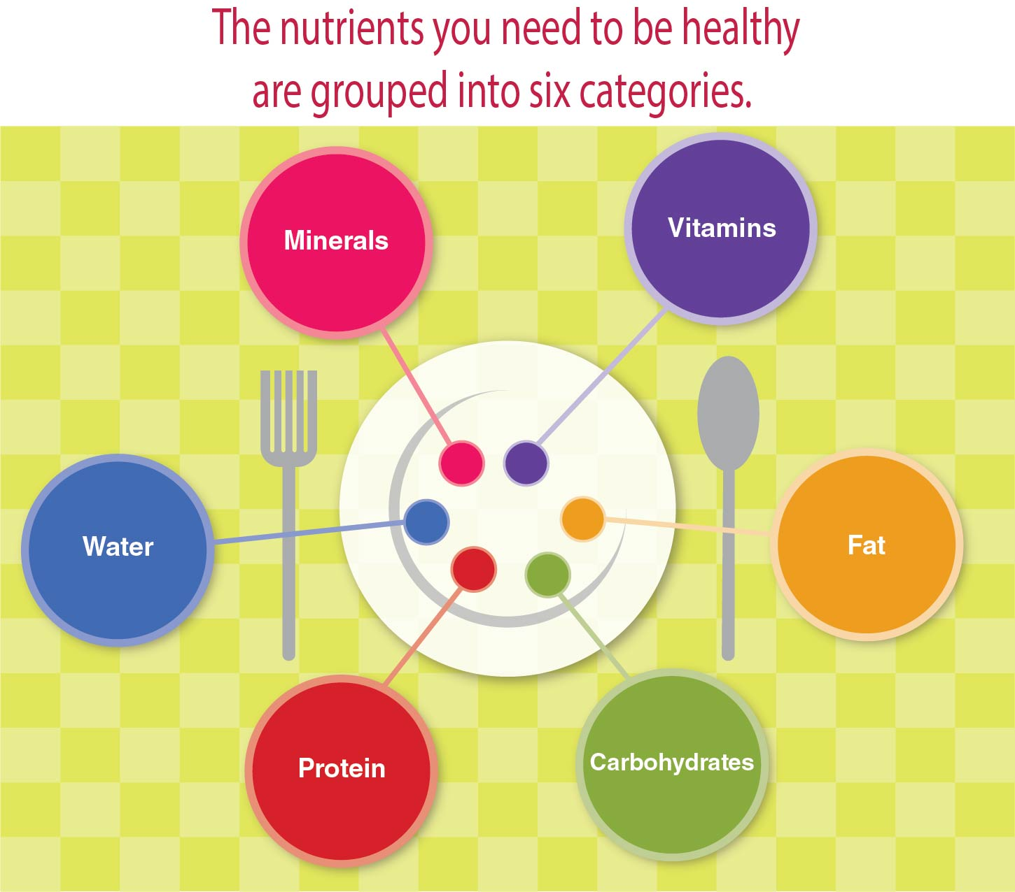
Six Categories of Nutrients
Notes:
Figure 3.1

Slide 5
Energy Nutrients and Foods
Calories are the form of energy found in foods.
It is important to eat enough calories from the right types of foods.
Nutrients that give us calories are
carbohydrates,
fats, and
proteins.

Slide 6
Carbohydrates (1 of 2)
They are our body’s main source of energy.
There are two types of carbohydrates.
Simple carbohydrates, also called simple sugars, can come from fruits and milk.
Complex carbohydrates, also called starches, can come from bread, pasta, potatoes, and rice.
(continued)

Slide 7
Carbohydrates (2 of 2)
Healthy carbohydrates contain fiber.
Fiber is found in plant foods, such as fruits, vegetables, and whole grain foods.
Fiber is hard for the body to digest, so it helps to clear out things such as cholesterol from the digestive system.

Slide 8
Fats
Fats are used to make hormones and serve as carriers for other substances in the blood.
Fat also protects organs and keeps your body warm.
Some fats are better than others.
Fat from plants is considered healthier than fat from an animal.

Slide 9
Proteins
Proteins are substances found in food that provide calories and help build and repair tissues.
Proteins are like building blocks.
Complete proteins found in animal products (eggs, meat, and cheese) have all the building blocks you need.
Incomplete proteins come from other foods and are missing one or more building blocks.

Slide 10
Vitamins and Minerals (1 of 2)
Vitamins and minerals are small substances found in foods that are essential for life.
Vitamins and minerals have no calories, so they don’t provide energy.
Vitamins and minerals work as helpers to get the energy out of carbohydrates, fats, and proteins.
(continued)

Slide 11
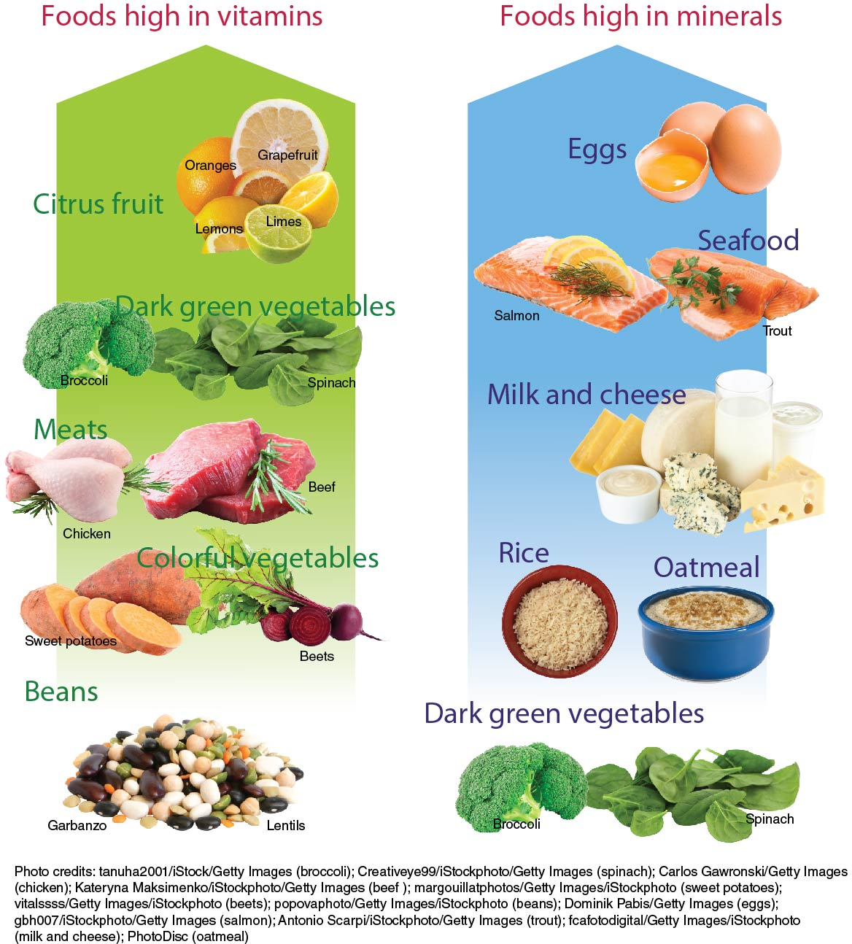
Vitamins and Minerals (2 of 2)
Notes:
Figure 3.7

Slide 12
Water
Water is essential for life.
Water carries nutrients around in the body and keeps the body at a constant temperature.
The body is made up mostly of water.
Water should be the main fluid in your diet.
Drinks such as coffee, sport drinks, and energy drinks can have unnecessary or even dangerous levels of sugar and caffeine.

Slide 13
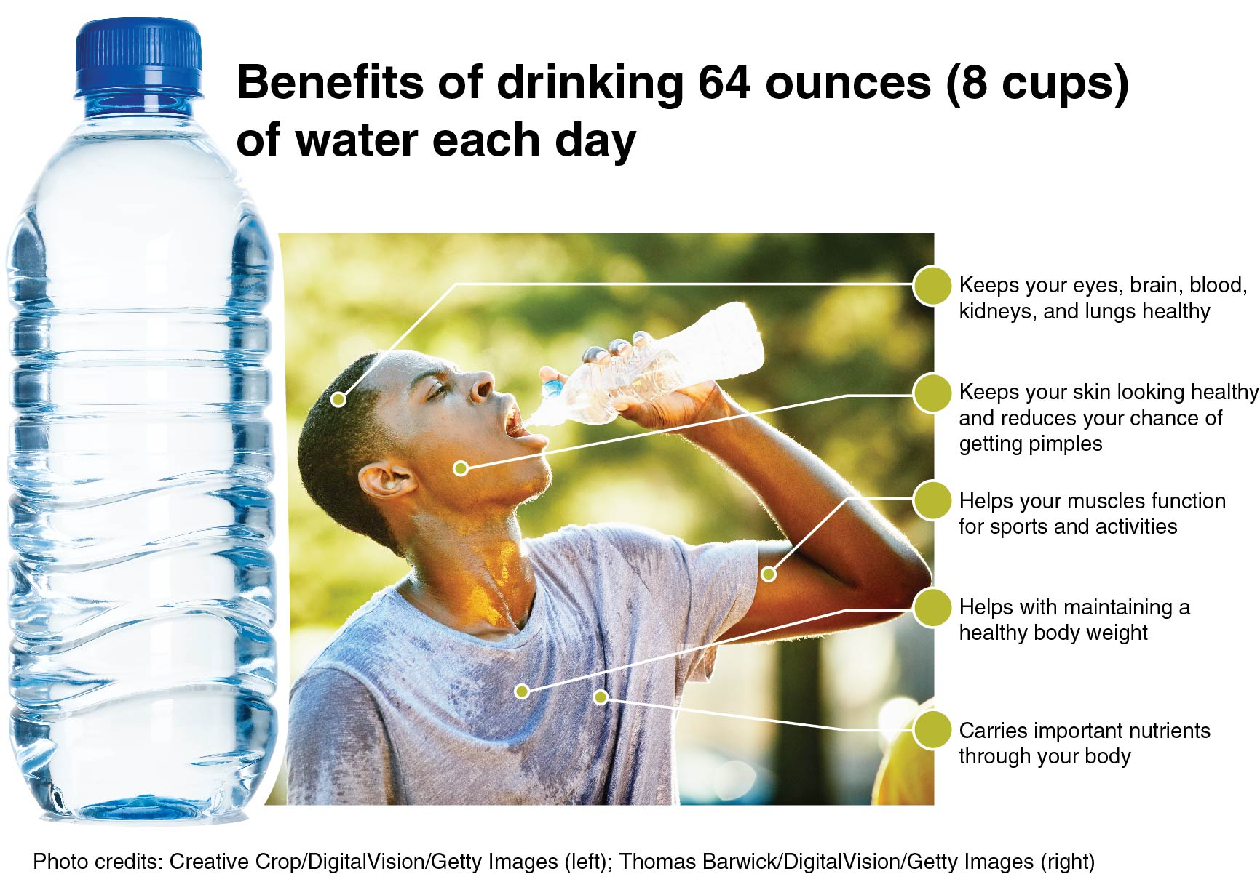
Benefits of Drinking Water
Notes:
Figure 3.8

Slide 14
Drinks High in Sugar
Drinks high in sugar, sodium, or caffeine are not healthy choices for getting the water you need.
Sodas can be the biggest source of sugar in your diet.
Sugar can lead to cavities in your teeth, a risk of type 2 diabetes, or weight gain.
Drinks high in sugar are described as empty-calorie foods because they have no real nutritious value.
High sugar drinks can also keep you from eating healthier foods, such as fruits and vegetables.

Slide 15
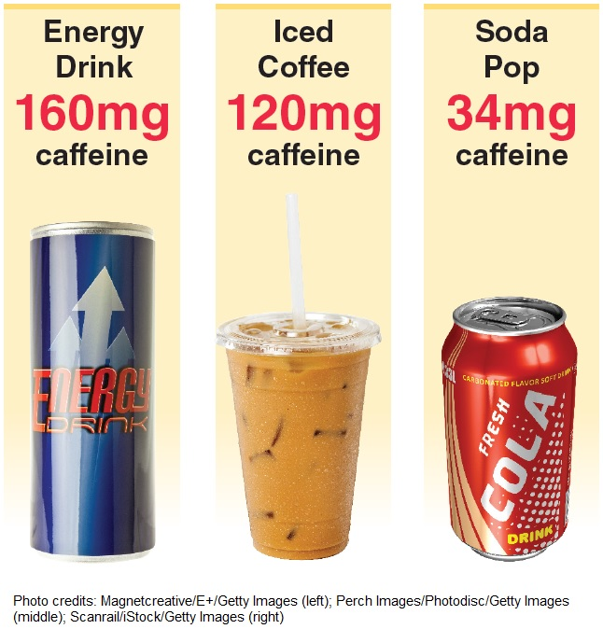
Energy Drinks
Notes:
Figure 3.9

