Slide 1
Lesson 2.4
Healthy Sleep and Rest
Chapter 2

Slide 2
Write About It
How many hours of sleep did you get last night?
What things help you get a good night’s sleep?
What things make it harder for you to sleep?

Slide 3
Understanding Sleep (1 of 2)
We all need to get a good quality of sleep each night.
  Good-quality sleep is sleep that is long enough, peaceful, and deep.
  An adequate amount is enough to help you function properly throughout the day.
  If you wake up feeling refreshed and well rested, you probably got a good quality of sleep. If you find yourself feeling sleepy during the day, you probably did not.
  If you don’t get enough good-quality sleep each night, you will become sleep deprived.
(continued)

Slide 4
Understanding Sleep (2 of 2)
When you sleep, your body is unconscious. This means that your body is inactive and without awareness even though your brain is still very active.
  Some scientists believe that your brain uses sleep to recover from stress, solve problems, and replenish important chemicals it needs to function.
  The truth is, we don’t fully understand everything that happens when we sleep.

Slide 5
The Importance of Sleep
Benefits of a good night’s sleep
  Helps the body heal and stay healthy
  Reduces risk of heart attack, stroke, and cancer
  Helps the body with growth and development
  Improves alertness and concentration
  Reduces depression and enhances mood
  Improves memory and productivity
  Increases alertness and reduces risk of accidents
  Helps metabolism and can help control weight

Slide 6
Getting Enough Sleep
Everyone’s need for sleep will vary, and your needs will differ depending on your age. Teenagers need a lot of sleep to support growth and maturation.
  School age (6-12 years) = 9-12 hours
  Teenage (13-18 years) = 8-10 hours
  Adult (18+) = 7 or more hours

Slide 7
What Happens When You Don’t Sleep Enough or Don’t Sleep Well?
Good-quality sleep doesn’t just help you feel your best; it also protects you from health conditions, diseases, and other challenges to good health.
  Research shows that 6 out of 10 middle school students don’t get enough sleep.
  Poor sleep can contribute to various health issues.

Slide 8
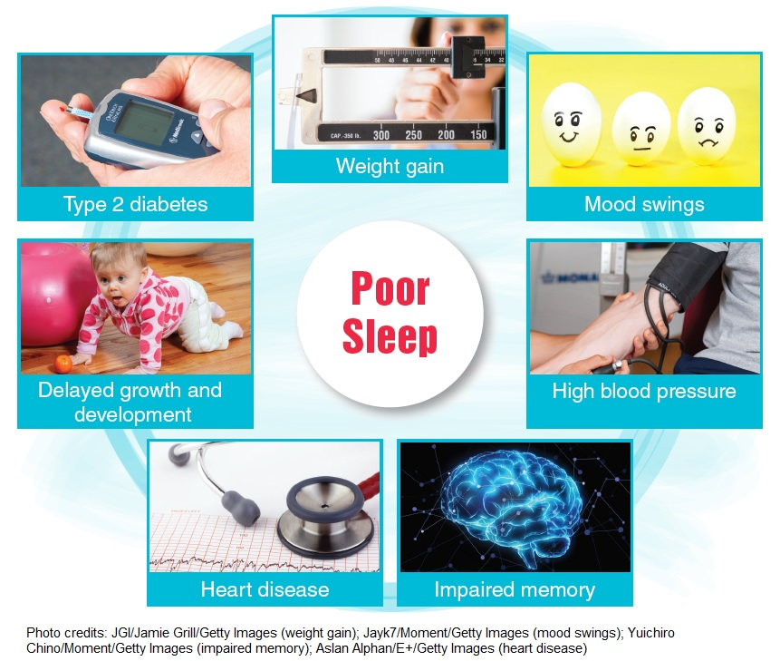
Problems Associated With Poor Sleep
Notes:
Figure 2.15

Slide 9
Common Sleep Problems (1 of 2)
It is not unusual to have problems sleeping now and then.
  Stress, anxiety, or excitement can keep us awake or disturb our sleep.
  Almost everyone experiences an occasional disruption to sleep.
  If your sleep is disrupted night after night, your body develops a sleep debt, and eventually your judgment, focus, and overall function will suffer.
(continued)

Slide 10
Common Sleep Problems (2 of 2)
Bed-wetting (accidentally urinating while sleeping)
Insomnia (not being able to fall asleep or sleep through the night)
Nightmares (scary dreams that can cause you to wake up)
Sleepwalking (getting out of bed and walking around while in a state of deep sleep)
Sleep apnea (stopping breathing for short periods of time during sleep)
Narcolepsy (falling asleep suddenly during the day)

Slide 11
Self-Management for Good Sleep (1 of 2)
You should plan for sleep just like you do other important parts of your life. Every day you should do these things:
  Take naps. Short naps can help improve mood, alertness, and performance.
  Get regular exercise. Daily exercise helps you sleep longer and deeper.
  Get natural light during the day. Natural light helps your biological clock work at its best.
(continued)

Slide 12
Self-Management for Good Sleep (2 of 2)
When preparing to sleep, do the following:
  Set and follow a sleep schedule. Going to bed at the same time each night and getting up at the same time in the morning helps your body get into a routine.
  Avoid stimulants (caffeine, screen time) before bed.
  Relax before bed. Reading a book or taking a bath can help you relax and fall asleep more easily.
  Create a quality sleeping environment (temperature, darkness, quiet, comfort). You will sleep best in a cool, dark, quiet space that is comfortable.

