Slide 1
Lesson 2.3 Healthy Vision and Hearing
Chapter 2

Slide 2
Write About It
How many hours did you spend wearing earbuds or headphones this week?
How many hours did you spend looking at a screen (your phone, television, tablet, or computer)?
Do you think these behaviors affect the health of your eyes and ears? Explain your answer.

Slide 3
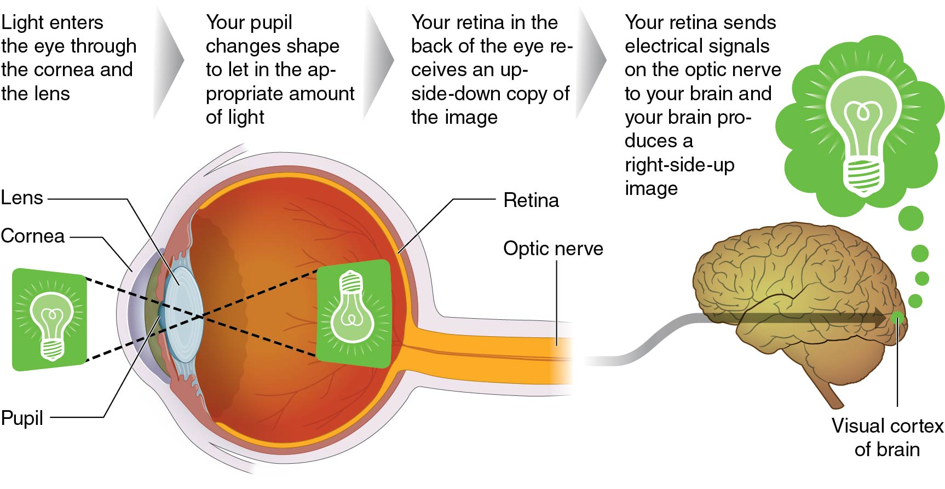
Your Eyes and How You See
Your eyes function similarly to how the camera on your cell phone works.
Notes:
Figure 2.10

Slide 4
Protecting Your Vision (1 of 2)
Whenever you are outside in the sun, it is important to wear sunglasses.
Good sunglasses will protect your eyes from any flying debris in the air (such as bugs, dirt, and gravel) and will also protect your eyes from harmful ultraviolet (UV) rays that can damage the shape of the cornea.
(continued)

Slide 5
Protecting Your Vision (2 of 2)
Eye strain is a form of fatigue that happens to your eyes when they must focus on a close-up object for long periods of time (for example, computer screens).
Best treatment for eye strain is to cut back on the hours of screen time you have each day.
Symptoms of eye strain include blurred vision; double vision; dry, red eyes; eye irritation; headaches; and neck or back pain.

Slide 6
Common Problems With Vision (1 of 2)
Nearsightedness (myopia)
Can see objects that are up close clearly but have a harder time seeing objects in the distance
Farsightedness (hyperopia)
A condition where light focuses behind the retina and objects that are up close are hard to see clearly
Astigmatism
Occurs when the light is not focused evenly on the retina, which makes objects appear blurry or distorted
(continued)

Slide 7
Common Problems With Vision (2 of 2)
Presbyopia
It means the lens of the eye becomes stiffer. Light isn’t focused as well, and it becomes harder to see objects up close.
Color blindness
It is a color vision deficiency that keeps a person from seeing colors in the way most people do
Red or bloodshot eyes
The eye surface is covered in blood vessels that expand when they’re irritated or infected.
Night blindness
A person has a hard time seeing in the dark.

Slide 8
Your Ears and How You Hear (1 of 2)
Your hearing allows you to listen to your favorite music, dance, and talk to your friends and helps you maintain your equilibrium, or balance.
Your ears are very complex organs that help you take in sound waves from the environment and convert them into things you recognize.
Your eardrum vibrates the sound waves into the middle ear, where three small bones further vibrate the sound waves into the cochlea in the inner ear.
(continued)

Slide 9
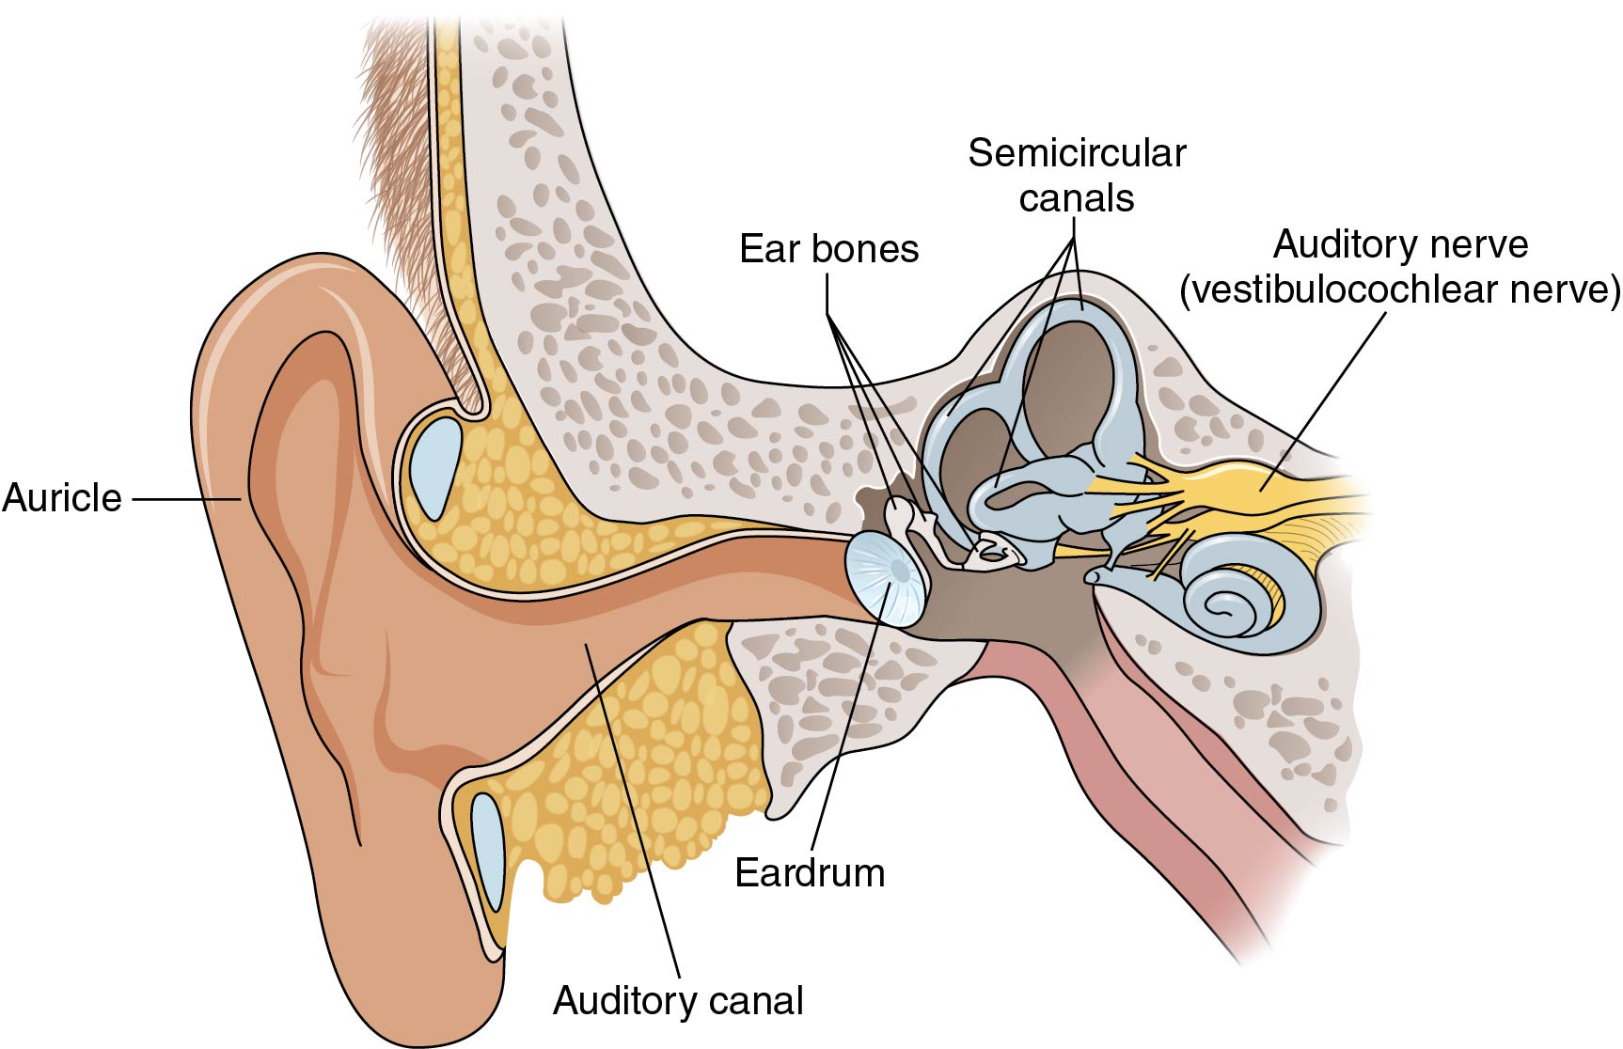
Your Ears and How You Hear (2 of 2)
Notes:
Figure 2.12

Slide 10
Protecting Your Hearing (1 of 2)
Avoid very high levels of noise, such as rock concerts and similar situations. If you do need to be in these situations, protect your ears.
It is important not to stick objects into the ears because you might puncture or damage the eardrum. This includes cotton-tipped swabs. You should clean only the outside of your ears.
Your regular medical exams will include inspection of your ears for earwax or signs of infection. If either is present, there are safe medicines that can be used to clean and heal the ear.
(continued)

Slide 11
Protecting Your Hearing (2 of 2)
If you lose all or part of your hearing, it is unlikely that you will ever get it back.
Most hearing loss is permanent.
Hearing aids can help restore some hearing in many situations.
It is important to protect your ears so that you limit the chances that you will experience hearing loss.

Slide 12
Social Norms and Listening Behaviors
Social norms (going everywhere with cell phone, earbuds in ears most of the day, etc.) act like unofficial rules or laws. We are influenced by social norms because we want to fit into a particular social group.
They may keep people from wanting to talk about, protect themselves from, or seek help for vision or hearing problems.
We can help limit social norms that are harmful by developing empathy for others. Empathy is when you understand and appreciate the feelings and emotions of others.

Slide 13
Hearing Loss
The most serious ear-related health issue is permanent hearing loss.
Conductive hearing loss occurs when sound is not being transmitted into the inner ear. Damage to the eardrum (a rupture or tear) is an example.
Sensorineural hearing loss occurs when there is damage to the auditory nerve itself and sound information from the inner ear is not passed to the brain properly.
It can be mild, moderate, severe, or profound.
It can come on suddenly or develop over time.

Slide 14
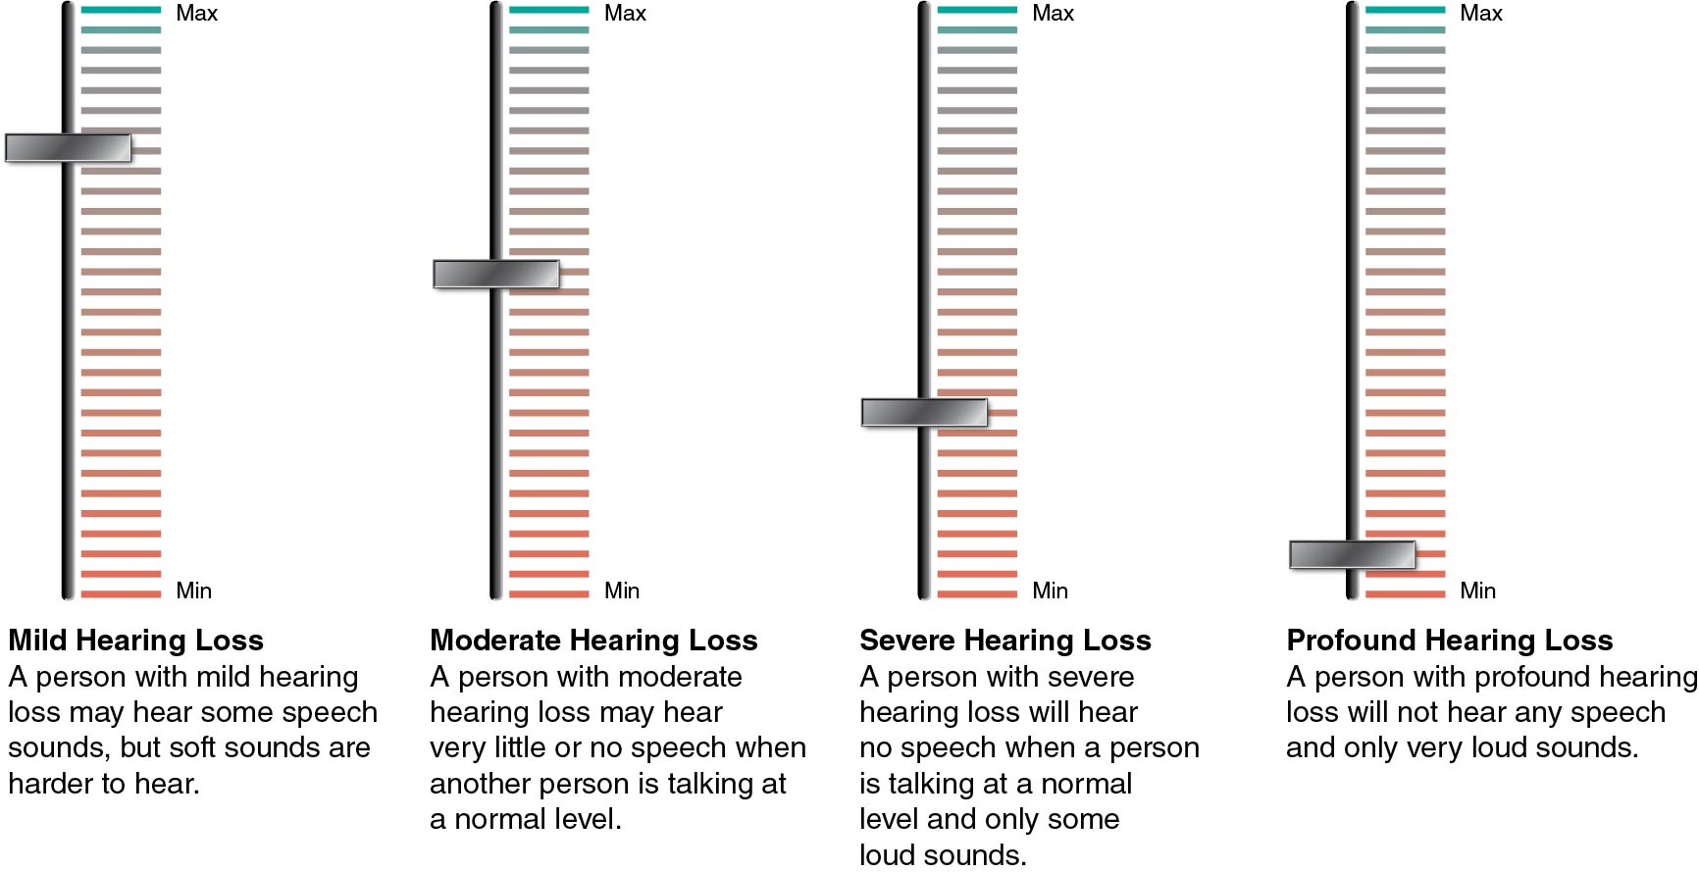
Degrees of Hearing Loss
Notes:
Figure 2.13

Slide 15
Tinnitus
A common hearing problem described as a ringing, buzzing, or other sound present in the ear
Most people experience some ringing in the ears at some point in their lives.
It can be caused by damage to some part of the middle or inner ear or by hearing loss itself.
Chronic, ongoing tinnitus occurs in about 1 in every 22 people, or 4.5 percent of the U.S. population.
Unfortunately, most tinnitus cannot be cured, but treatments include learning coping strategies and using distraction techniques.

