Slide 1
Lesson 1.5
Noncommunicable Diseases
Chapter 1

Slide 2
Write About It
What do you know about heart disease, cancer, or diabetes?
Do you know anyone with any of these diseases?
Make a list of things you know about each of these diseases.

Slide 3
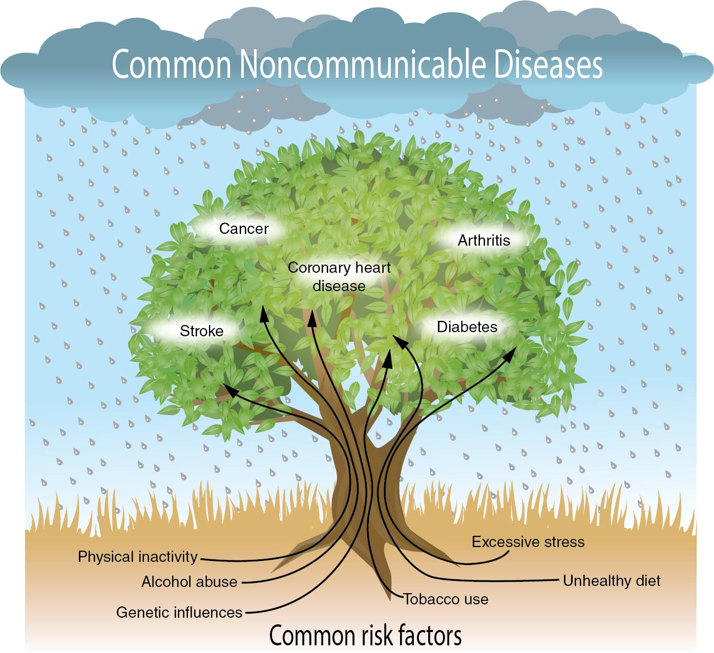
Noncommunicable Diseases
Notes:
Figure 1.21

Slide 4
Cardiovascular Disease
Coronary heart disease
  Atherosclerosis = clogged arteries
  Arteriosclerosis = hardened arteries
  Heart attack = loss of blood and oxygen to the heart
  Stroke = loss of blood and oxygen to the brain
  High blood pressure = increased pressure of blood in system

Slide 5
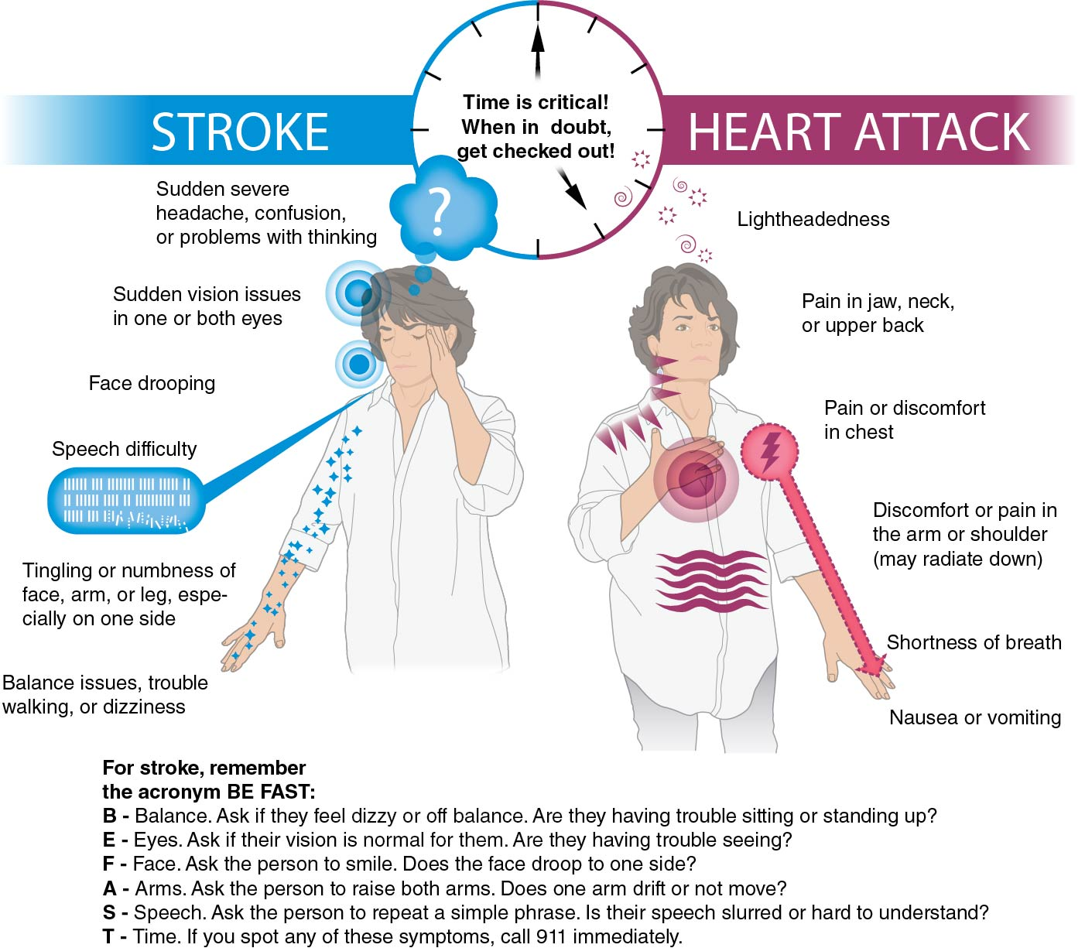
Warning Signs of Heart Attack and Stroke
Notes:
Figure 1.22

Slide 6
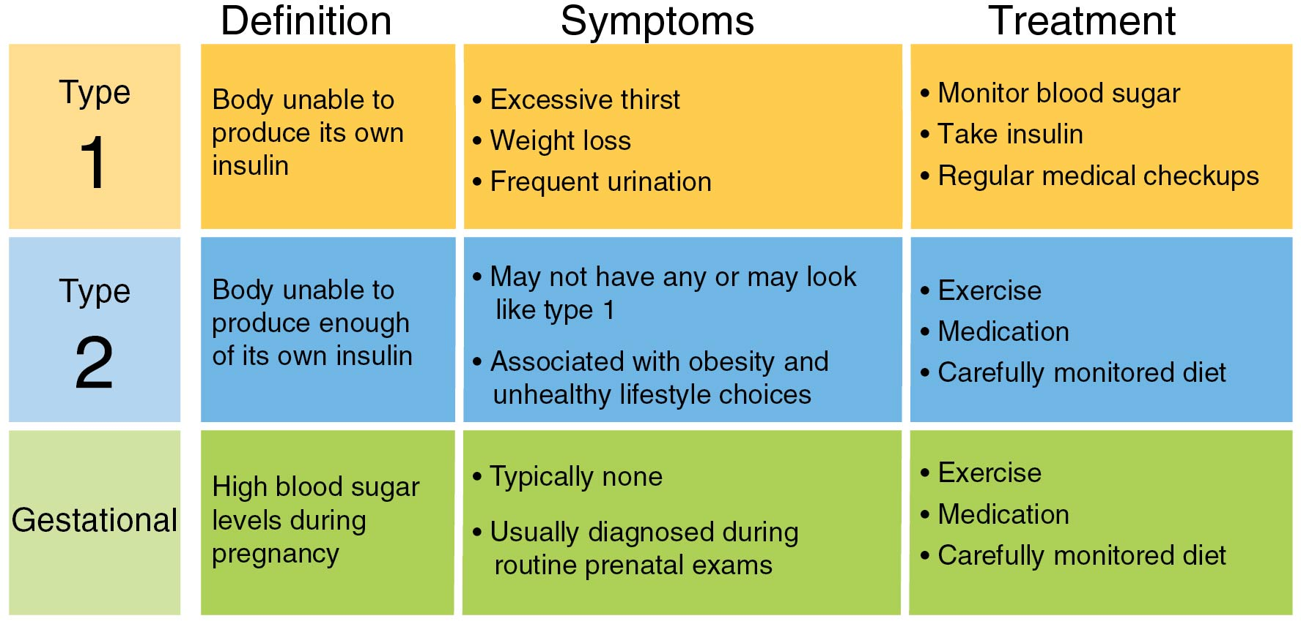
Diabetes
Notes:
Figure 1.23

Slide 7
Cancers
Uncontrolled growth of abnormal cells
Common cancers include
  breast cancer,
  colon cancer,
  leukemia,
  lung cancer,
  melanoma, and
  prostate cancer.

Slide 8
Preventing Skin Cancer
Seek shade, especially in the middle of the day.
Wear clothing that covers and protects your skin, such as hats, long sleeves, and long pants.
Wear a hat with a wide brim to protect your neck, ears, and face.
Wear sunglasses that block UVA (long-wave) and UVB (short-wave) sun rays.
Use sunscreen with a sun protection factor (SPF) of at least 15.
Avoid tanning indoors or outdoors.

Slide 9
Osteoporosis
Weakening of the bones
  Osteoporosis is caused by not making new bone or losing existing bone or both.
  Caucasian women are at highest risk.
  Teenagers with eating disorders are at higher risk later in life.

Slide 10
Arthritis and Lung Disease
Arthritis = swelling and damage to joints
  Over 100 different types
  Exercise, diet, and medications can help manage arthritis.
Lung disease = a variety of conditions that impact ability to breathe and use oxygen
  Asthma is one common form of lung disease.

Slide 11
Alzheimer’s and Dementia
Dementia = a loss of brain function over time
Alzheimer’s disease = the most common form of dementia
  Alzheimer’s disease is more common among women.
  High blood pressure or past head trauma increase risk.

Slide 12
Behavior Contracts
A behavior contract is an agreement you make with yourself to change a specific health behavior.
A behavior contract includes
  goals,
  deadlines (dates),
  plan or strategy to complete goals, and
  reward for completing goals.
Most behavior contracts are witnessed, or signed by, someone else.

