Slide 1
Lesson 1.4 Communicable Diseases
Chapter 1

Slide 2
Write About It
How often do you wash your hands each day?
Describe how you wash your hands.
Why do you think it is important to keep your hands clean?

Slide 3
Communicable Diseases
When a disease can spread between two people, it is said to be contagious.
Contagious diseases are also called communicable diseases.

Slide 4
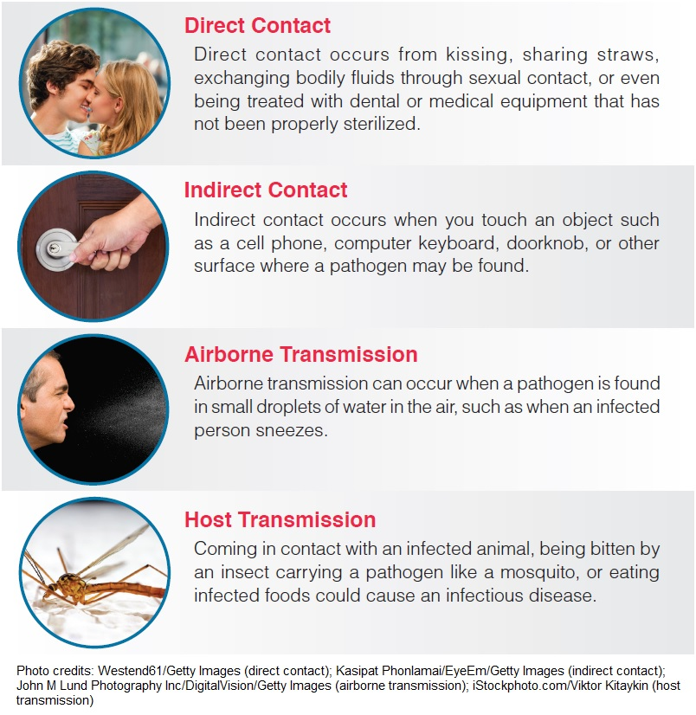
Methods of Transmission
Notes:
Figure 1.15

Slide 5
Preventing Communicable Diseases
Universal precautions are a set of specific steps that are taken to prevent diseases from spreading through blood and body fluid contact.
Other ways to prevent the spread of disease include
washing hands with soap and water,
covering face and nose when sneezing,
getting vaccinated, and
staying home if you are sick.

Slide 6
Types of Communicable Diseases
Bacterial infections
Lyme disease and tuberculosis
Viruses and viral infections
Flu, cold, mononucleosis, and conjunctivitis (pink eye)
Fungi and fungal Infections
Athlete’s foot
Protozoan infections
Malaria

Slide 7
Communication: Tips for Being Assertive
1. Use “I” statements.
2. Practice saying no.
3. Practice what you want to say.
4. Watch your body language.
5. Check your emotions.

