Slide 1
Lesson 1.3
Your Immune System
Chapter 1

Slide 2
Write About It
When was the last time you were really sick?
What type of illness did you have?
Why do you think you got sick?
What did you do to try to feel better and to get healthy again?

Slide 3
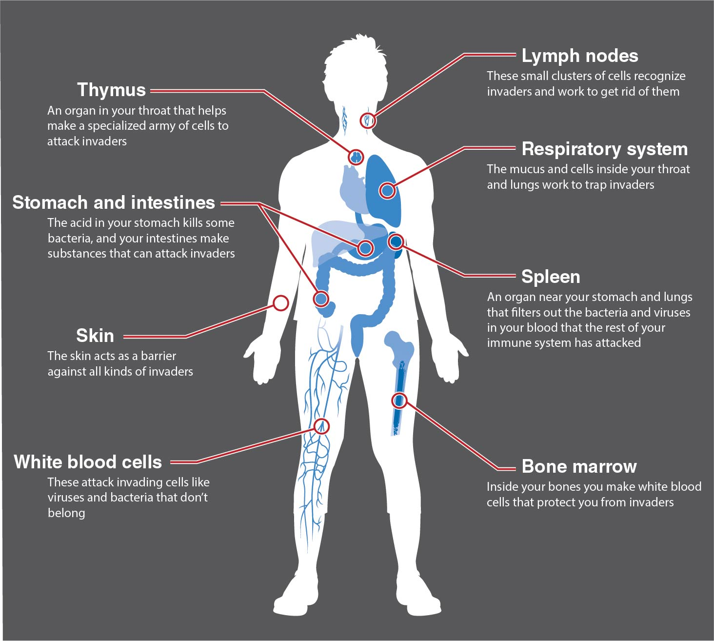
Your Immune System
Notes:
Figure 1.9

Slide 4
Types of Pathogens (1 of 2)
Anything foreign that enters your body and can cause disease is called a pathogen.
The most common forms of pathogens are viruses and bacteria.
(continued)

Slide 5
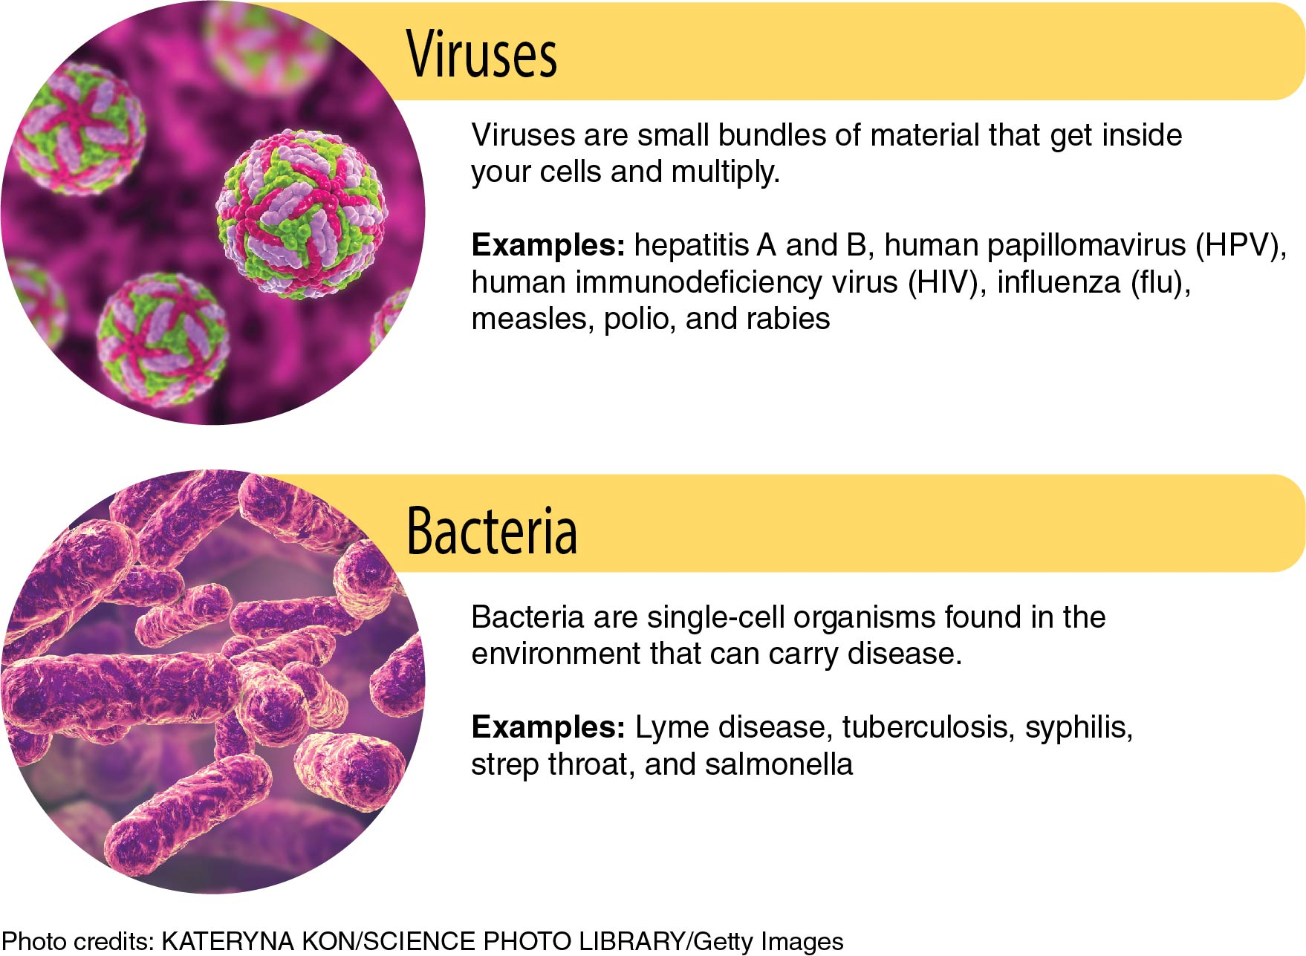
Types of Pathogens (2 of 2)
Notes:
Figure 1.10

Slide 6
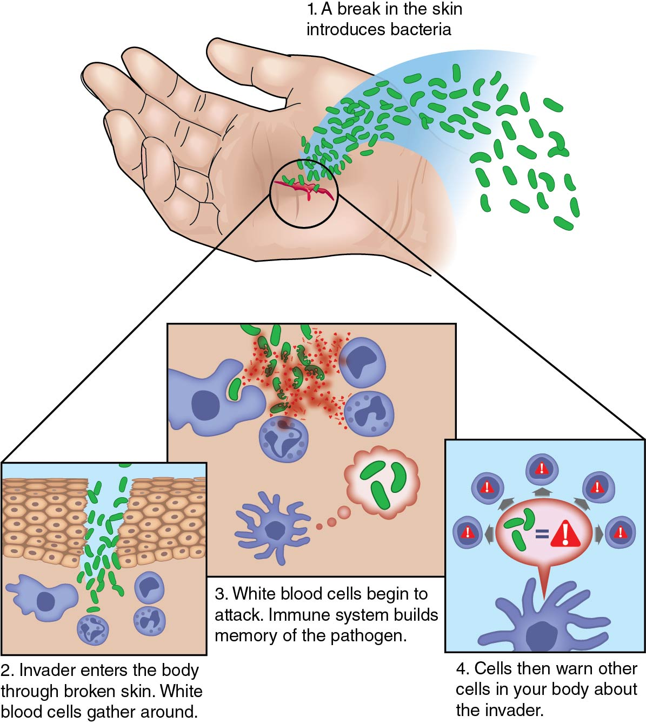
The Immune Response
Notes:
Figure 1.11

Slide 7
Keeping Your Immune System Healthy
Eat foods rich in vitamins and minerals, such a fruits and vegetables.
Get at least 30 minutes of exercise most days of the week.
Get 8 to 10 hours of sleep every night.
Wash your hands regularly.
Keep up with your vaccinations.
Keep your weight healthy.
Don’t drink too much alcohol.
Don’t smoke.
Manage your stress through relaxation, exercise, and social support.

Slide 8
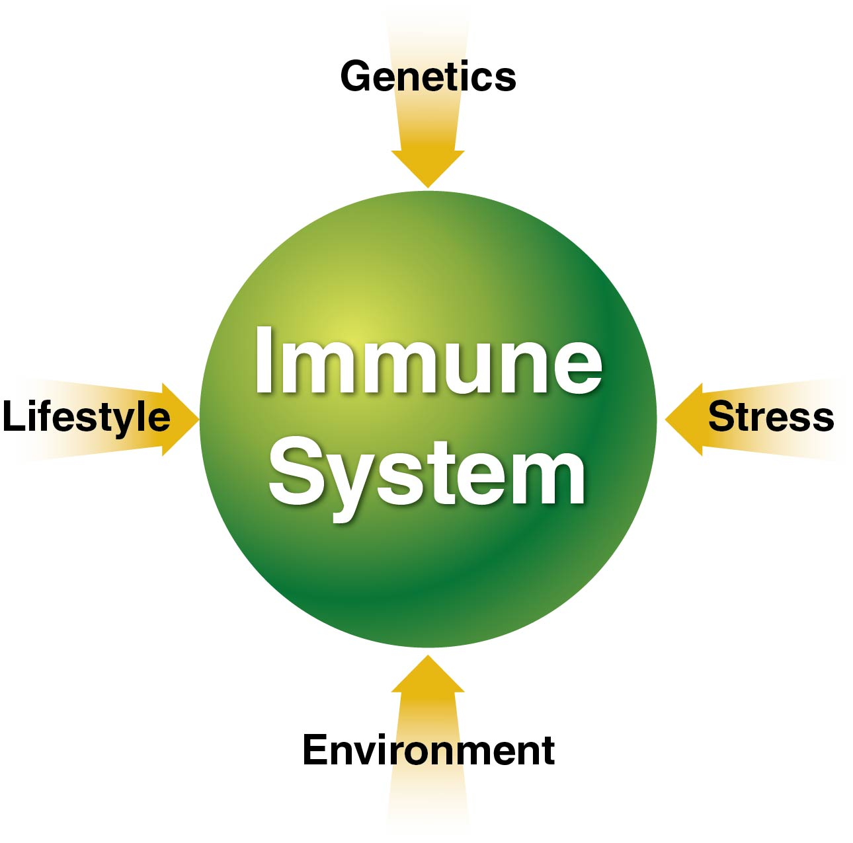
Influences on Your Immune System
Notes:
Figure 1.12

Slide 9
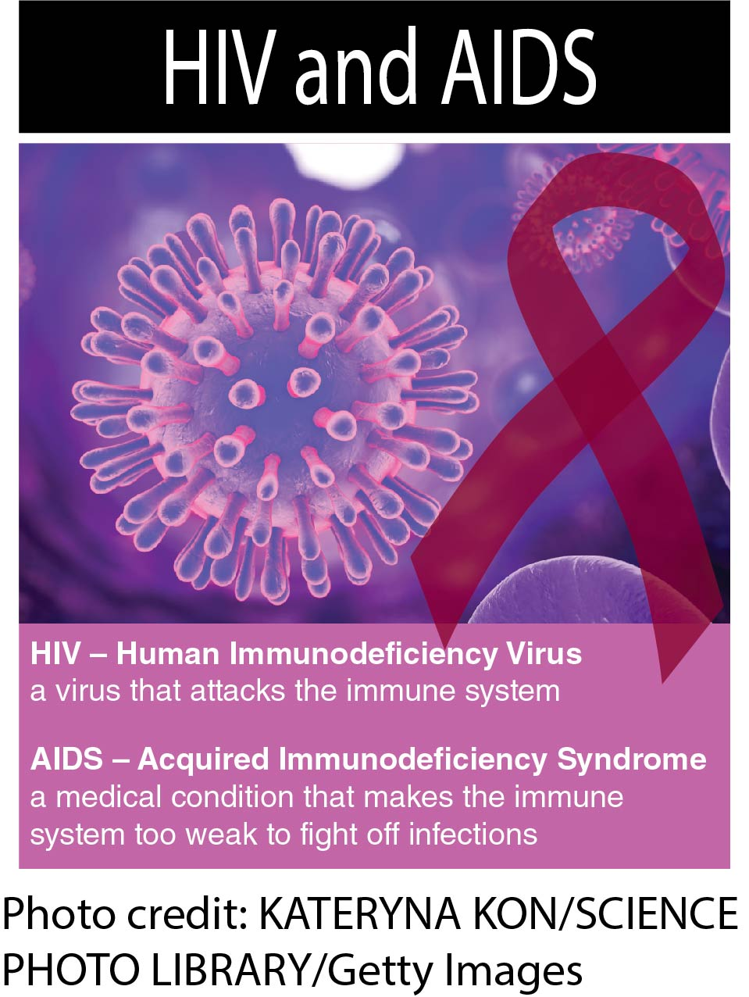
HIV and AIDS
AIDS is the sixth leading cause of death among young people ages 25 to 44.

Slide 10
Problems With the Immune System
Your immune system can experience health problems of its own.
  Immune deficiency disorders, such as HIV
    Immune system is not strong
  Autoimmune disorders, such as rheumatoid arthritis
    Immune system attacks parts of the body
  Allergic disorders
    Immune system reacts to things that normally don’t cause a response
  Cancers of the immune system (lymphoma)
    Immune system develops cancerous cells

