Slide 1
Lesson 1.1 Exploring Health and Wellness
Chapter 1

Slide 2
Write About It
Do you think that a person who has a disability can be healthy?
Why or why not?

Slide 3
Health, Wellness, and Disease
Health means that you are free of illness or disease.
Wellness is more than just being free from disease; it is the pursuit of making healthy choices in all parts of your daily life.
A disease is something that causes the body not to function properly.

Slide 4
Components of Wellness (1 of 2)
Mental and emotional
How you feel, connect with others, manage stress, solve complex problems, and deal with changes
Intellectual
How you do in school and engage in creative activities
Spiritual
Having a sense of purpose in life
(continued)

Slide 5
Components of Wellness (2 of 2)
Social
Finding meaningful connections with others and doing well in different social situations
Physical
Having the physical energy and ability to do daily activities, bounce back from being sick, cope with stress, and recover from injury

Slide 6
Disability
A disability is different from a disease or illness.
A person with a disability experiences a loss of function somewhere in the body.
It is important to provide accommodations to those with disabilities so that they can fully engage in all aspects of life.

Slide 7
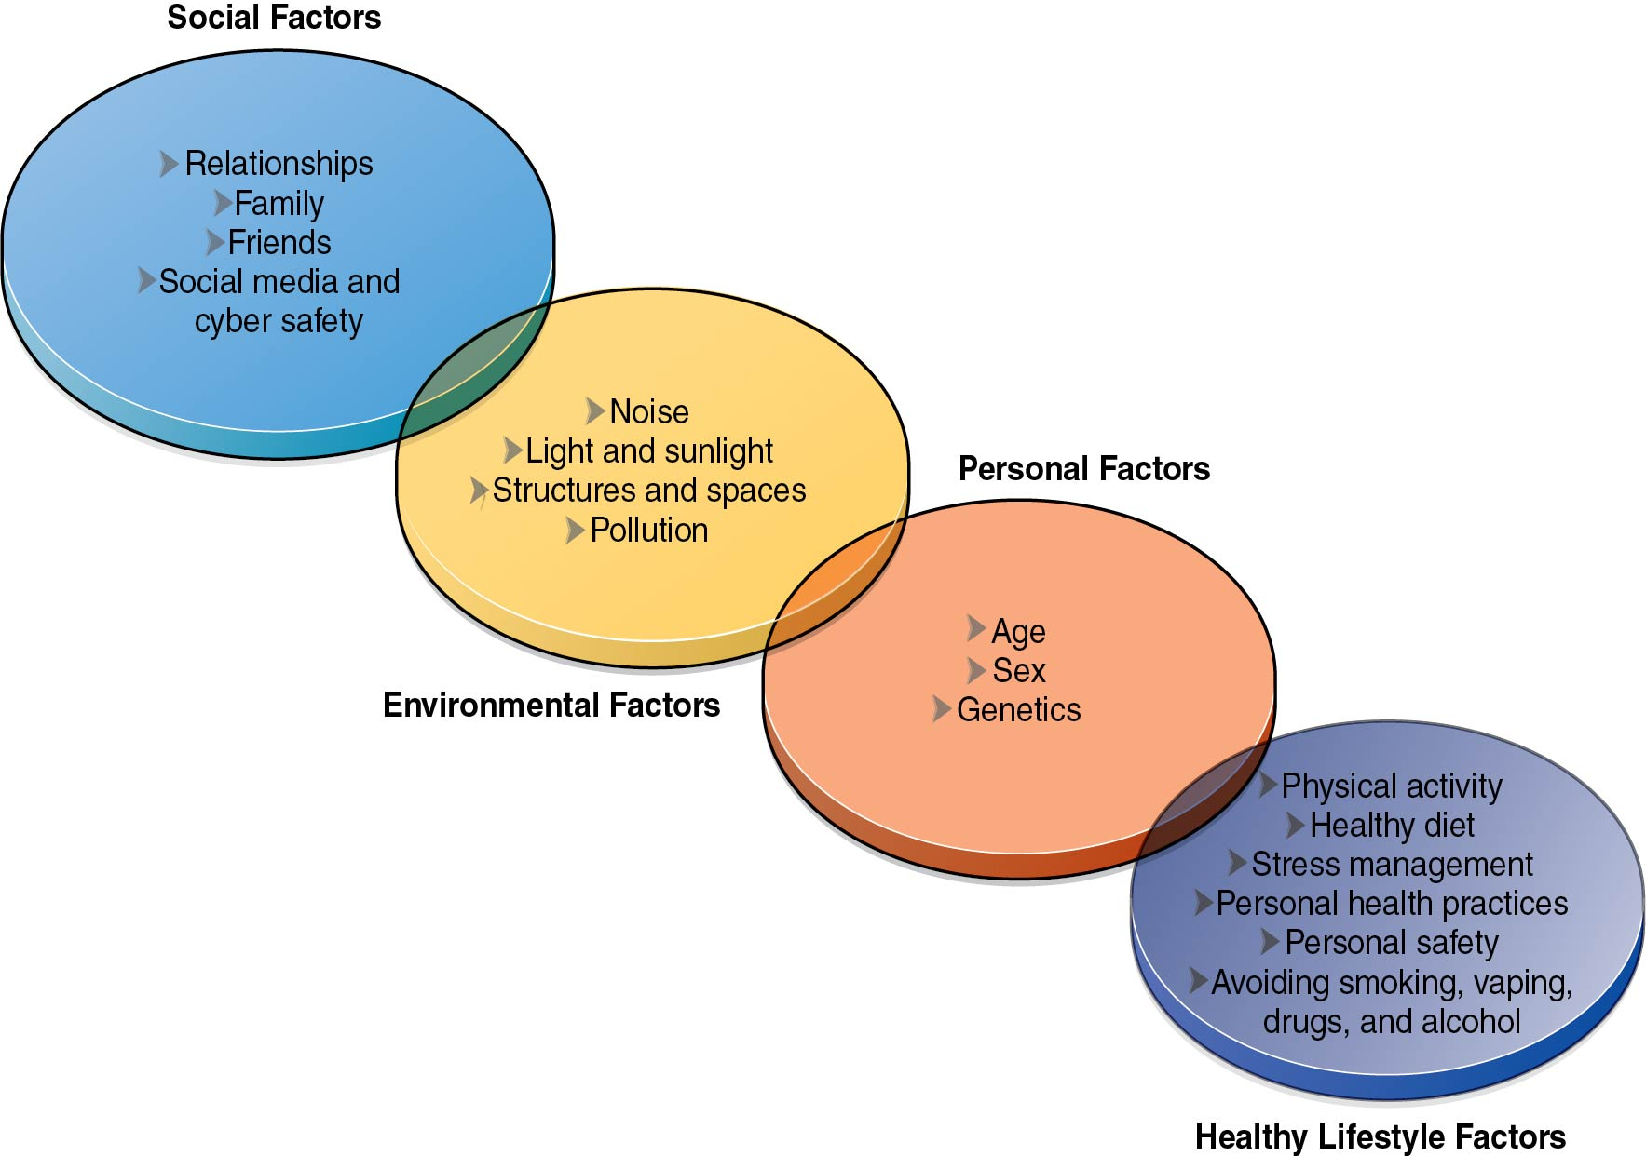
Factors That Influence Health
Notes:
Figure 1.2

Slide 8
Personal Influences on Health
Personal influences on your health are not things you can control.
Age
Heredity (genetics)
Biological sex
Heredity is the passing of characteristics from a parent to a child.

Slide 9
Environmental Influences on Health
Loud noises can harm hearing.
Sunlight can damage skin and cause cancer.
Pollution can influence respiratory health.
Access to open space, food, and medical care can impact all parts of your wellness.

Slide 10
Social Influences on Health
The people you socialize with influence your choices and your health.
If your friends take risks, you are more likely to.
If your friends exercise and eat healthy, you are more likely to do those things too.

Slide 11
Healthy Lifestyle Choices
Getting regular physical activity
Eating a well-balanced diet
Managing your stress and anxiety
Getting regular and adequate sleep
Practicing good hygiene and personal health
Avoiding dangerous situations and maintaining boundaries
Avoiding tobacco, vaping, alcohol, and drugs

