Slide 1
Violence, Weapons, and Gangs
Live Well: Comprehensive High School Health
Chapter 10, Lesson 4

Slide 2
Write About It
How do you feel about gun ownership?
Do you think guns help prevent or contribute to violent behaviors?

Slide 3
Can you . . .
Compare the risks associated with various types of weapons?
Describe the risks and consequences of gang involvement?
Explain how to avoid and report gang violence?
Analyze how public policies about weapons influence the health and safety of communities?

Slide 4
Youth Violence
Youth violence is any violent behavior between young people ages 10 to 24.
It includes fights, threats with weapons, gang violence, and bullying.
It is linked with lack of impulse and emotion control.
Youth violence also affects the larger community.
It creates a need for more emergency medical care, makes certain neighborhoods undesirable, and creates a greater burden for police and social service workers.

Slide 5
Weapons, Violence, and Risk
A majority of weapons are intended for legal activities like hunting or self-protection, but all weapons pose a risk to the user.
Firearms: Even when gun safety is followed, the presence of a gun increases the risk of accidental shootings, suicide, and homicide.
Knives: Knife wounds can cause serious injury and can be fatal.
Pepper spray: Designed to hold off an attacker, it can also get into the user’s lungs and eyes, making escape more difficult.

Slide 6
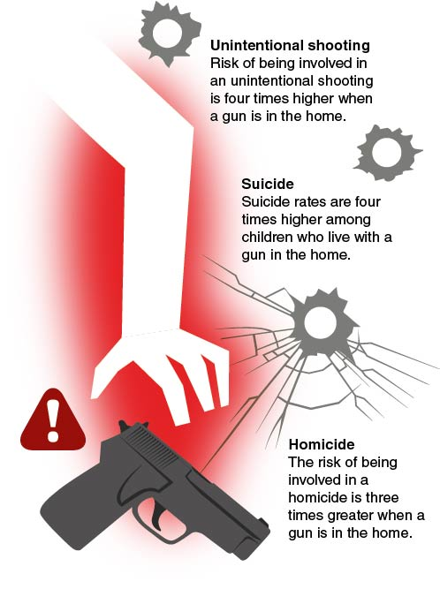
Risks Associated With Access to Firearms
Notes:
Figure 10.12 Risks associated with access to firearms.

Slide 7
Gang Violence
A gang is a group of people who commit violent and illegal acts.
Gangs may promise economic benefits (often from illegal activity) and claim to offer protection, friendship, and status.
Gangs are actually unsafe and dangerous because they involve violent, and often illegal, behavior.

Slide 8
Risks of Gang Violence
Level of influence | Factors
Individual | Illegal gun ownership, drug trafficking, aggression, alcohol or drug use, previous delinquency, previous victim of violence
Peer | Affiliation with gang members, friends who use drugs, strong friendships with delinquent peers
School | Poor performance, low motivation, negative labeling by teachers, lack of role models, low connection to school
Family | Parent or guardian drug or alcohol abuse, family members who are gang members, lack of role models, family violence or neglect
Community | High poverty, high crime, drug availability, firearm availability, cultural norms around gangs
Notes:
Figure 10.13 Risk factors of gang violence.

Slide 9
Consequences of Gang Violence
Consequences of gang membership can last a lifetime.
Gang members can be killed or seriously injured and often abuse drugs and alcohol.
Gang members are more likely to go to prison or become victims of violent crime themselves.

Slide 10
Avoiding Gang Violence
Young people can reduce gang violence by not joining a gang in the first place.
Joining clubs, sports teams, and student organizations or participating in after-school activities is a better way of belonging than joining a gang.

Slide 11
Reporting Gang Violence
If you feel pressured to join a gang, use refusal skills.
Use a strong voice and be clear that your answer is no.
Give a reason why you are saying no.
Walk away and go to a safe place, such as your classroom or home.
For help, call the National Center for Victims of Crime at 855-484-2846. You can also text or call the HopeLine at 919-231-4525 or 877-235-4525.

Slide 12
School Violence
School violence is any violence that happens on school property.
It can have consequences for education even if criminal charges are not filed.
Follow rules and policies at school.
Report suspicious activity and violence.
Suspicious activity is anything that seems out of place or doesn’t belong.

Slide 13
Skill-Building Challenge
Research federal and local laws related to owning and carrying weapons.
Describe these laws and how they might influence individuals’ behaviors and the health and safety of communities.
Use the information to create a two-minute speech that either supports existing laws or supports changing the laws.

