Slide 1
Bullying and Hazing
Live Well: Comprehensive High School Health
Chapter 10, Lesson 3

Slide 2
Write About It
Do you think teasing someone is the same as bullying? Explain your answer.

Slide 3
Can you . . .
Compare and contrast traditional bullying and cyberbullying?
Identify strategies for preventing all forms of bullying?
Describe how victims of bullying can seek help?
Explain how violating laws against cyberbullying may affect one’s future?
Compare and contrast bullying and hazing?
Identify long- and short-term consequences of participating in hazing?

Slide 4
Bullying
Bullying is a common occurrence in schools and online.
Bullying is any unwanted aggressive behavior by another youth or group of youths who are not siblings or dating partners.
Bullying involves perceived differences in power.
Bullying can be physical, emotional, or social.

Slide 5
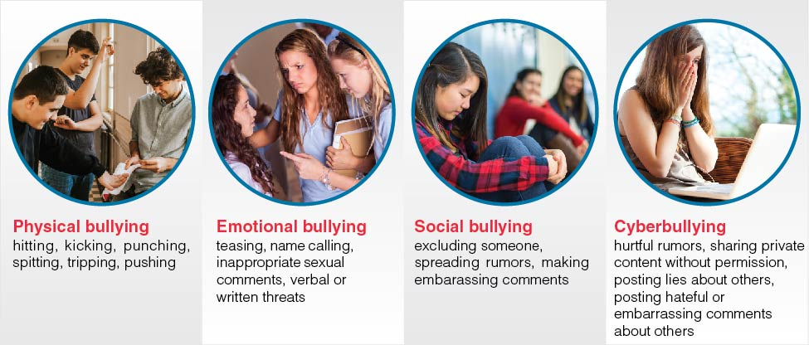
Types of Bullying
Notes:
Figure 10.8 Types of bullying.

Slide 6
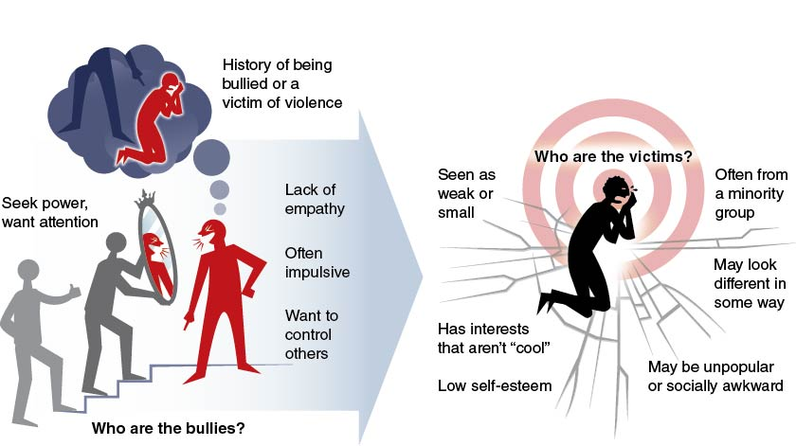
Influences on Bullying Behavior
Notes:
Figure 10.9 Characteristics of bullies and victims of bullying.

Slide 7
Consequences of Bullying
Consequences of bullying can be short- and long-term for the victim. They include the following:
  Fear
  Anxiety
  Difficulty concentrating
  Poor academic performance
  Depression
  Suicide

Slide 8
Recognizing Signs of Bullying
Victims of bullying may display signs such as:
  Anger and aggression.
  Feeling lonely and withdrawn.
  Feeling sad or being depressed.
  Feeling afraid and helpless.
  Fearing to go to school or be in social situations with their bully.

Slide 9
Responding to Bullying
Speak up and tell someone.
Ask the bully to stop.
Don’t respond; just walk away.
Avoid a physical confrontation.
Stay close to friends and adults.

Slide 10
Helping Others Who
Are Bullied
Say something to the bully.
Don’t bully back.
Be a friend to the victim.
Say something to other bystanders.
Tell an adult or someone in authority.

Slide 11
Cyberbullying
Cyberbullying is bullying that occurs through technology, such as by text or social media.
Electronic media are very fast, and damage can be done quickly.
People are more aggressive when they can “hide” online.
Cyberbullying can happen repeatedly over time.
It is definitely bullying; treat it as bullying.

Slide 12
Responding to Cyberbullying
Don’t join in on cyberbullying.
Reach out to the person being cyberbullied and offer support.
Block the person who is cyberbullying you.
Do not respond; it only brings on more bullying.
Take screenshots for proof of cyberbullying.
Consult the social media site for guidelines and policies on how to handle cyberbullying.

Slide 13
State Laws and Cyberbullying
All 50 states have some form of bullying legislation in place.
Many states allow cyberbullying to be reported anonymously.
Violating an order to stop cyberbullying can result in jail time and financial penalties.

Slide 14
Sexting, Child Pornography, and Cyberbullying
Sexting is when a person sends sexual or explicit images online or through social media.
A person who engages in sexting can be charged with distributing pornography.
If the individual in a shared photo is underage, then the sender could be charged with distributing child pornography.

Slide 15
Hazing
Hazing is any activity that is expected of someone joining a group that humiliates, degrades, abuses, or endangers them.
Unlike bullying, hazing is a ritual designed to include new members into a group.
Hazing includes the following:
  Verbally abusing or embarrassing the victim
  Assigning embarrassing tasks for victims
  Depriving victims of necessities like sleep or food
  Forcing victims to binge drink or play drinking games

Slide 16
Consequences of Hazing
Hazing rituals kill at least one person every year in the United States and cause injury or illness to many others.
Alcohol poisoning from forced drinking is the main cause of death and serious illness from hazing.
Victims also experience anxiety, depression, and other emotional consequences.

Slide 17
Skill-Building Challenge
Think about whether you are at risk for engaging in bullying or cyberbullying or becoming a victim of such behavior.
Write down as many positive and negative influences that you can think of that are related to your risk (individual, peer, family, media, technology, or societal).
Place a plus sign beside each positive influence and a negative sign beside each negative influence.

