Slide 1
Understanding Violent Behavior
Live Well: Comprehensive High School Health
Chapter 10, Lesson 1

Slide 2
Write About It
How might your opinion of someone else influence the way you treat that person?
How might opinions lead to violent behavior?

Slide 3
Can you . . .
Compare and contrast physical and emotional violence?
Explain how personal, social, family, and community influences affect violent behavior?
Explain how prejudice, bias, and intolerance are related to violent behavior?
Compare and contrast the consequences of violent behavior to the victim, bystander, and offender?
Communicate respect for others?

Slide 4
What Is Violent Behavior?
Violent behavior includes the intentional use of words or actions that cause or threaten to cause injury.
Violent behavior often starts with words and can quickly become a physical act.
Violent behavior may be:
physical violence,
sexual violence, or
emotional violence.

Slide 5
Categories of Violent Behavior
Categories of violent behavior include the following:
Bullying and cyberbullying
Hazing
Neglect
Physical, sexual, and emotional abuse
Child, sibling, and elder abuse
Animal abuse
Hate crimes
Human trafficking
School violence and gang violence

Slide 6
Influences on Violent Behavior
The offender is the person who commits a violent act.
The victim is the person on the receiving end of the violent act.
Violent behavior is linked to the following:
Personal and social risk factors, such as peer pressure, rejection of social values, and bias and discrimination
Family and community risk factors, such as substance abuse, violence in the home, and high crime rates

Slide 7
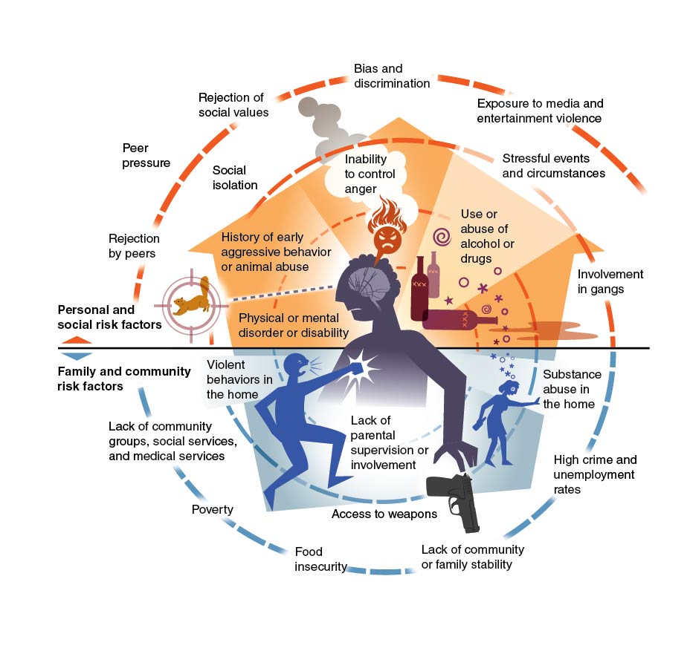
Risk Factors for Violent Behavior
Notes:
Figure 10.2 Risk factors for violent behavior.

Slide 8
Prejudice, Bias, and Intolerance
Prejudice is having an opinion about someone or something that is not based in reason or actual experience.
Bias is treating a person or group differently based on how we think about them.
Intolerance is when we don’t examine our prejudices and biases and are unwilling to accept others’ beliefs or behaviors.
Intolerance can lead to hate and violence.

Slide 9
Consequences of Violent Behavior (1 of 2)
Violent behavior can lead to
emotional and mental disorders, such as anxiety and depression;
injury, illness, and death;
substance abuse;
suicide; and
jail time, job loss, and more violence.
(continued)

Slide 10
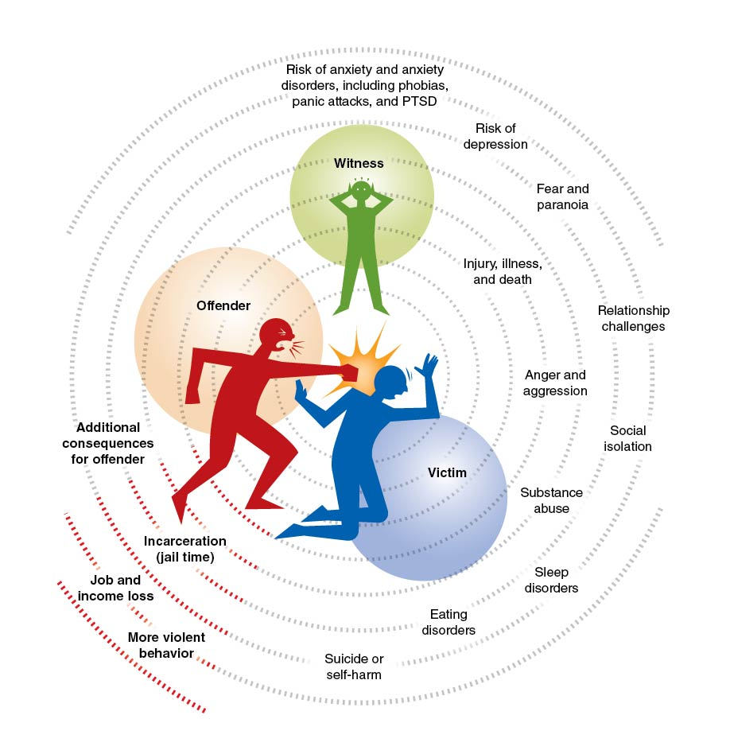
Consequences of Violent Behavior (2 of 2)
Notes:
Figure 10.3 Consequences of violent behavior.

Slide 11
Preventing Violence
Individuals can help prevent violence the follow ways:
Examine their attitudes, beliefs, and behaviors.
Accept and celebrate differences.
Surround themselves with supportive people.
Community and society can
reduce social isolation,
promote tolerance, and
develop policies and laws that promote equity.

Slide 12
Reporting Violence
People who witness a violent act can help by calling 911 to report the crime or by telling a trusted adult about the situation.
Reporting violence is the right thing to do.

Slide 13
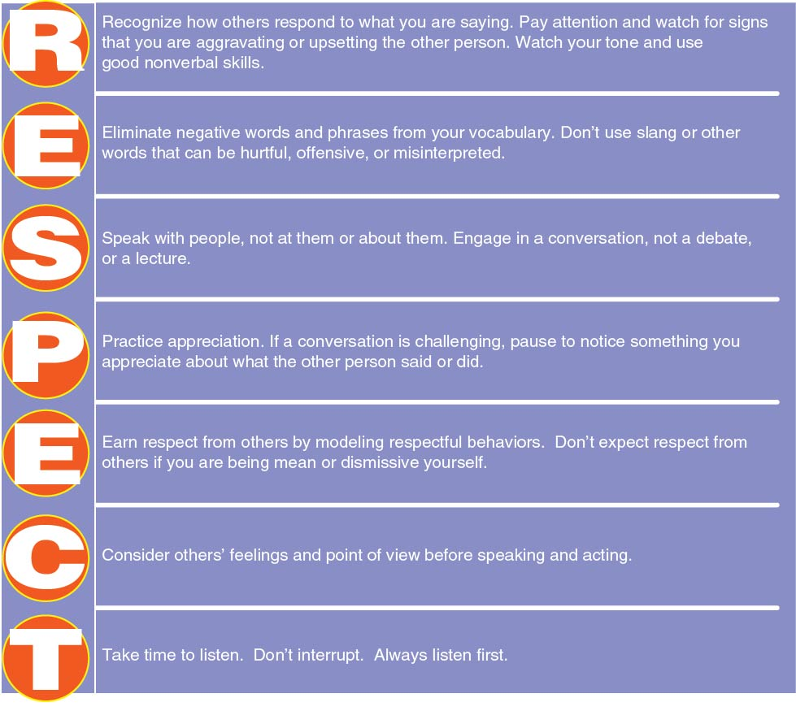
Communicating Respect for Others
Notes:
Figure 10.4 Talk with RESPECT to help reduce violence.

Slide 14
Skill-Building Challenge
Select one of the topics that reflects something about your own identity.
Write a short response to the prompt you selected and then share it with a classmate or small group.
As you discuss your topic, use the RESPECT acronym to guide your conversation with others.

