Slide 1
Recognizing and Managing Stress
Live Well: Comprehensive High School Health
Chapter 7, Lesson 4

Slide 2
Write About It
When was the last time you felt stressed?
What caused you to feel that way?
How did you handle the situation?

Slide 3
Can you . . .
Explain what stress is?
Identify four examples of common stressors?
Describe how negative stress can affect you?
Identify three ways to manage stress?

Slide 4
What Is Stress?
Stress is the body’s reaction to a demanding or difficult situation.
The stress we feel can be positive because it motivates us to work harder or be at our best.
The thing that triggers you to feel stress is called a stressor.
A stressor can be anything from someone jumping out in front of you in a dark alley to having to speak in public.

Slide 5
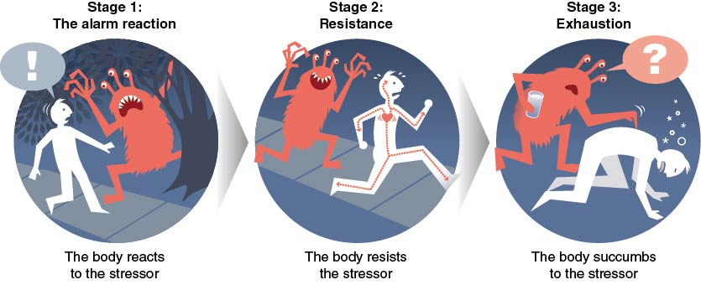
How We Respond to Stress
Notes:
Figure 7.12 The three stages we go through when we become stressed.

Slide 6
Types of Stressors
Acute (short-term) stressors: for example, taking a test
Chronic (long-term) stressors): for example, worrying about a sick relative
Routine stressors: for example, getting homework done on time
Major life events: for example, moving to another state
Trauma: for example, a terrorist attack

Slide 7
Common Stressors Teens Experience (1 of 2)
Tests and homework
Relationships with friends
Relationships with siblings
Having a significant other
Moving to a new home or school
Sports and other extracurricular activities
Employment
(continued)

Slide 8
Common Stressors Teens Experience (2 of 2)
Feeling socially excluded
Too much to do
Too fast or too slow physical development
Family problems, including abuse and alcohol
Not achieving something you really wanted
Money problems in the family
Violence in school or in the neighborhood

Slide 9
Stress and the Body
The human body is built to deal with physical stressors like a bear on your path or someone chasing you.
In modern society, most of the stressors we encounter are not direct physical threats but rather psychological or emotional stressors.
Physiological changes in your body are a negative form of stress called distress.

Slide 10
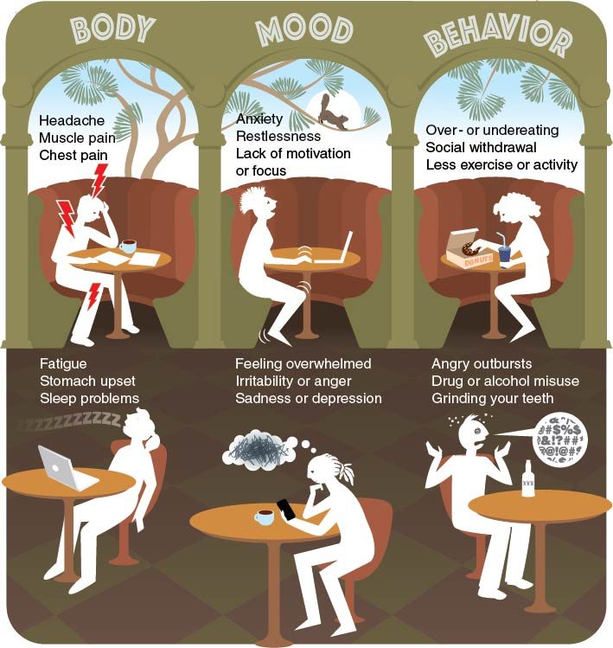
Common Signs of Distress
Notes:
Figure 7.14 Common signs of distress.

Slide 11
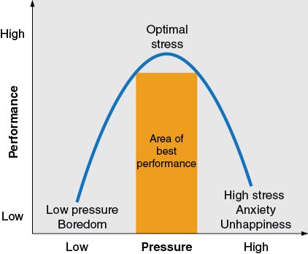
Stress and Performance
Optimal stress is the right amount of stress to help you perform at your best.
Notes:
Figure 7.15 Optimal stress is stress that allows you to perform your best.

Slide 12
Stress and Health
Chronic stress can contribute to a wide range of health problems, including the following:
Type 2 diabetes
High blood pressure
Heart disease
Obesity
Ulcers
Irritable bowel syndrome
Insomnia
Skin conditions
Infections

Slide 13
Managing Stress
Managing stress is like managing your emotions.
Stress management can include things such as time management and positive self-talk.
Relaxation techniques are specific stress management strategies that reduce the intensity of the flight-or-fight response.

Slide 14
Stress Management Techniques
Breathe deeply
Use positive self-talk
Reframe the situation
Remove yourself from the situation
Be mindful
Find ways to relax
Exercise
Learn time management

Slide 15
Skill-Building Challenge
To effectively manage stress, you need to learn and practice stress management techniques.
Use your Goal-Setting Skill Cues and your SMART goal skill steps to help you write one short-term and one long-term goal and to set action steps that will help you manage your stress.
Consider the techniques in this lesson as well as other strategies you may know.

