Slide 1
Building Self-Awareness
Live Well: Comprehensive High School Health
Chapter 7, Lesson 2

Slide 2
Write About It
What makes you unique and different from other people?

Slide 3
Can you . . .
Explain what identity means and describe ways in which identity varies?
Compare and contrast self-image and self-esteem?
Explain how self-esteem can influence health?
Demonstrate how self-esteem can influence decision making?

Slide 4
Self-Awareness
Self-awareness means having a clear sense of your personality, including your strengths, weaknesses, thoughts, beliefs, motivation, and emotions.
Having self-awareness allows you to understand how other people see you. That understanding allows you to respond to others effectively and appropriately.

Slide 5
Your Identity
Your identity is who you are. It includes:
physical characteristics, such as your hair color and height and
personality characteristics.
Your abilities, interests, and biography (life story) are also part of your identity.

Slide 6
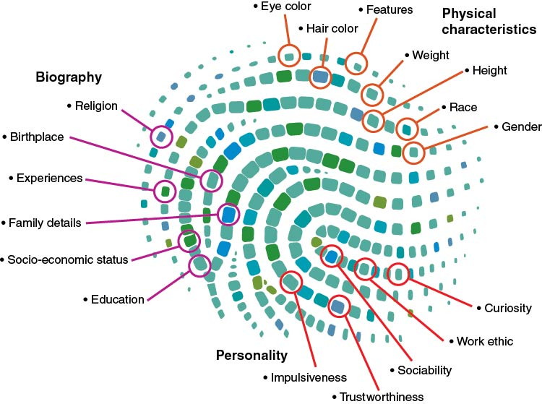
Your Identity Is What Makes You Unique
Notes:
Figure 7.6 Your identity is what makes you unique.

Slide 7
Self-Image
Self-image is what you think about yourself.
How you perceive what others think about you influences your self-image.
You may think you are smart, or nerdy, or funny, because you think others think these things.
Body image comes from the thoughts, feelings, and behaviors you have about your body weight, shape, size, and appearance.

Slide 8
Self-Esteem
Self-esteem is how much you like, admire, and value yourself regardless of what others think.
It is possible to value and like yourself even if you think others don’t like you, but it is hard.
Most people want to be liked and respected by others.
Some people try so hard to be liked by others that they act in ways that are not authentic to who they are.

Slide 9
Self-Esteem and Health
Self-esteem and physical health have a strong correlation.
People with high self-esteem tend to take care of themselves by eating well, exercising, and being good to themselves and others.
Low self-esteem can lead to a variety of negative health outcomes.

Slide 10
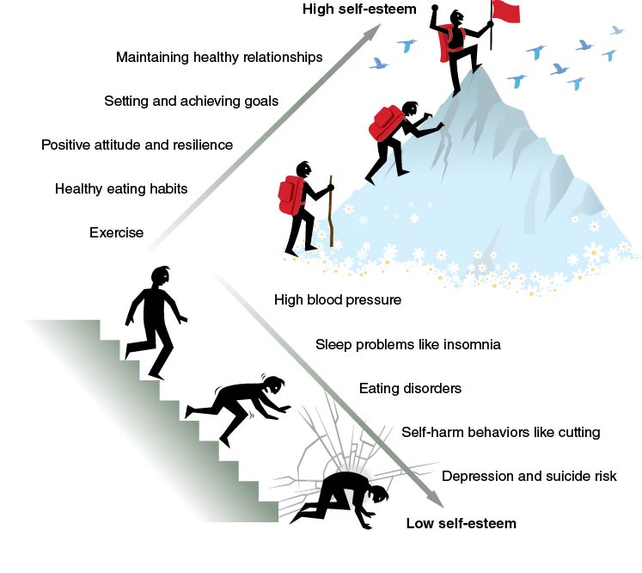
High Self-Esteem and Healthy Behaviors
Notes:
Figure 7.9 High self-esteem is associated with healthy behaviors, and low self-esteem negatively affects health and wellness.

Slide 11
Self-Confidence
Self-confidence means that you trust yourself to manage challenges, seize opportunities, and deal with difficult situations.
Being successful at tasks helps us improve our confidence.
Confidence helps us tackle more challenging tasks.
Confidence is also specific to each task.

Slide 12
Busting Your Self-Esteem and Self-Confidence
Beating yourself up. When you are too hard on yourself, you’ll talk negatively to yourself.
Staying in your comfort zone. It’s hard to build self-confidence if you never challenge yourself to grow.
Trying to be perfect. If you believe you must be perfect, you’ll become stuck and unable to grow.
Making things worse than they are. If something doesn’t go the way you want, don’t make it into a big deal.

Slide 13
Boosting Your Self-Esteem and Self-Confidence
Learn your strengths and weaknesses. Keep a list of things you do well and poorly.
Be kind to yourself. Treat yourself like you are your own best friend.
Grow from your mistakes. A good mistake helps you grow; it is a mistake worth making.
Know when to ask for help. Self-confident people are quick to get help when they need it.

Slide 14
Skill-Building Challenge
Read the start of the story about Bharat.
Finish the story in two ways: by assuming Bharat had low self-esteem and by assuming he had high self-esteem.
As you write the ending of each story, think about how self-esteem could influence Bharat’s decisions.

