Slide 1
Tips and Tools for Eating Well
Live Well: Comprehensive High School Health
Chapter 4, Lesson 3

Slide 2
Write About It
How often do you read a food label when you are choosing what to eat?
Have you ever asked to see the nutrition information when eating at a restaurant?
Why do you think you do or do not use these tools to help you make decisions?

Slide 3
Can you . . .
Explain the four keys to a healthy diet?
Explain what biased information is?
Demonstrate the ability to read a nutrition facts label?
Explain how to use MyPlate to plan a healthy diet?
Demonstrate how to access valid and reliable nutrition information?

Slide 4
Building a Healthy Diet
The combination of nutrients you eat and the way you eat is called your diet.
Some factors are common to all healthy diets. Balance, variety, moderation, and adequate calories and nutrients are the four keys to a healthy diet.

Slide 5
The Four Keys to a Healthy Diet
Balanced: A diet has balance if it has enough carbohydrate, fat, and protein to meet the body’s needs
Varied: A diet has variety if it includes a lot of different foods.
Moderate: Not eating too much of any one thing means your diet is moderate.
Adequate: Your diet is adequate if you get enough calories and nutrients to stay healthy.

Slide 6
Accessing and Using Nutrition Information
Not all nutrition information on the Internet is accurate.
Inaccurate information that is based on feelings and opinions more than facts is called biased information.
Some websites might also try to sell you vitamin and mineral supplements with inaccurate information.
  The goal of these sites is to get your money, not to make you healthier.

Slide 7
Dietary Guidelines for Americans
The Dietary Guidelines for Americans help us understand what we need to do to eat healthy.
These guidelines are based on research and are updated every five years.

Slide 8
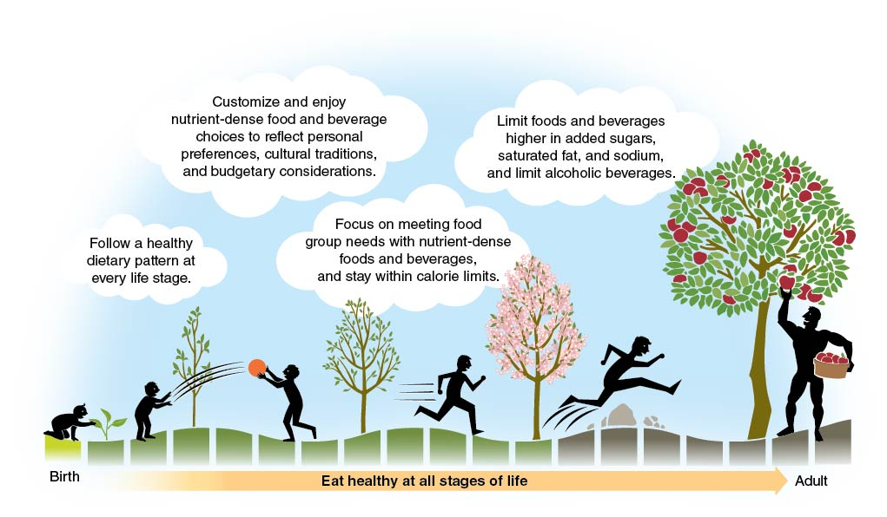
Key Ideas in the Dietary Guidelines for Americans
Notes:
Figure 4.16 Key ideas in the Dietary Guidelines for Americans.

Slide 9
Reading Food Labels
(1 of 3)
A nutrition facts label is a great tool you can use to choose healthy foods.
This is a label found on all food products and provides you with important nutrition information.
  (continued)

Slide 10
Reading Food Labels
(2 of 3)
Use these components of a nutrition facts label to make healthier food choices.
  Serving size: Shows how much of this food is normally eaten
  Servings per container: Shows the total number of servings in the entire food package or container
  Calories: Tells you the total number of calories in one serving of the food
  % Daily value: Shows how much each nutrient listed contributes to the daily diet
  (continued)

Slide 11
Reading Food Labels
(3 of 3)
All labels are required to tell you the amount of added sugars in the product.
  Added sugars are sugars added to foods during processing or packaging.
The ingredients list is not part of the nutrition facts label, but it is also a helpful tool.
  Ingredients are listed by weight, so the ingredient that is most common in the food by weight is listed first.

Slide 12
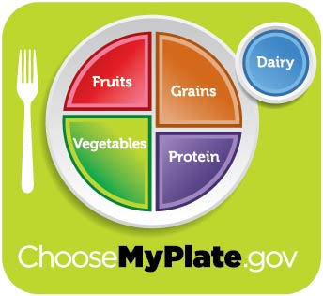
MyPlate
MyPlate is a graphic tool and website designed to help you make healthy food choices.
Notes:
Figure 4.18 The MyPlate graphic.

Slide 13
How to Use MyPlate
Use MyPlate to help you with the following:
  Plan meals that are balanced and nutritious.
  Find information about how much of each food group to eat.
  Balance your calories and get the right types of foods.

Slide 14
Other Sources of Nutrition Information
Dietitians are professionals who have
  a university education in nutrition and
  a professional license.
Other reliable sources for nutrition information include medical doctors, school nurses, and health and physical education teachers.
Be careful with information from nutritionists.
  Many who claim to be nutritionists lack professional training and may be interested only in making money.

Slide 15
Skill-Building Challenge
Beware of bad nutrition information online. Learning how to find accurate information is important.
Use the Internet to research the following diets. Look for valid and reliable sources.
  Lacto-ovo vegetarian
  Vegan
  Pesco vegetarian

