Slide 1
Developing Skills for Healthy Living
Live Well: Comprehensive High School Health
Chapter 1, Lesson 2

Slide 2
Write About It
How hard or how easy is it for you to say no when a friend wants you to do something unhealthy or risky like drinking alcohol, vaping, or texting while driving? Why do you think it is easy or hard for you?
Explain your answer using an example from your own life if possible.

Slide 3
Can you . . .
Explain what health literacy is and why it is important?
Explain each of the eight health skills?
Explain the difference between reliable and valid health information?
Describe advocacy using a real-world example related to health?
Apply effective verbal communication skills to enhance health?

Slide 4
Health Literacy and Health Skills
A person with good health literacy can find and understand basic health information and can use that information to make good health decisions.
Developing basic health skills enables you to put your knowledge into practice.
Healthy skills can become healthy habits.

Slide 5
Health Skills
Developing basic health knowledge
Analyzing what influences your health
Accessing valid and reliable health information and services
Communicating your health needs
Making healthy decisions
Setting healthy goals
Practicing healthy behaviors
Advocating for good health for yourself and others

Slide 6
Health Knowledge and Health Literacy
Knowing basic information allows you to understand accurate health information.
Health knowledge helps you to not be confused or overwhelmed by health information.
Finding, processing, and understanding health information and using it to make appropriate decisions and choose health services are all parts of developing health literacy.

Slide 7
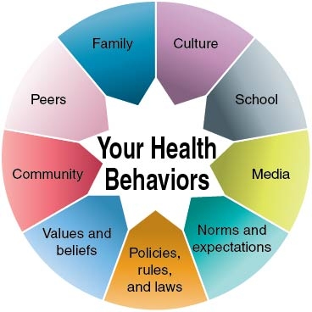
What Influences Your Health Behaviors?
Notes:
Figure 1.5 What influences your health behaviors?

Slide 8
Accessing Valid and Reliable Health Information and Services
Valid information = logically and factually accurate
Reliable information = consistent across sources and dependable
Reliable websites often end in .gov, .edu, and .org.

Slide 9
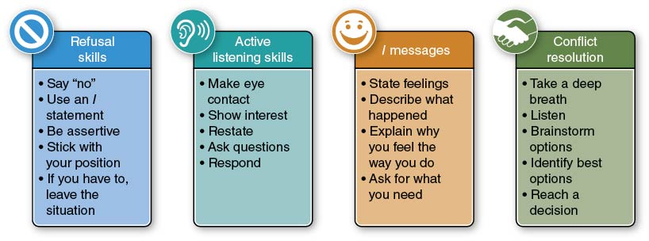
Communicating Your Health Needs
Communication skills influence your health behaviors in many ways.
Notes:
Figure 1.6 The four types of communication skills.

Slide 10
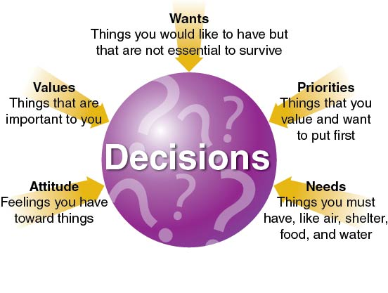
Making Healthy Decisions
Many factors influence your decision making. Making healthy decisions is critical to good health.
Notes:
Figure 1.7 What influences your decision making?

Slide 11
Setting Healthy Goals
Short-term goals
  Smaller targets you can reach in a shorter amount of time
  Usually one day to one month
Long-term goals
  Larger targets that require one to six months to achieve

Slide 12
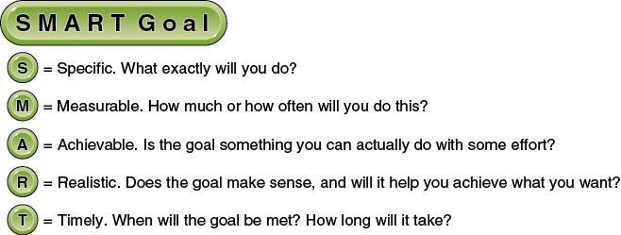
SMART Goals
Notes:
Figure 1.8 When creating goals, you should practice using SMART goals.

Slide 13
Practicing Healthy Behaviors
Good health is a series of choices you make every day.
The only way to become healthy is to practice being healthy.
Try to develop these healthy habits:
  Be physically active.
  Eat a well-balanced diet.
  Get enough quality sleep.
  Be supportive and kind to others.

Slide 14
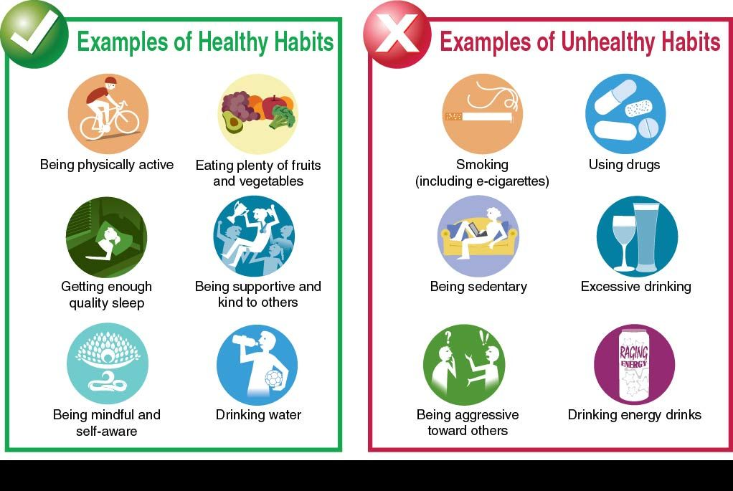
Healthy Habits Versus Unhealthy Habits
Notes:
Figure 1.9 Habits can be healthy or unhealthy.

Slide 15
Advocating for Good Health
Part of good health is learning how to advocate for yourself and others.
Advocacy is the process of supporting or promoting a cause or an issue.
You can advocate for your own health, for family members and friends, and for your community.

Slide 16
Skill-Building Challenge
Conduct research on the concept of wellness.
Using reliable sources, gather some facts about what wellness is, why it is important, and what we can do to improve it.
Use the information you’ve gathered to create a brochure or handout.
Focus on the key elements of plain language.

